Slide 1
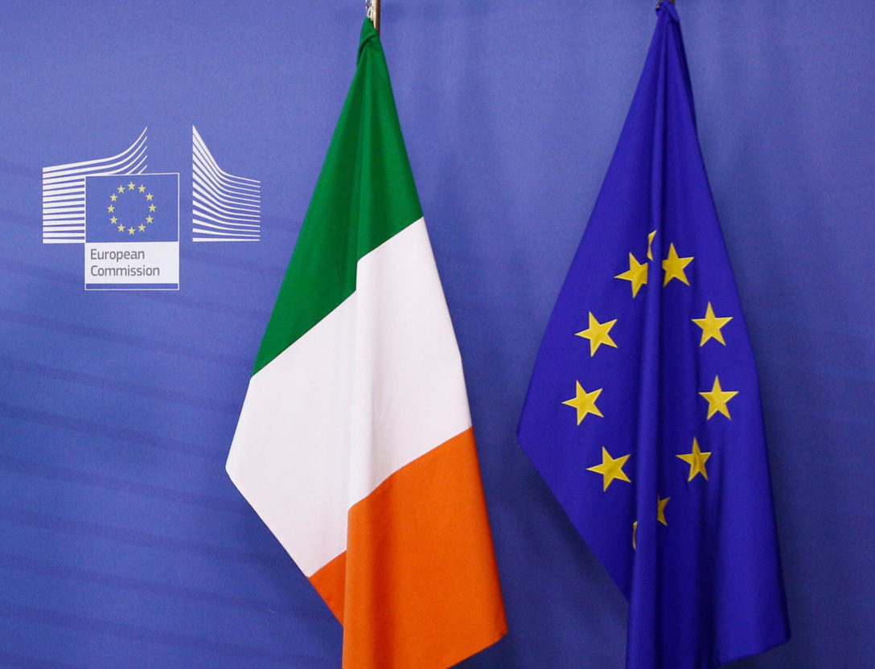
The Irish Public on
Climate Change,
Food Security
& Responsibility
Dochas Worldview Wave 7
David Hudson
April 2026
www.developmentengagementlab.org

Slide 2
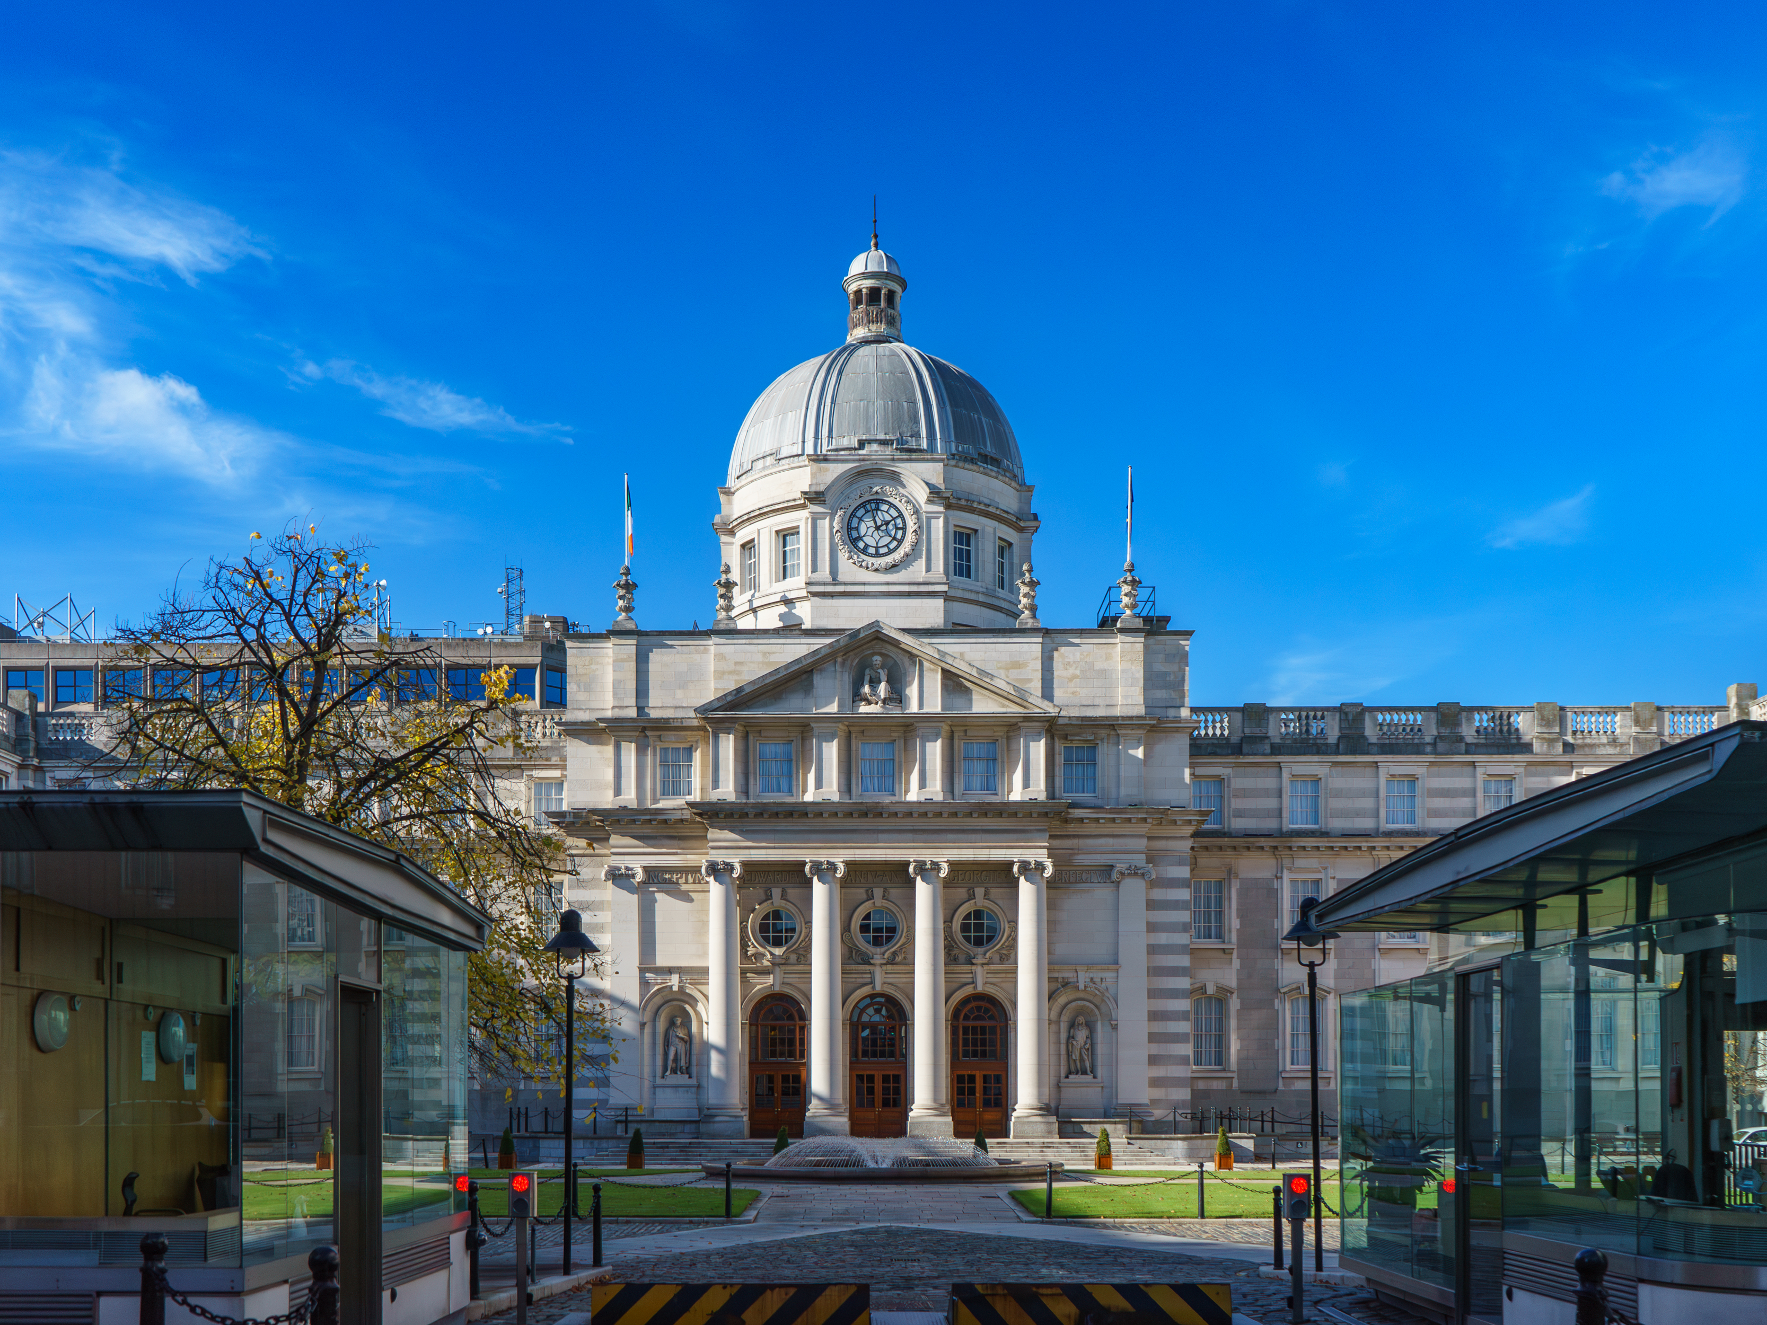
Irish Public on
Climate Change,
Food Security
& Responsibility
Climate effects and connections
Who should fix it and how?
A Mandate to act: Ireland’s 2026 EU Presidency

Slide 3
Climate effects and connections
The Irish public tends to accept the science, feel the effects, and see the link between climate change and food security

Slide 4

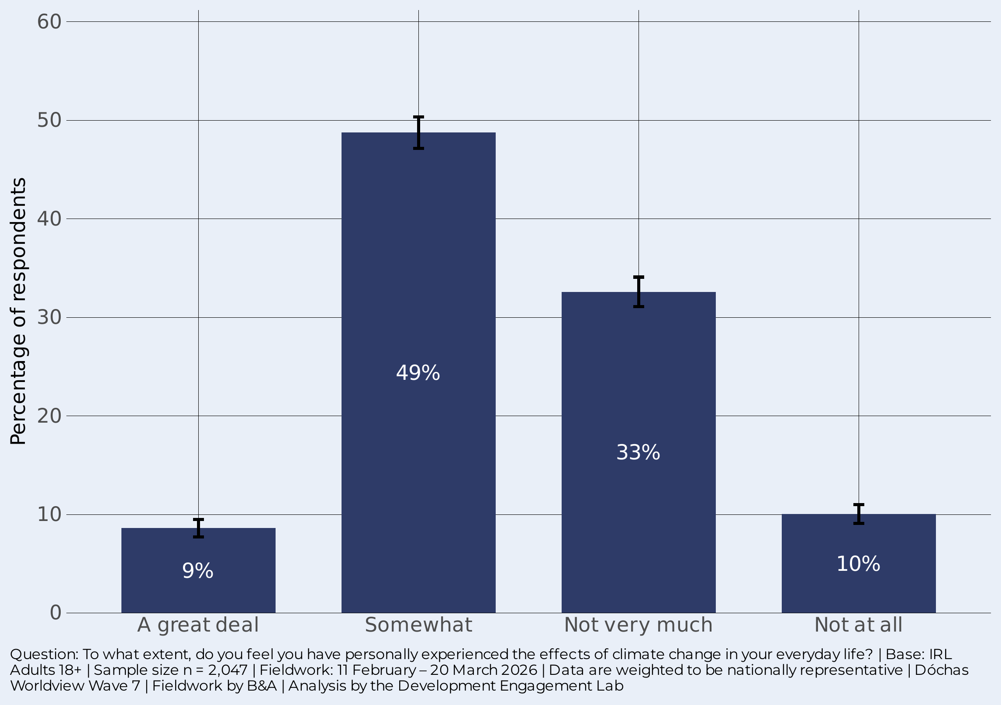
Majority feel effects of Climate Change
58%
have personally experienced climate change to at least some extent
A majority of the Irish public say they have personally experienced the effects of climate change. Nearly half (49%) say “somewhat”, while 9% say “a great deal”.
A third (33%) say “not very much” and one in ten (10%) “not at all”. For most, members of the public, climate change is real-but-background presence rather than a dramatic disruption.

Slide 5
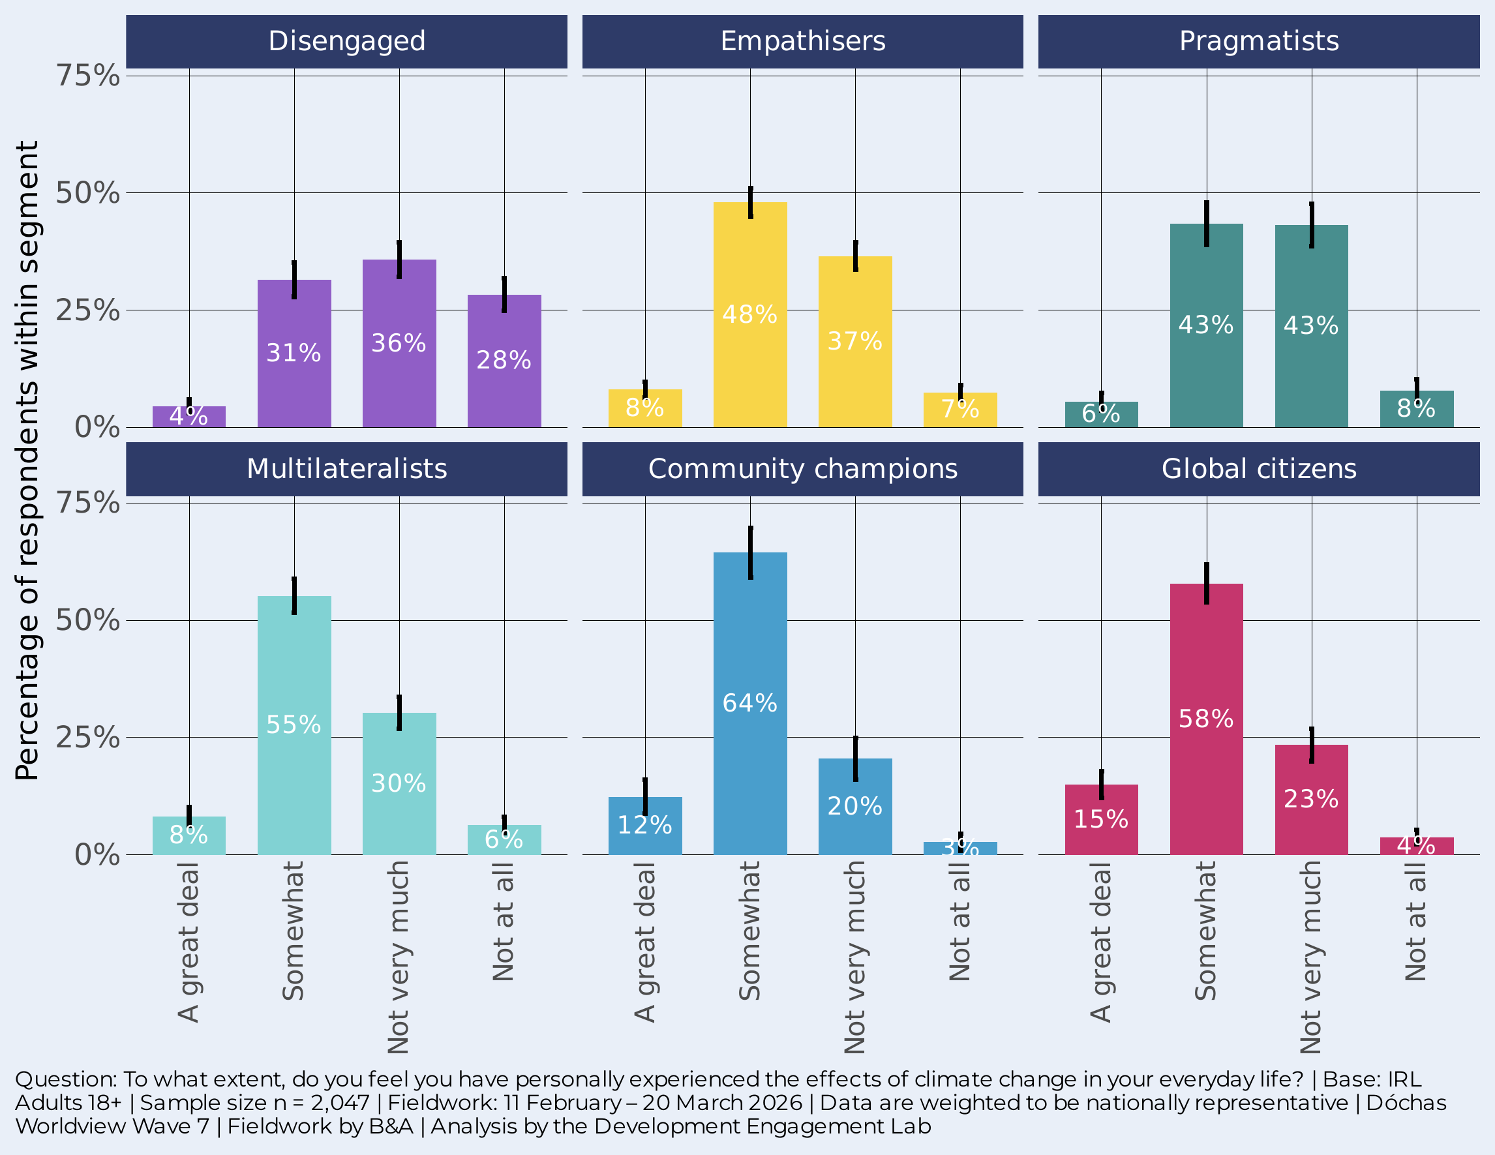
… but experience tracks engagement
28%
of the Disengaged say “not at all” — vs 3-4% among Global citizens and Community champions
Among Community champions, 77% report experiencing climate change. Global citizens are close behind at 73%. The Disengaged are the clear outlier: 64% say “not very much” or “not at all”.
Over a quarter (28%) of the Disengaged say “not at all” – more than seven times the rate among the most engaged segments. This engagement gradient runs through every question in this survey – with a gap between the Disengaged and the other five segments.

Slide 6
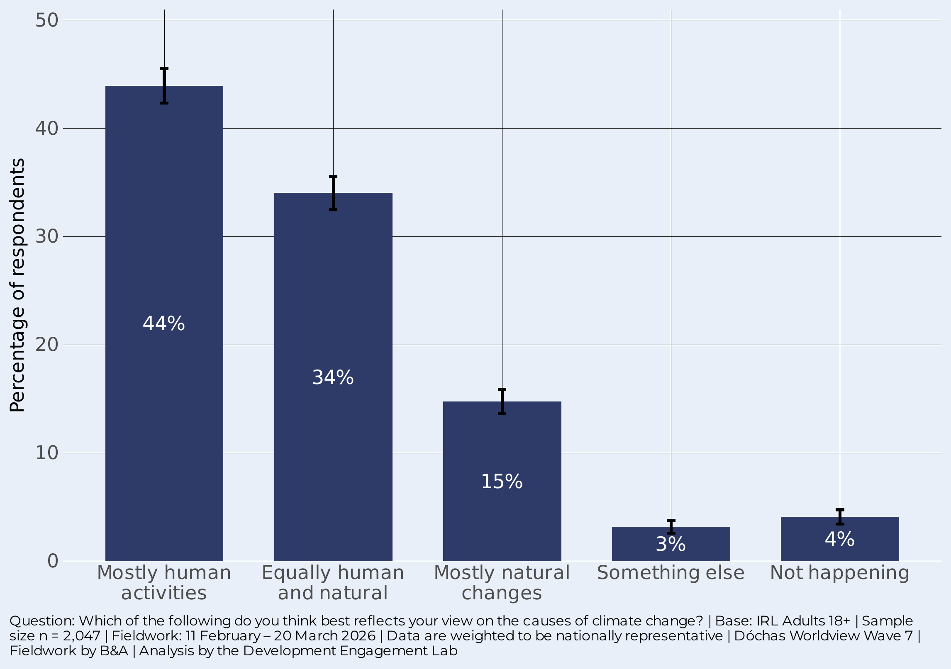

Anthropogenic causes are widely accepted
78%
accept a significant human role in climate change
The plurality view is that climate change is caused mostly by human activities (44%). A further third (34%) see it as equally human and natural. Together, 78% accept a significant human role.
Climate denial remains marginal: only 4% say it is “not happening”. Around 15% attribute it mostly to natural changes.
Notes:
NB on the 4% - this tracks across the other questions that have the option of ‘not happening’

Slide 7

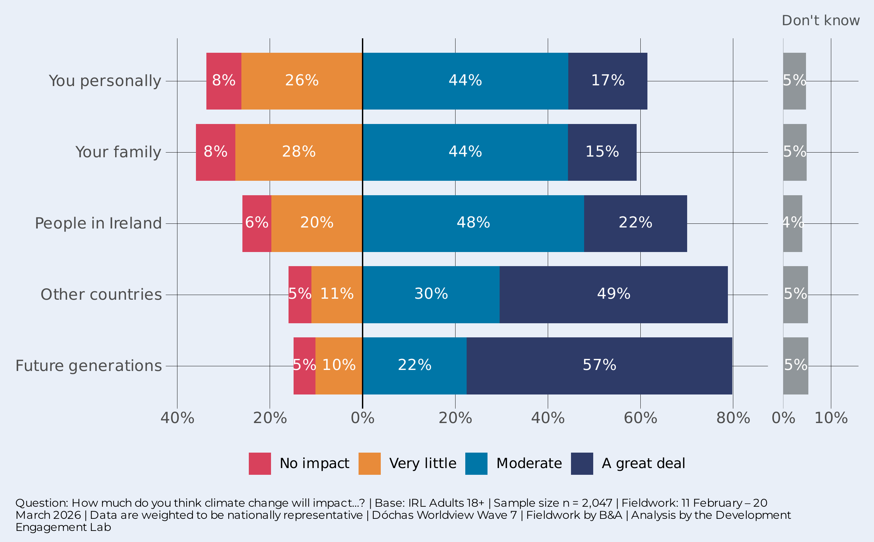
A THREAT FOR OTHERS AND FOR THE FUTURE
57%
say climate change will have “a great deal” of impact on future generations
There is a striking proximity-distance effect. Only 17% report that they will personally be impacted “a great deal”, but this rises to 22% for Ireland as a whole, 49% for other countries, and 57% for future generations.
NB Wave 4 in 2023 …

Slide 8
Perceived impact of climate change
2023 vs 2026: Coming home?
We also asked this question in 2023. The plot compares the percentage of respondents saying 'A great deal' or 'Moderate' impact” in 2023 (orange) with 2026 (blue).
It shows that there has been no change in the perceived impact of future generations (and other countries – see note below), but big jumps in the perceived impact on respondents personally (+10 percentage points), respondents’ families (+14pp) and other people in Ireland in general (+6pp).
These data give the overwhelming impression of climate change ‘coming home’ in terms of its impacts.
NB We had to exclude from comparison: ”People in other countries” because it was asked differently in 2023 and are not directly comparable. From Wave 4 (2023) People in the Global South = 80%, People in the Global North = 68%. From Wave 7 (2026) People in other countries = 79%
Notes:
Higher level of concern possibly due to adults with kids – their concern for their childrens futures

Slide 9
What is it that makes people say their family?
Experience is the gateway. Irish adults who have personally experienced climate change are 26 percentage points more likely to believe it will substantially impact their family. Nothing else comes close. This effect operates independently of demographics, media habits, and even worldview segment – making it the most powerful communications lever available.
The climate–food link is a bridge to personal risk. Believing that climate change threatens food security independently adds 22 pp to family impact perception. Connecting the global (food system disruption) to the local (family grocery bills, children's nutrition) is an effective frame – it holds up after full statistical controls.
Denial blocks personal risk perception. People who deny the human cause of climate change are 14 pp less likely to perceive family impact. Cause belief is a necessary, if not sufficient, precondition. No amount of family-framing messaging lands with this group until the causal story is accepted.
Income and location matter modestly. Higher-income households (>€100k) are 8 pp more likely to perceive family impact, and Dublin residents are 5 pp more likely than those outside the capital. Both effects are modest but consistent

Slide 10

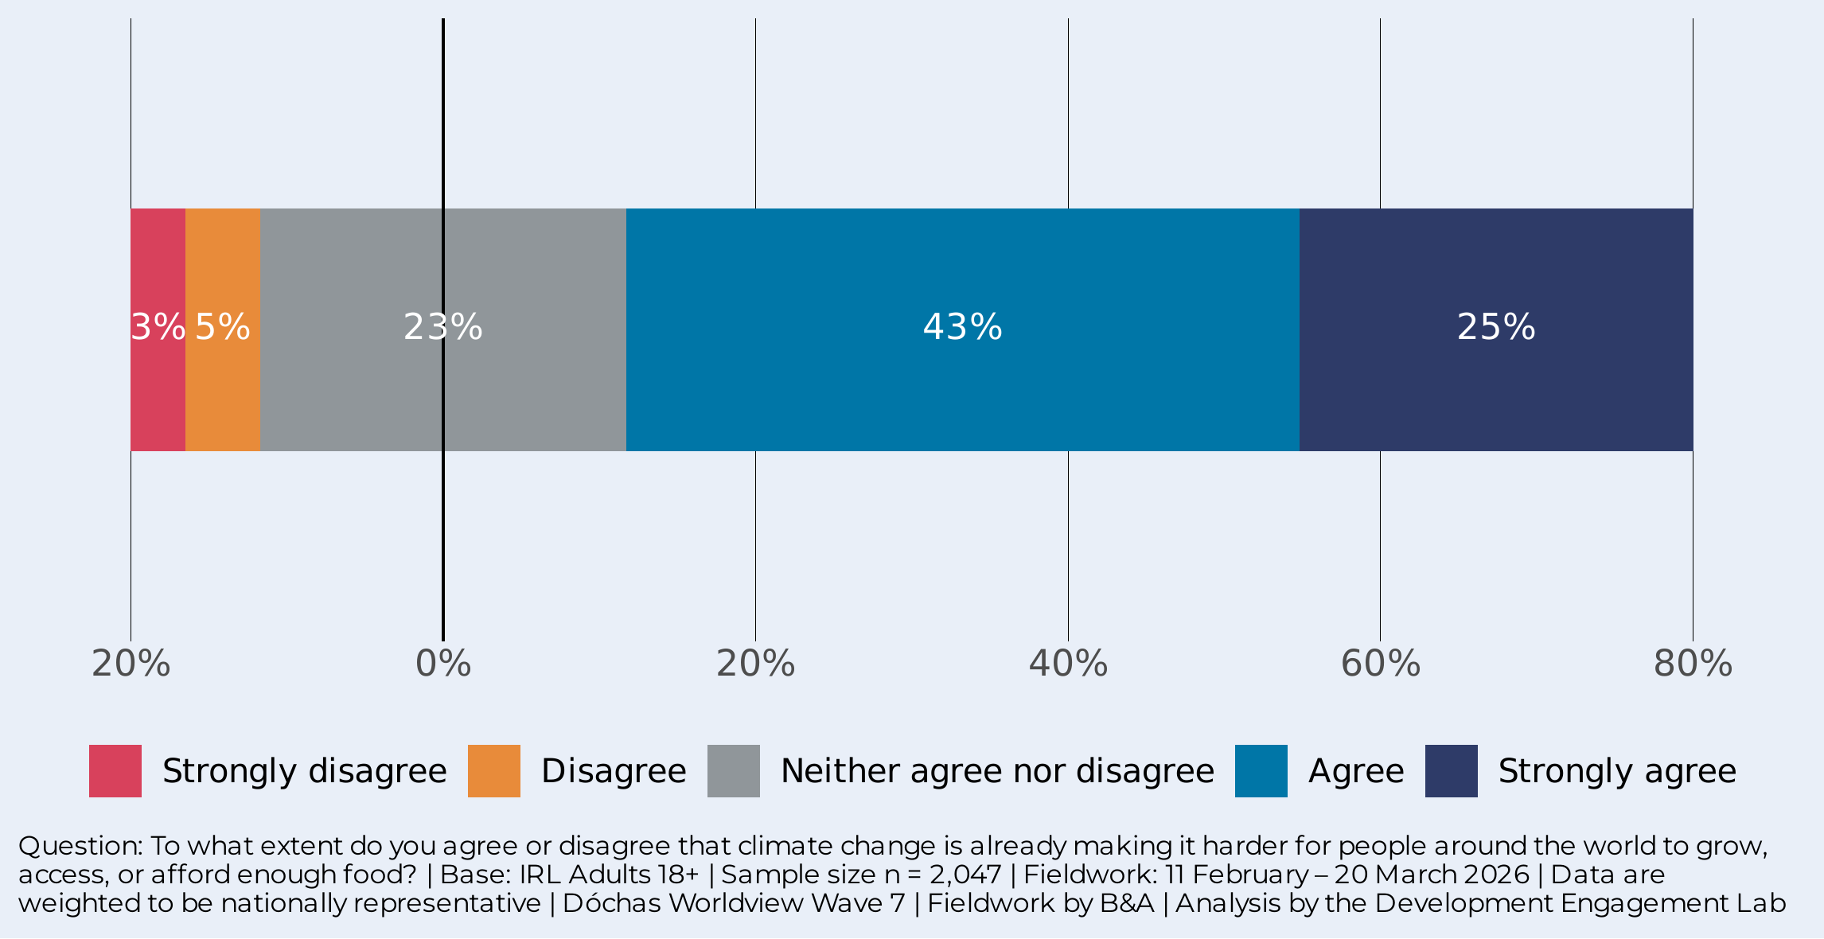
THE FOOD SECURITY LINK IS ALREADY REAL
68%
agree that CC is already making it harder for people to grow, access, or afford food
Over two-thirds agree that climate change is already making it harder for people to grow, access, or afford food – with a quarter (25%) strongly agreeing. Only 8% disagree.
This is not seen as a future problem. The Irish public recognises that climate change is already disrupting food systems around the world.

Slide 11
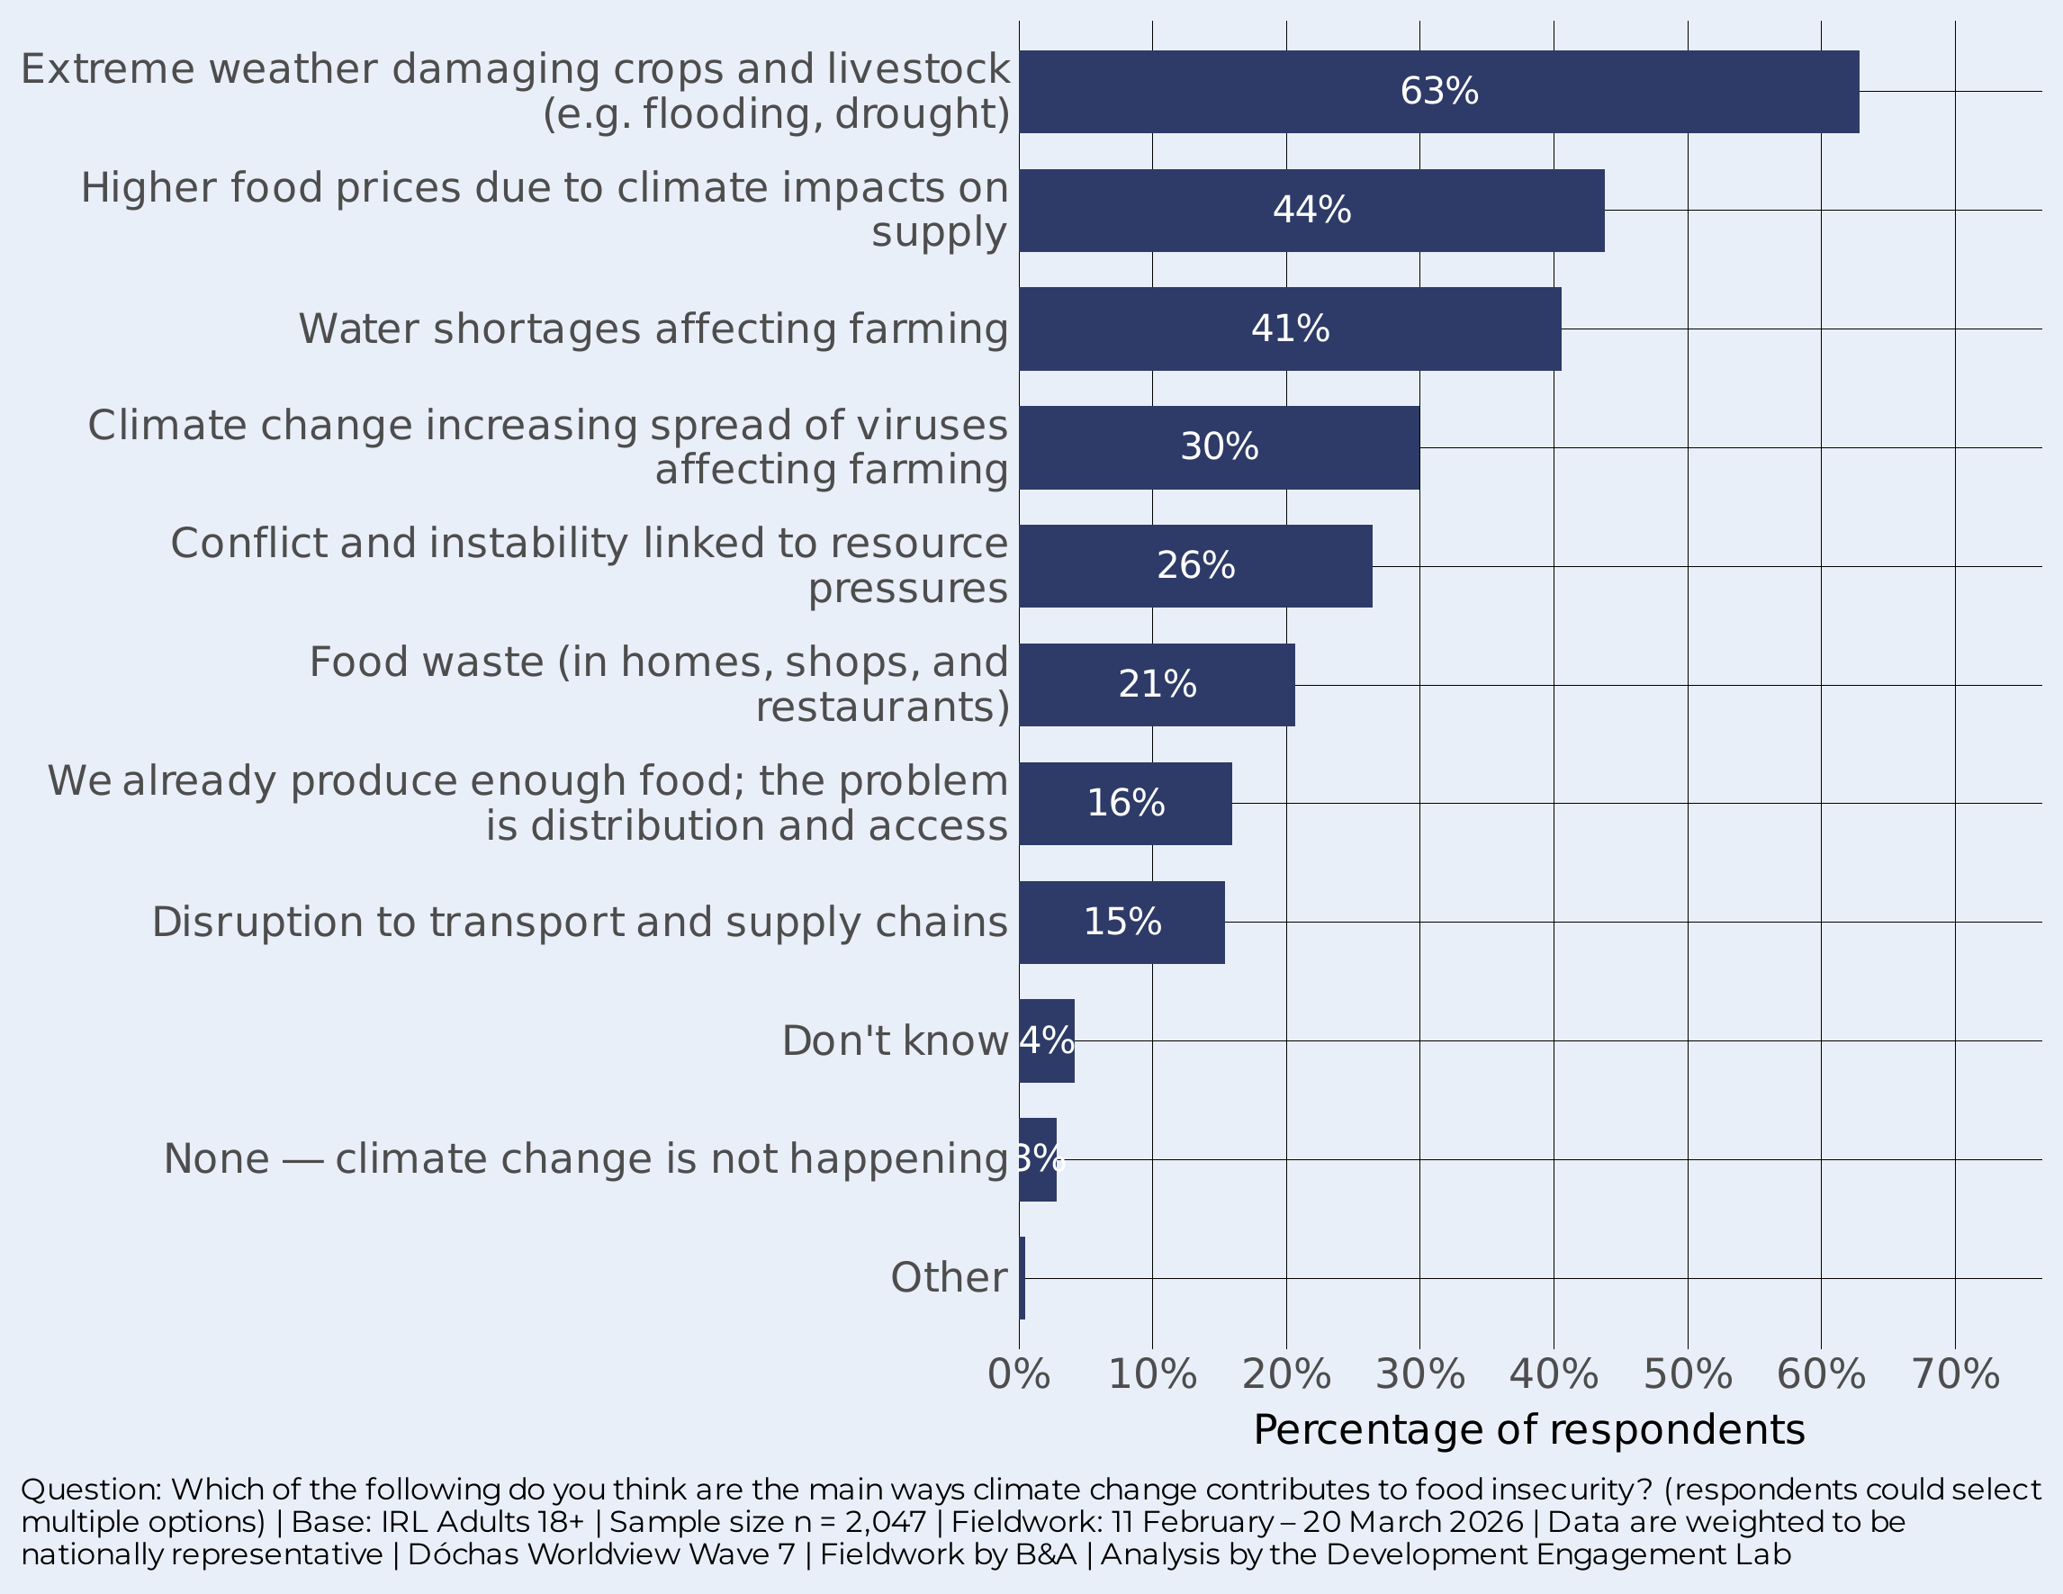
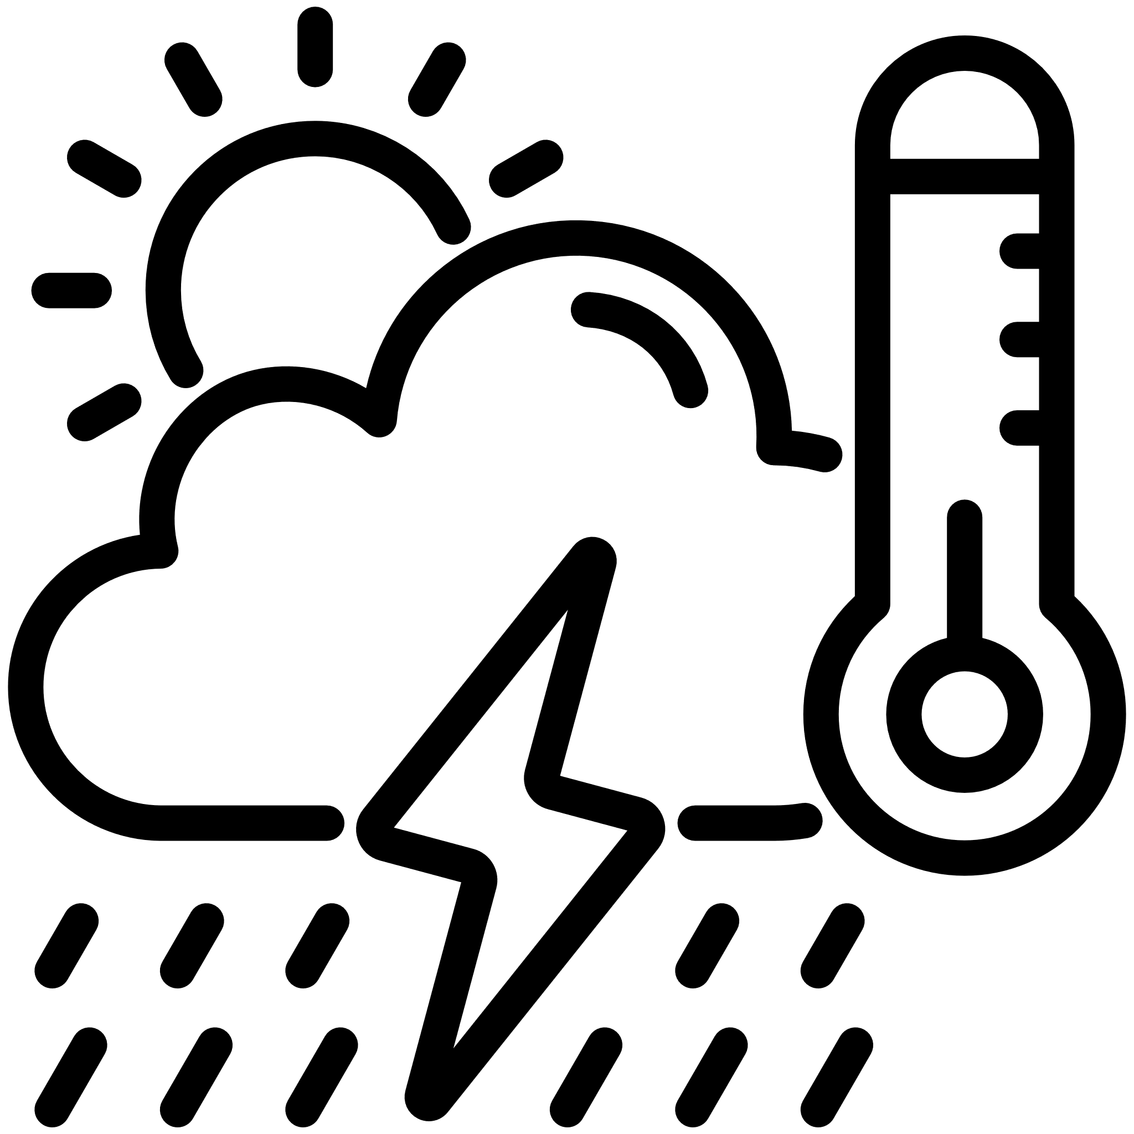
EXTREME WEATHER seen as KEY PATHWAY for FOOD INSECURITY
63%
cite extreme weather damaging crops and livestock
Extreme weather is the primary pathway (63%) by some way. Higher food prices (44%) and water shortages (40%) form a second tier. The spread of viruses (30%) and conflict (26%) are also identified.
The public has a relatively clear mental model of how climate change hits food: through weather, then prices, then water.

Slide 12

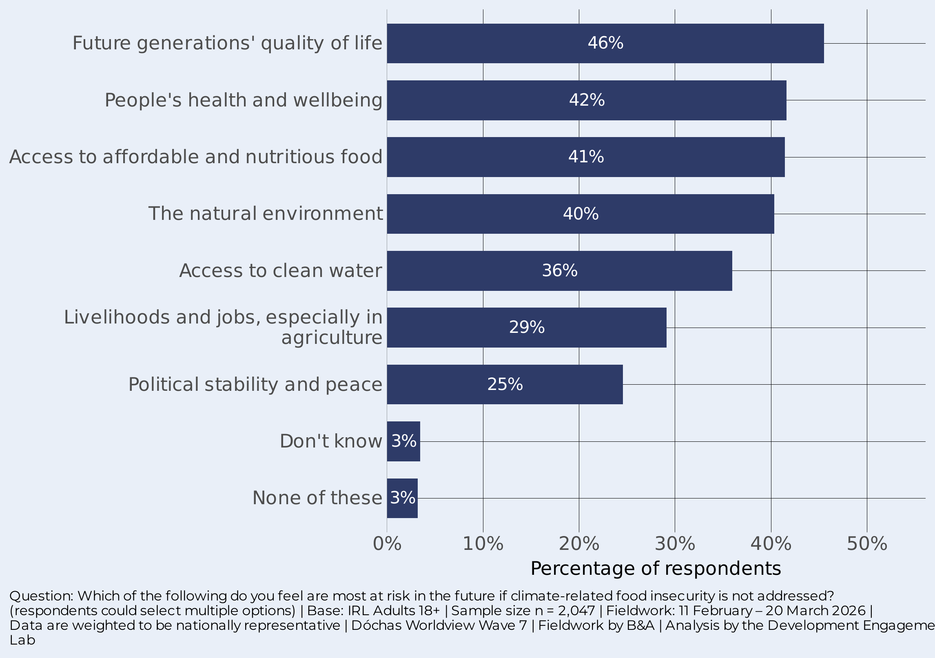
FUTURE GENERATIONS SEEN AS MOST AT RISK
46%
say future generations’ quality of life is most at risk
Future generations (46%), health and wellbeing (42%), affordable food (42%), and the environment (40%) top the list. The public’s concern is strongest when looking into the future and at broad human systems.
Political stability (25%) is less prominent but still significant – a quarter of the public connect food insecurity to peace and stability.

Slide 13

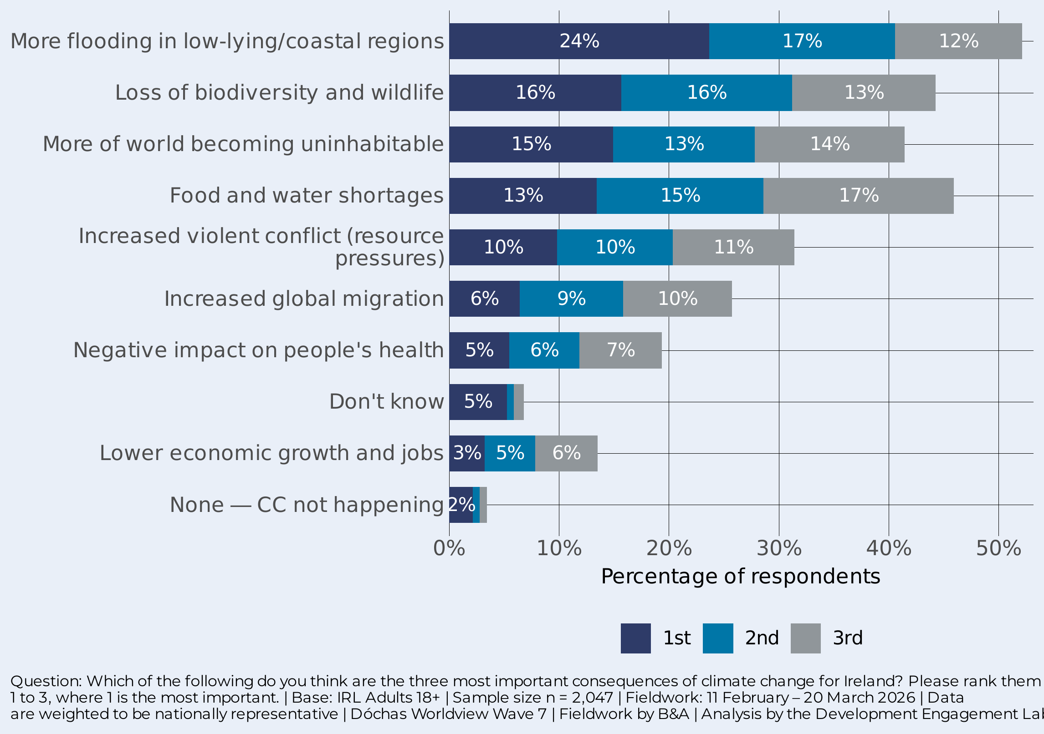
FLOODING, FOOD & BIODIVERSITY TOP THE LIST
52%
place flooding in their top three consequences for Ireland
What’s the nature of the problem? Flooding tops the list (52%, ranked first by 24%). Food and water shortages (46%), loss of biodiversity (44%), and more of the world becoming uninhabitable (42%) form a tightly clustered second tier.
The public sees climate change in environmental and stability terms – health impacts (19%) and economic growth (14%) are mentioned less frequently.

Slide 14
Who should fix it and how?
The public sees this as an institutional problem. Businesses, the EU, and international organisations should bear the greatest responsibility.

Slide 15
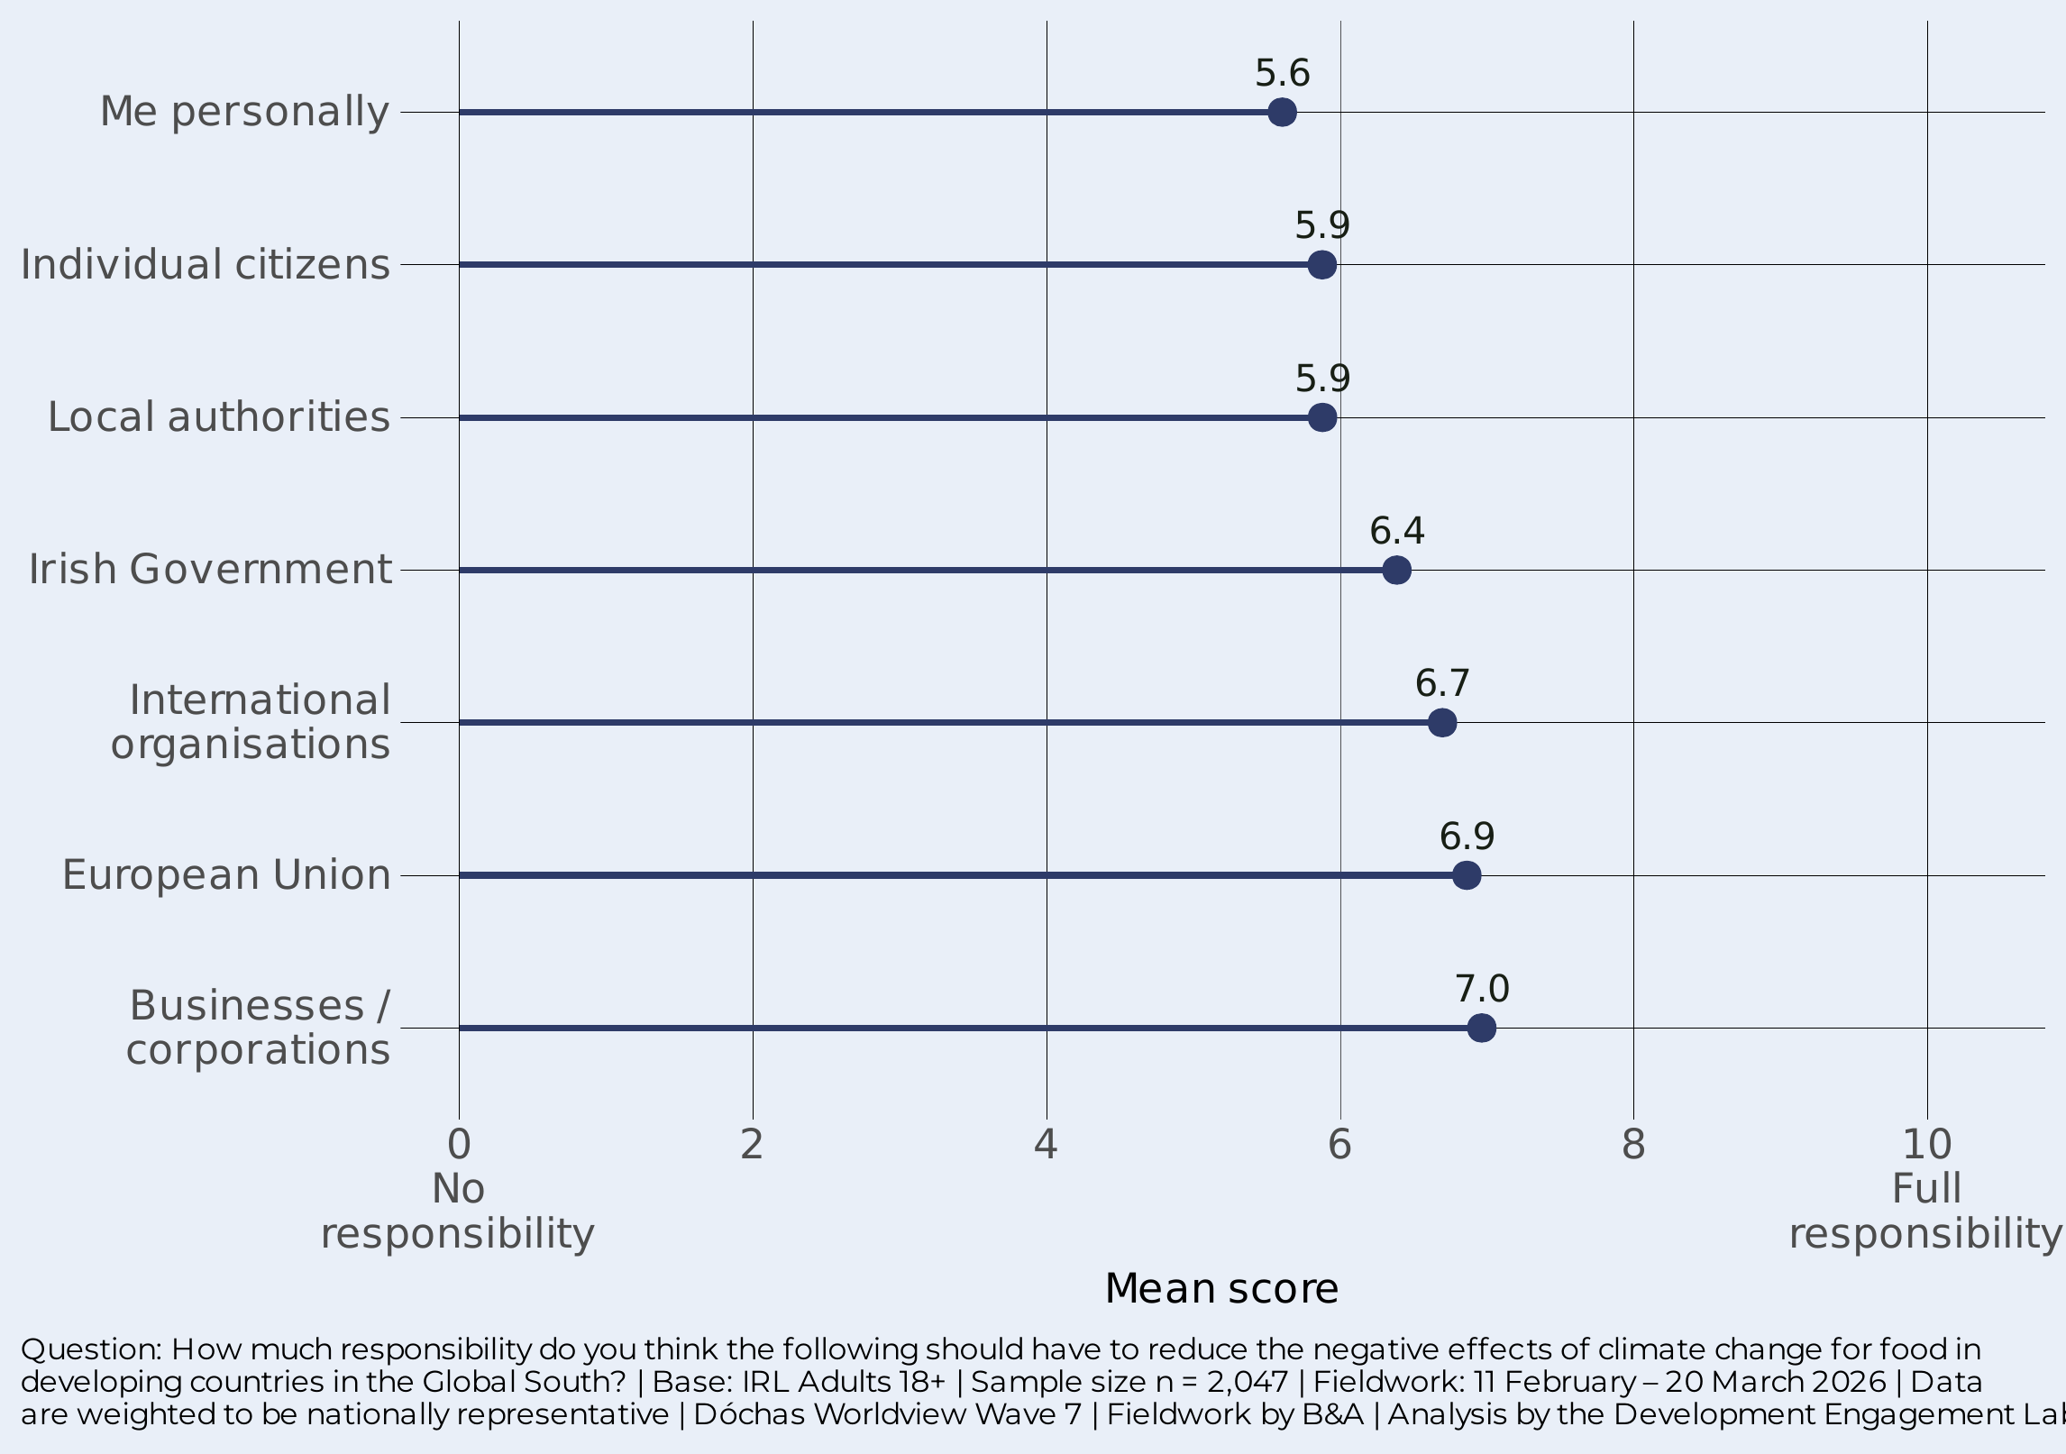

Responsibility for taking action: INSTITUTIONS FIRST, INDIVIDUALS LAST
7.0
mean score for businesses — rated most responsible on the 0–10 scale
Businesses (7.0), the EU (6.9), and international organisations (6.7) top the responsibility ranking. The Irish Government scores 6.4. Individual citizens and local authorities both sit at 5.9; “me personally” at 5.6.
The hierarchy is clear: the public places most responsibility on powerful institutional actors. Systemic problems call for systemic solutions.

Slide 16
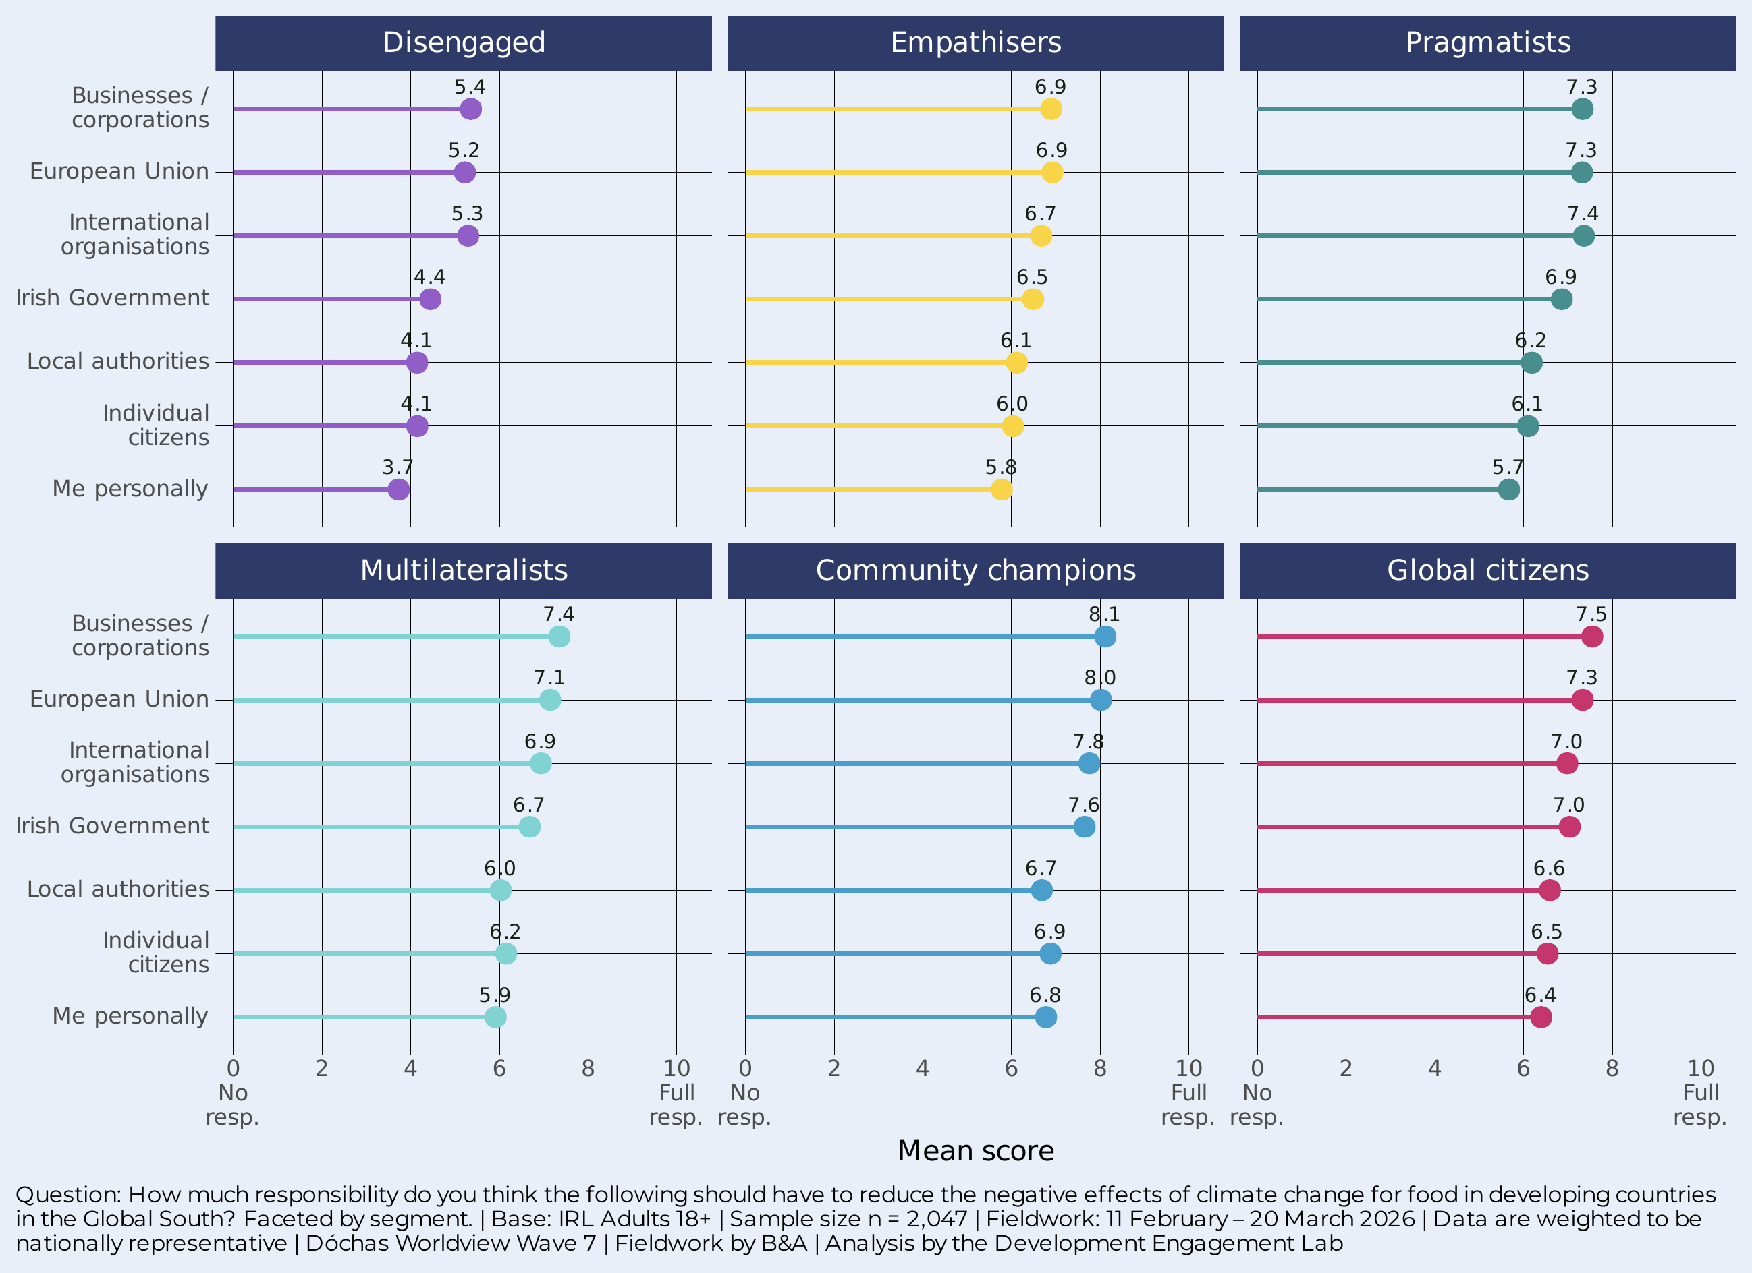
THE DISENGAGED are 50/50 on INSTITUTIONAL RESPONSIBILITY
8.1
Community champions’ rating for businesses — vs 5.4 among the Disengaged
Community champions assign the highest scores across all actors: businesses (8.1), the EU (8.0), international organisations (7.8). They also accept higher personal responsibility (6.8) than any other segment.
The Disengaged rate every actor 1.5–2 points lower. Their “me personally” score is just 3.7. Even institutional responsibility barely registers for this segment.
The gap between segments tells us that the challenge is not just persuading people to act personally – it is persuading the Disengaged that anyone should act at all.

Slide 17
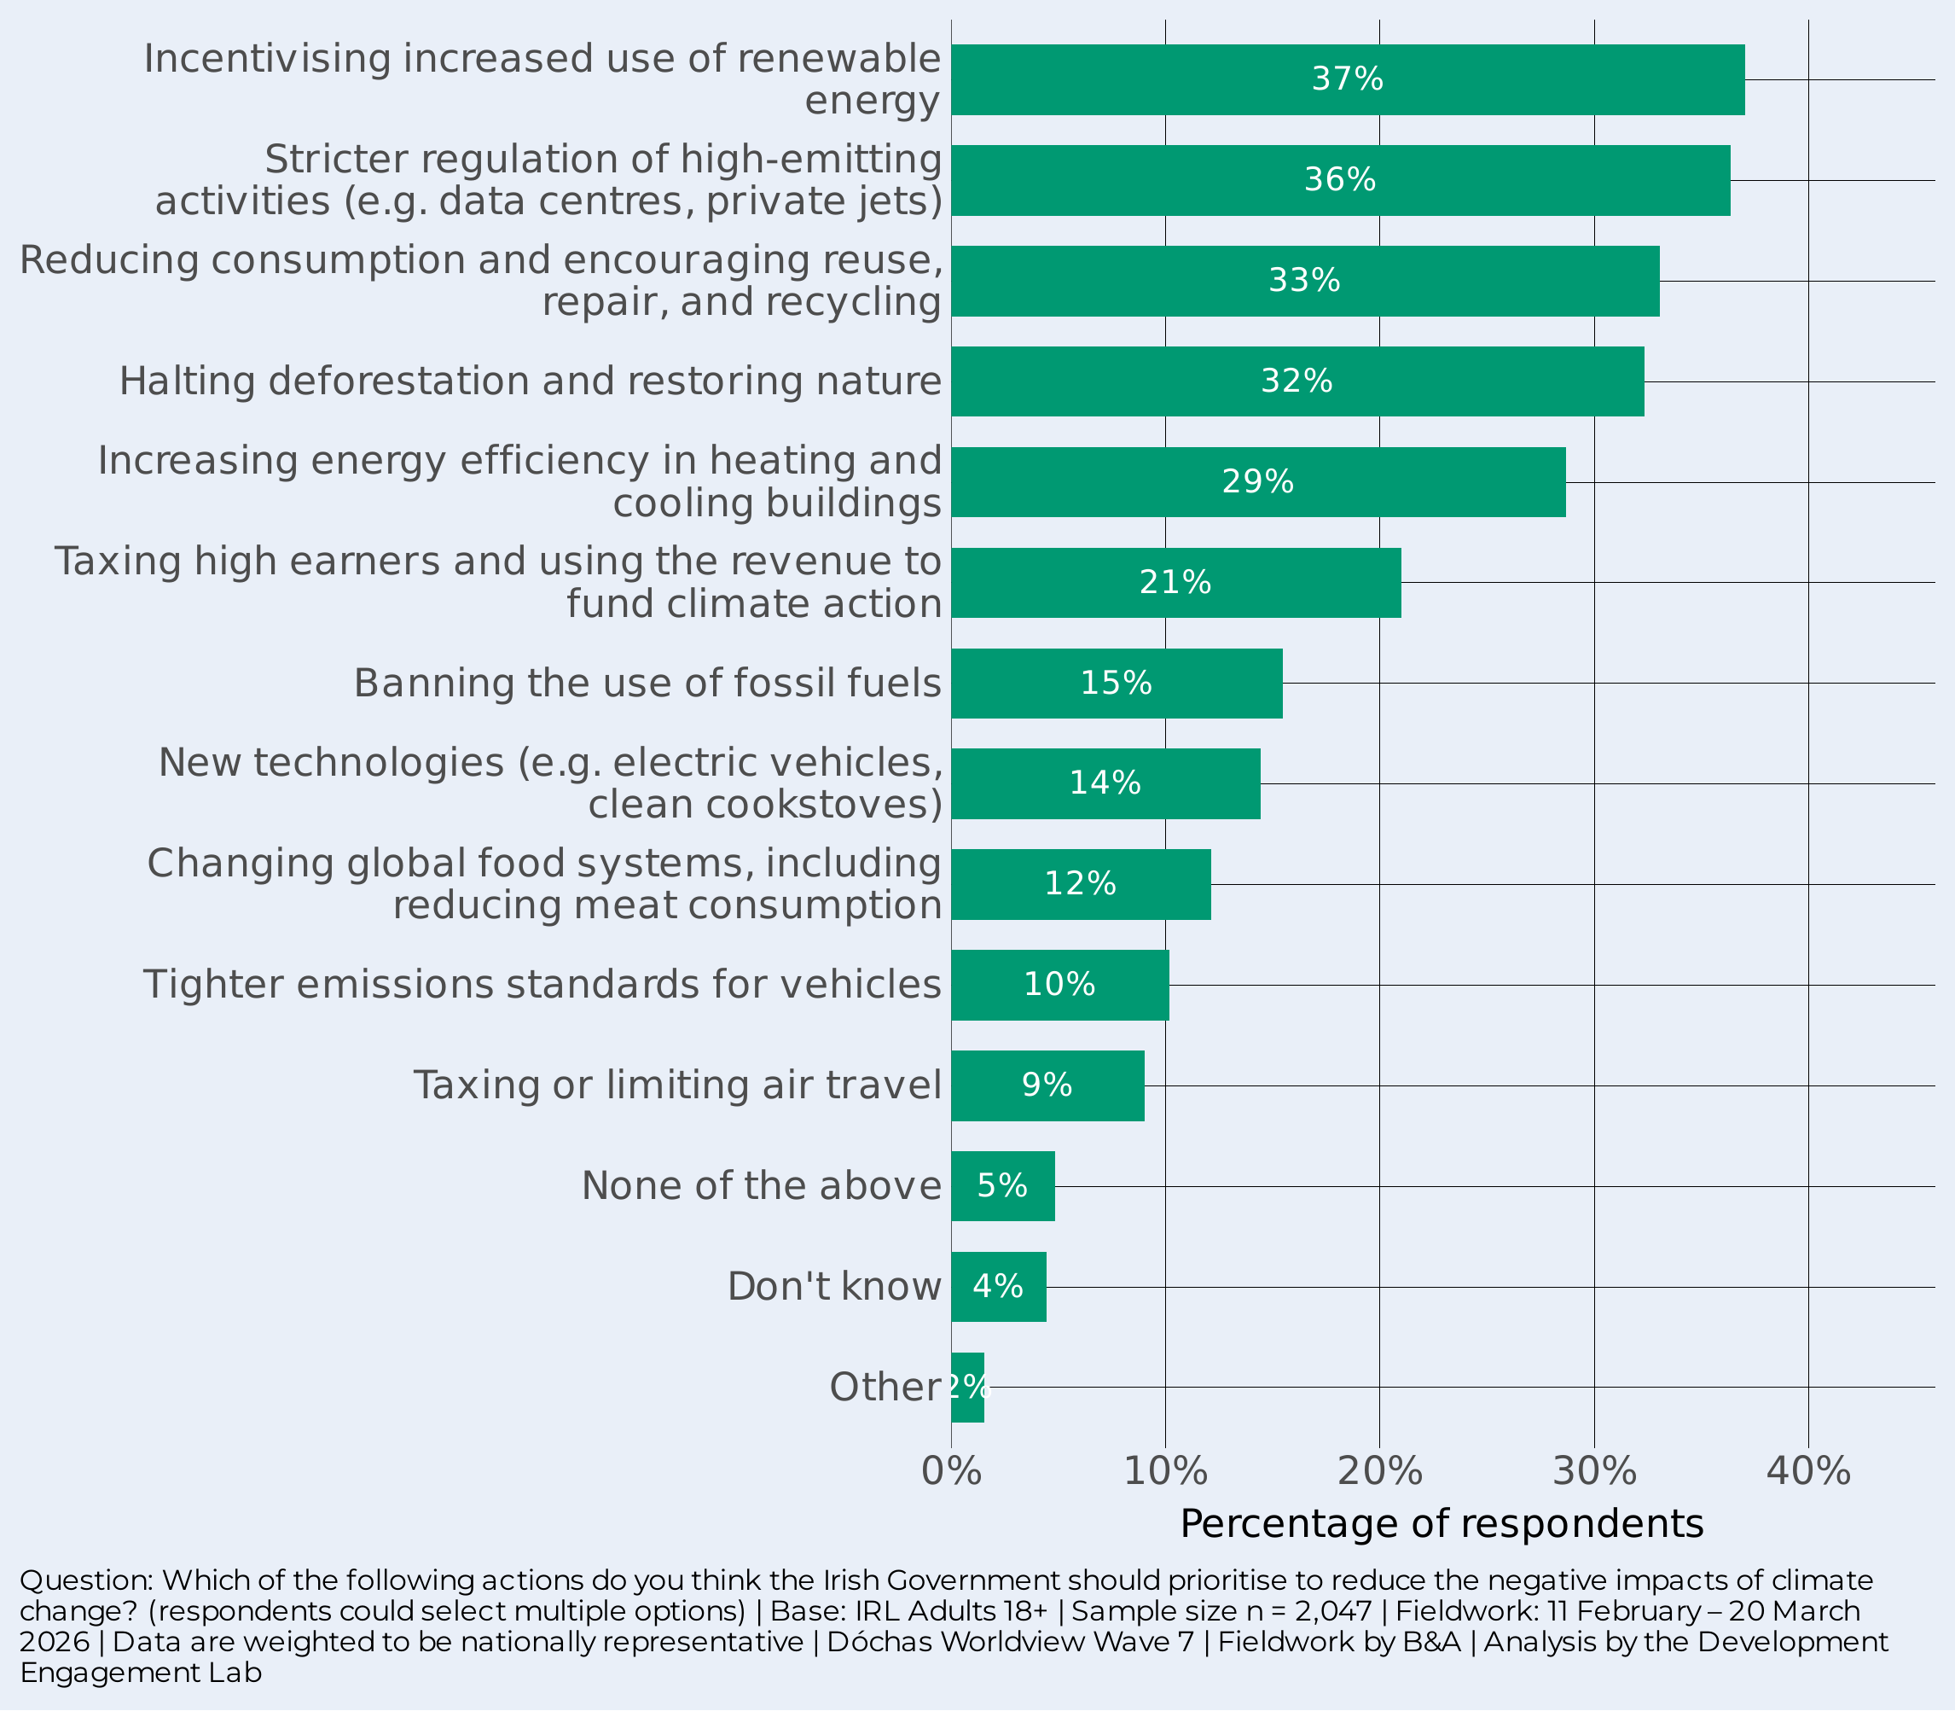

INCENTIVES AND REGULATION, NOT PERSONAL SACRIFICE
37%
say incentivising renewable energy should be a government priority
Renewable energy incentives (37%) and stricter regulation of high emitters (36%) top the list. Reducing consumption/reuse (33%) and halting deforestation (32%) follow closely.
The public favours carrots and sticks for big polluters over personal lifestyle changes or outright bans. Banning fossil fuels (16%), changing food systems (12%), and taxing air travel (9%) are much less popular.

Slide 18
A Mandate to act: Ireland’s 2026 EU Presidency
The public wants government action, trusts scientists, and supports Ireland using its EU Presidency to champion climate and food security

Slide 19


CLEAR MANDATE FOR IRELAND’S EU PRESIDENCY
63%
agree Ireland should use its EU Presidency to prioritise tackling climate-related food insecurity
Nearly two-thirds agree that during its July-December 2026 Presidency, Ireland should push the EU to prioritise climate-related food insecurity at home and abroad. Only 11% disagree.
This is a clear public mandate. The Irish public wants Ireland to lead — not just contribute – on the issue of food security and the intersection of climate change and global hunger.

Slide 20
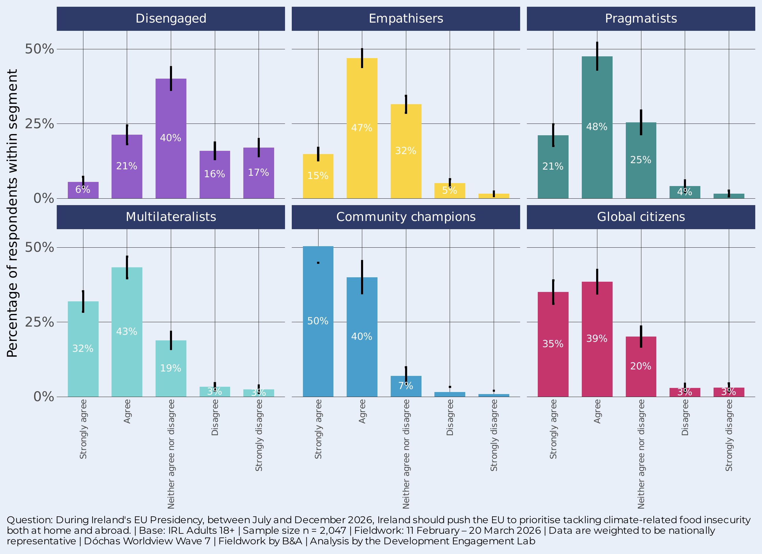
MANDATE ACROSS ALL ENGAGED SEGMENTS
90%
of Community champions agree — with half strongly agreeing
Agreement is overwhelming among Community champions (90%), Multilateralists (75%), Global citizens (74%), Pragmatists (69%), and Empathisers (62%). The five engaged segments represent over 80% of the population.
Only the Disengaged dissent: 27% agree, 33% disagree, 40% sit on the fence.
The scale of consensus across the engaged majority provides a solid foundation for Irish leadership on tacking climate-related food insecurity.

Slide 21
What predicts support for Ireland's EU Presidency climate-food priority?
If the goal is to build public support for Ireland's EU presidency climate-food priority, the model suggests the most effective levers are attitudinal — specifically, building the connection between climate change and food insecurity in people's minds, reinforcing that climate change impacts people in other countries, and building confidence that government action can make a difference. The demographic and media channels matter mainly insofar as they shape those attitudes.
Notes:
What predicts support for Ireland's EU Presidency climate-food priority?
Sociodemographics alone (Step 1) explain very little. Adding behaviours and media (Step 2) roughly doubles this. But the real jump comes with the attitudes block (Step 3), which triples the explanatory power. Adding segments (Step 4) barely moves the needle further (0.316). So attitudes are doing the heavy lifting here — who you are matters far less than what you think and do.
Positive predictors:
Food security agreement is the single strongest predictor in the model. People who agree that climate change is already making food harder to grow/access/afford are about 22 percentage points more likely to support the EU presidency push.
Government efficacy (the belief that government action can make a difference, 0–10 scale) is significant at +2.4pp per point on the scale. Each step up on the 0–10 scale adds about 2.4pp to the probability of support — so the gap between someone at 0 and someone at 10 is about 24pp. This is robust across both steps where it appears.
Donated to an international development organisation is the strongest behavioural predictor. It increases support by +7.2pp in the full model.
CC experience (personally experienced climate change effects) and CC impact on other countries (believing climate change substantially impacts people in other countries) are both robustly significant. Personal experience adds about 3.6pp; believing in substantial impact on others adds about 8pp. Both hold up after controlling for segments.
Boomer+ is the only generation effect that survives all four steps, though it attenuates dramatically — from +16.5pp in Step 1 down to +4.2pp in the full model. The large initial effect is mostly mediated by the behaviours and attitudes that older people tend to hold.
Multiculturalism: positive — people who see Ireland becoming more diverse as a positive thing are about 5.9pp more likely to support in the full model. This is interesting because it suggests a broader cosmopolitan orientation matters, not just climate-specific attitudes.
Negative predictors:
CC denial works in the opposite direction: deniers are about 7.5pp less likely to support the priority.
Travelled overseas is significantly negative in every step.
Catholic is robustly negative across all four steps (-6.8pp in Step 1, -3.7pp in Step 4). Self-identified Catholics are less supportive even after controlling for everything else.
Predictors that wash out — the mediation story:
University education is a good example of mediation. It's strongly significant in Step 1 (+10.9pp) and Step 2 (+9.3pp), but drops to near zero and non-significant once attitudes are added in Step 3. This means the "education effect" on EU presidency support is entirely explained by the climate attitudes and beliefs that university-educated people tend to hold.
Citizen: European and Citizen: global follow a similar pattern — significant in Steps 1–3 but losing significance in the full model. The cosmopolitan identity effect is partially mediated by attitudes and partially by segment membership.
News consumption — TV, radio, newspaper, social media all have small positive effects in Step 2, but every one drops to non-significance once attitudes enter in Step 3. News consumption shapes climate attitudes, which in turn shape policy support — but news consumption doesn't have an independent direct effect.
The segment effects (Step 4 only):
Only two segments differ significantly from the Empathiser reference group. Disengaged are 8.3pp less likely to support, and Community Champions are 10.6pp more likely. The other segments (Pragmatists, Multilateralists, Global Citizens) don't differ significantly from Empathisers once all the individual-level predictors are controlled for. This is informative — it means most of what makes segments different in their support for this policy is captured by the behaviours and attitudes already in the model. The segments that remain distinct are the extremes: the least engaged (Disengaged) and the most community-oriented (Community Champions).
The bottom line: If the goal is to build public support for Ireland's EU presidency climate-food priority, the model suggests the most effective levers are attitudinal — specifically, building the connection between climate change and food insecurity in people's minds (the food security agree variable is far and away the strongest predictor), reinforcing that climate change impacts people in other countries, and building confidence that government action can make a difference. The demographic and media channels matter mainly insofar as they shape those attitudes.

Slide 22
What predicts support for Ireland's EU Presidency climate-food priority?
Positive predictors:
  Food security agreement: about 22 percentage points more likely to support the EU presidency push.
  Government efficacy: each step up on the 0–10 scale adds about 2.4pp to the probability of support
  Donated to a development NGO: +7.2pp
  Personal experience of climate change: Personal experience adds about 3.6pp; believing in substantial impact on others adds about 8pp.
  Belief that climate change impacts other countries
  Being born before 1965 (Baby Boomer or older): +4.2pp
  Multiculturalism: + 5.9pp
Negative predictors:
  Climate change denial: -7.5pp
  Travelled overseas
  Catholic: -3.7pp
Notes:
What predicts support for Ireland's EU Presidency climate-food priority?
Sociodemographics alone (Step 1) explain very little. Adding behaviours and media (Step 2) roughly doubles this. But the real jump comes with the attitudes block (Step 3), which triples the explanatory power. Adding segments (Step 4) barely moves the needle further (0.316). So attitudes are doing the heavy lifting here — who you are matters far less than what you think and do.
Positive predictors:
Food security agreement is the single strongest predictor in the model. People who agree that climate change is already making food harder to grow/access/afford are about 22 percentage points more likely to support the EU presidency push.
Government efficacy (the belief that government action can make a difference, 0–10 scale) is significant at +2.4pp per point on the scale. Each step up on the 0–10 scale adds about 2.4pp to the probability of support — so the gap between someone at 0 and someone at 10 is about 24pp. This is robust across both steps where it appears.
Donated to an international development organisation is the strongest behavioural predictor. It increases support by +7.2pp in the full model.
CC experience (personally experienced climate change effects) and CC impact on other countries (believing climate change substantially impacts people in other countries) are both robustly significant. Personal experience adds about 3.6pp; believing in substantial impact on others adds about 8pp. Both hold up after controlling for segments.
Boomer+ is the only generation effect that survives all four steps, though it attenuates dramatically — from +16.5pp in Step 1 down to +4.2pp in the full model. The large initial effect is mostly mediated by the behaviours and attitudes that older people tend to hold.
Multiculturalism: positive — people who see Ireland becoming more diverse as a positive thing are about 5.9pp more likely to support in the full model. This is interesting because it suggests a broader cosmopolitan orientation matters, not just climate-specific attitudes.
Negative predictors:
CC denial works in the opposite direction: deniers are about 7.5pp less likely to support the priority.
Travelled overseas is significantly negative in every step.
Catholic is robustly negative across all four steps (-6.8pp in Step 1, -3.7pp in Step 4). Self-identified Catholics are less supportive even after controlling for everything else.
Predictors that wash out — the mediation story:
University education is a good example of mediation. It's strongly significant in Step 1 (+10.9pp) and Step 2 (+9.3pp), but drops to near zero and non-significant once attitudes are added in Step 3. This means the "education effect" on EU presidency support is entirely explained by the climate attitudes and beliefs that university-educated people tend to hold.
Citizen: European and Citizen: global follow a similar pattern — significant in Steps 1–3 but losing significance in the full model. The cosmopolitan identity effect is partially mediated by attitudes and partially by segment membership.
News consumption — TV, radio, newspaper, social media all have small positive effects in Step 2, but every one drops to non-significance once attitudes enter in Step 3. News consumption shapes climate attitudes, which in turn shape policy support — but news consumption doesn't have an independent direct effect.
The segment effects (Step 4 only):
Only two segments differ significantly from the Empathiser reference group. Disengaged are 8.3pp less likely to support, and Community Champions are 10.6pp more likely. The other segments (Pragmatists, Multilateralists, Global Citizens) don't differ significantly from Empathisers once all the individual-level predictors are controlled for. This is informative — it means most of what makes segments different in their support for this policy is captured by the behaviours and attitudes already in the model. The segments that remain distinct are the extremes: the least engaged (Disengaged) and the most community-oriented (Community Champions).
The bottom line: If the goal is to build public support for Ireland's EU presidency climate-food priority, the model suggests the most effective levers are attitudinal — specifically, building the connection between climate change and food insecurity in people's minds (the food security agree variable is far and away the strongest predictor), reinforcing that climate change impacts people in other countries, and building confidence that government action can make a difference. The demographic and media channels matter mainly insofar as they shape those attitudes.

Slide 23

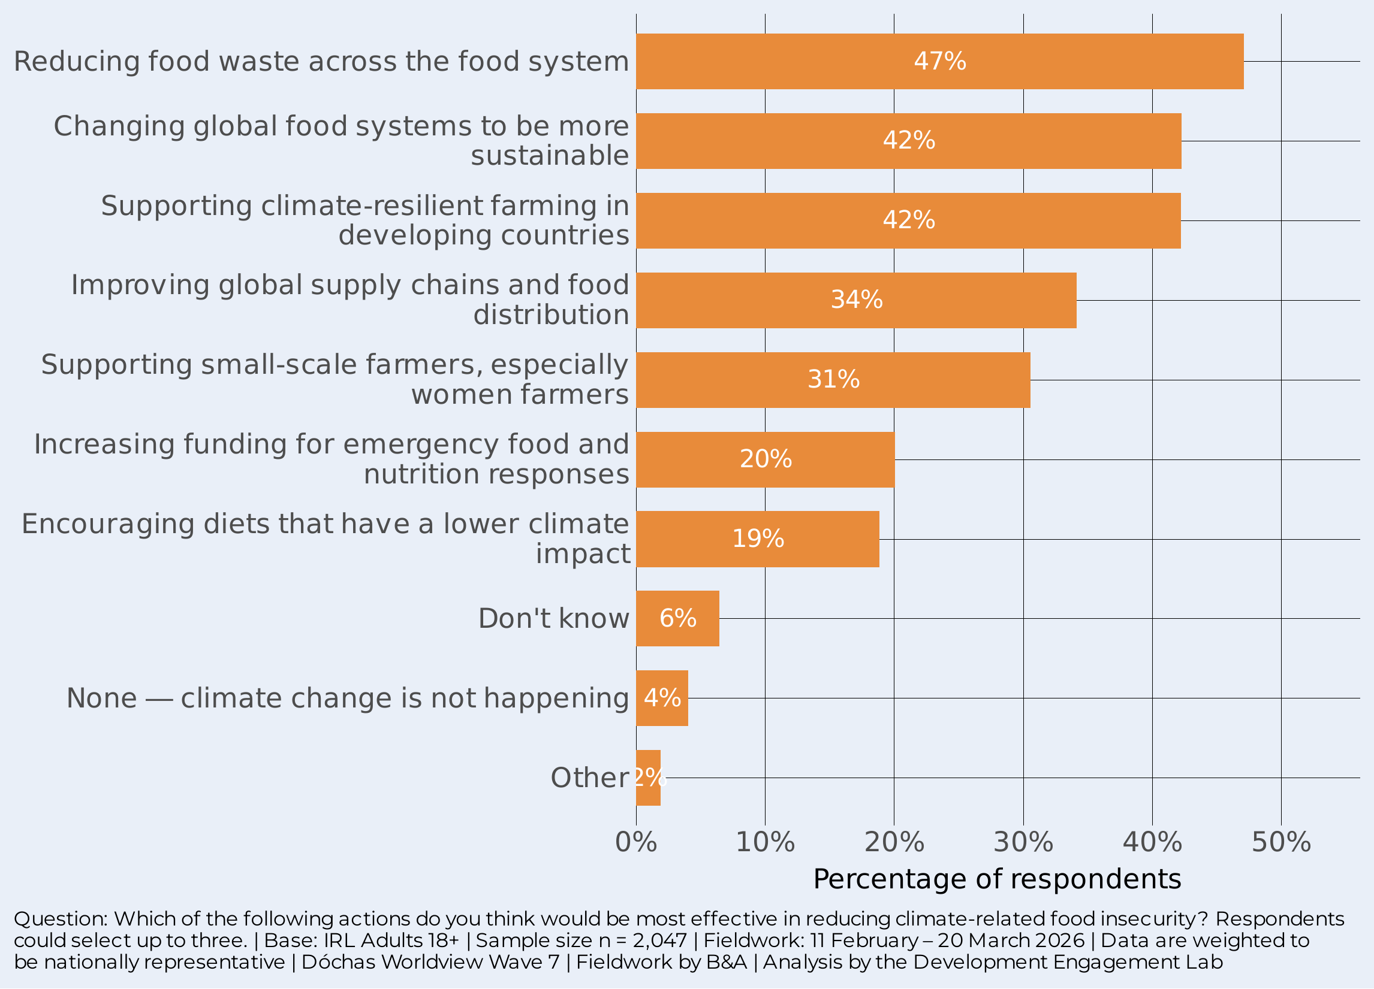
FIX SYSTEMS, Not patch problems
47%
say reducing food waste is the most effective action on food insecurity
It is striking that the Irish public is very much in the systems change space. Reducing food waste (47%), changing food systems (42%), and climate-resilient farming in developing countries (42%), improving supply chains (34%) and supporting small-scale farmers (31%) lead.
The emphasis on food waste is notable – a tangible, relatable action. But the strong support for structural solutions shows the public understands that food insecurity requires systemic change, not just emergency aid.

Slide 24
Pathways to the Irish Public based on how to address climate insecurity
FOR DÓCHAS MEMBERS & NGO CAMPAIGNERS
Groups 2 & 4 — Activate and Deepen (59%)
For Climate-Impact Believers: weather-led impact stories, concrete Irish examples (disrupted supply chains, food price rises). For Full-Spectrum Believers: systemic policy content — trade policy, global food systems, EU ambition. Both are primed for action; give them something specific to do.
Group 1 — Systemic Thinkers: engage the economic mind (22%)
Avoid weather stuff – it doesn't resonate here. Use trade, supply chains, prices, and economic sovereignty framing. "Climate change is a food security risk Ireland can't afford to ignore" speaks to this group. Link to Ireland’s economic interests in a stable global food system.
Group 5 — Distribution Framers: equity and access (17%)
Lead with justice and access. "We produce enough food — the problem is that climate change makes it impossible for millions to access it." Link to Dóchas members' overseas programming in drought/flood-affected communities. Trade and equity narratives land here. Natural Dóchas heartland.
Group 3 — Deniers: do not invest (3%)
No messaging strategy works for active Deniers. Their resistance is structural, not informational. Do not design campaigns around converting them – it’s a waste of time and money and may trigger reactance among the reachable 97%.
Group | Name | Size | What they believe
 | Climate-Impact Believers | 30% | Extreme weather drives their mental model — floods, crop failure, supply disruption. 76% agree CC affects food access. High trust in scientists (7.2/10). The mainstream of Irish climate opinion. Ready for specific policy asks and action-oriented messaging.
Class 4 | Full-Spectrum Believers | 29% | The most intellectually engaged group — they see all pathways: weather, water, conflict, prices, virus spread. 85% CC–food agreement; 75% back EU Presidency climate action. Highest scientific trust (7.7/10). Already converted; needs deepening, not convincing.
Group 1 | Systemic Thinkers | 22% | The counterintuitive group — they understand systemic pathways (conflict, prices, water) but do NOT select extreme weather as a cause. 61% CC–food agreement. More nuanced and analytical than emotional. Responds to economic and policy framing, not weather drama.
Group 5 | Distribution & Access Framers | 17% | Defined by a distinctive belief: the food problem is not production but distribution — "we already produce enough food." 59% CC–food agreement. Food justice and equity lens. Responds to Global South solidarity and trade justice narratives. Natural heartland for Dóchas.
Group 3 | Climate Deniers | 3% | 100% select the denial item. The only group for whom CC is not happening. 77% are Disengaged segment. 3% of the relevant public. Not a viable audience for CC–food messaging. Do not invest campaign budget here.

Slide 25
Worldview segment by LCA group
Dashed line = overall population average

Slide 26
Demographic over/under-representation Index of representation: 1× = population average. >1× = over-represented

Slide 27
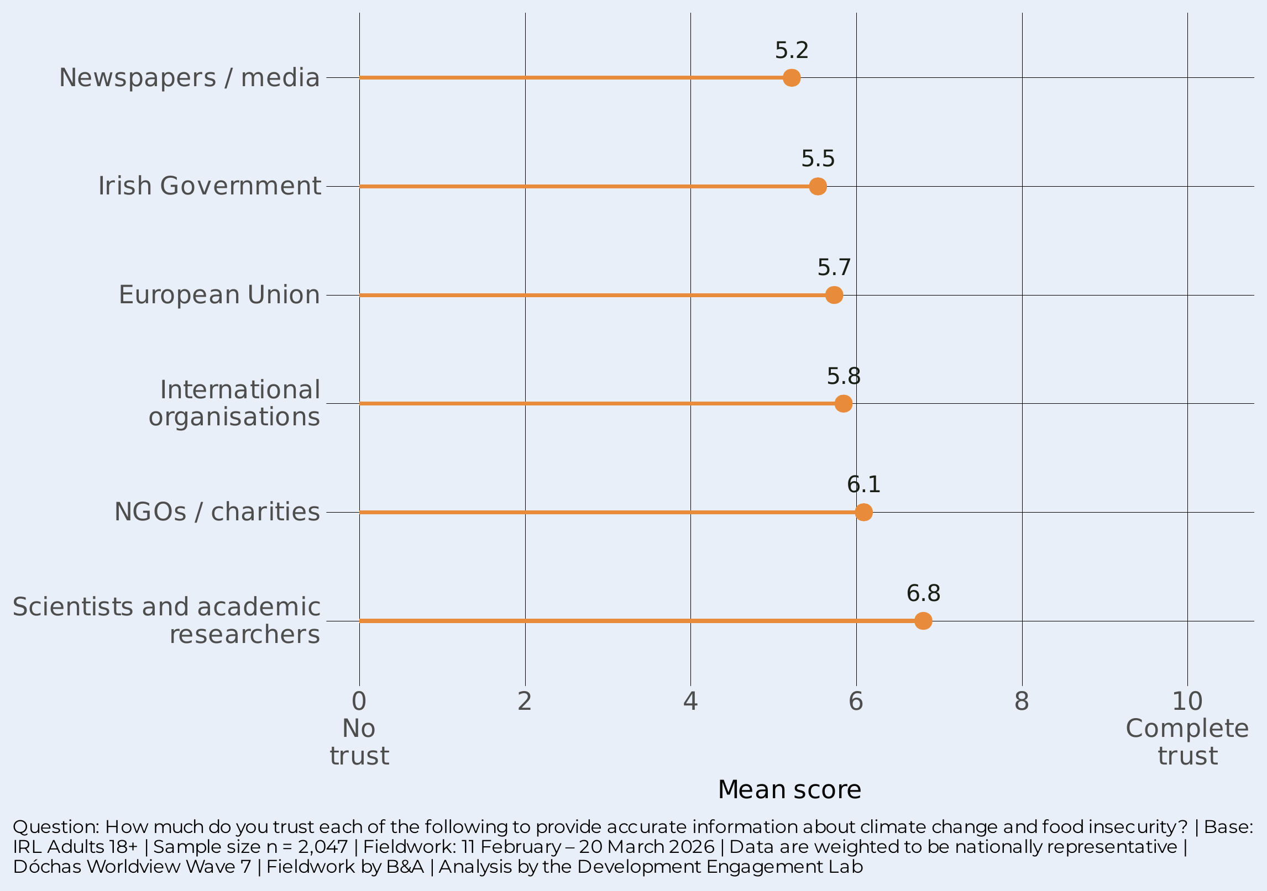

SCIENTISTS ARE THE MOST TRUSTED VOICE
6.8
mean trust score for scientists — well ahead of all other sources
Scientists and researchers are the most trusted voices on the issue (6.8), followed by NGOs/charities (6.1). International organisations (5.8), the EU (5.7), and the Irish Government (5.5) form a middle cluster. Media sit lowest (5.2).
The data suggests that independent expertise commands the most trust and credibility, suggesting that climate and food security communications could usefully be led by scientific messengers, supported by NGOs. Government and media are less trusted channels.

Slide 28
Trust profiles: who trusts whom?
Scientists are the most trusted spokespeople on climate and food security – across all segments, and significantly even for the Disengaged segment.
For the Disengaged, they tend to (just) trust scientists more than not trust them (5.2 out of 10), which is significantly more than the other sources shown in red.
NGOs and charities – among the five most engaged segments – enjoy mean scores >6/10 and are the second most trusted voice on the issue.
The heatmap shows the predicted trust scores from a multilevel model, adjusted for demographics.

Slide 29
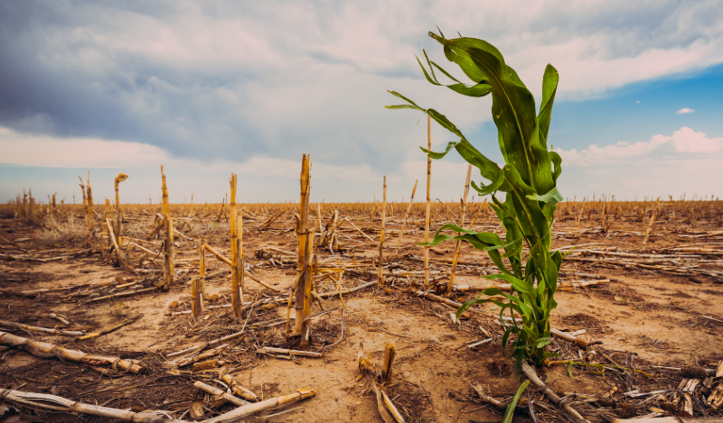
Insights
Climate awareness is broad, shallow, but deepening rapidly: 58% have experienced CC but only 9% “a great deal.” The public sees it as a serious future and global threat, and the 2026 data vs 2023 suggest that the personal, familial, and community effects are rapidly increasing.
The Disengaged (18%) are consistently the outlier — higher denial, lower trust, minimal acceptance of even institutional responsibility. Reaching them requires fundamentally different strategies.
The public places responsibility on institutions, not individuals. Businesses, the EU, and international organisations are expected to lead. Government policy should focus on incentives and regulation.
There is a clear mandate (63%) for Ireland to use its EU Presidency to champion climate-related food insecurity — with support above 62% in every engaged segment.

Slide 30
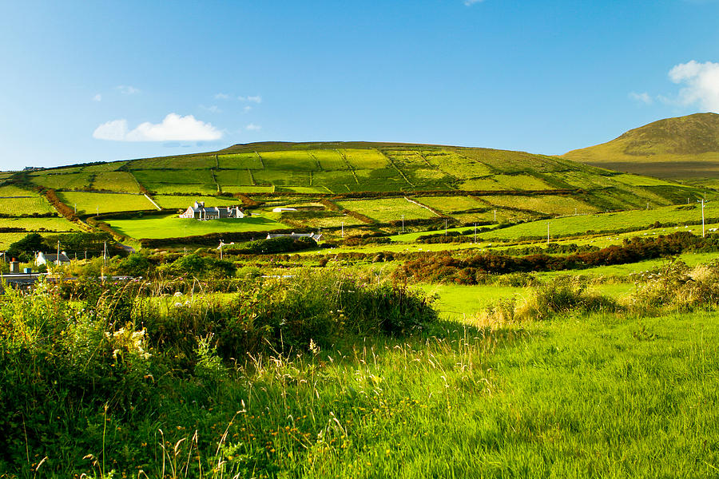
Messaging implication
Lead with lived experience. Use first-person testimonials – real Irish people describing how CC has already affected their lives. The bridge from 'it happened to them' to 'it will happen to my family’ is short, automatic, and emotionally available.
Frame food: make it local and concrete. 'Your family's food security is already in the chain’ – rising grocery prices, availability of Irish produce, the cost of a weekly shop. 59% are already disposed to believe this; specific examples convert disposition into conviction.
Messengers as well as the message. Scientists are the most trusted messengers. Communications should lead with scientific voices, supported by NGOs. Government and media are less effective channels.

Slide 31
The Development Engagement Lab (DEL) is a five-year study of public attitudes and engagement with global development in France, Germany, Great Britain, and the United States (2018-2023).
DEL is a partner focussed research programme, convening and co-producing research and insights with over 30 international development NGOs and government agencies to understand the drivers of engagement and inform development communications.
Fieldwork is carried out by YouGov and surveys are weighted to be a nationally representative of the adult population. DEL is funded by the Bill & Melinda Gates Foundation and led by Professor Jennifer Hudson (University College London) and Professor David Hudson (University of Birmingham).
The Development Engagement Lab
(Aid Attitudes Tracker Phase 2) has three goals:
Co-production of an evidence base for development campaigning
Enabling collaboration across the sector
Increasing advocacy capacity through the sharing of research and strategic insights
You can find out more information about DEL research at www.developmentcompass.org, follow us on Twitter @DevEngageLab or by contacting del@ucl.ac.uk.

