Slide 1
Media & News Trends
for Irish Audiences
Dóchas Persona Workshop
10th March 2026

Slide 2
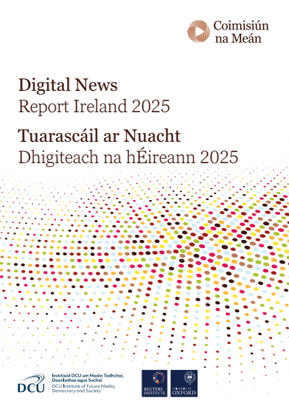
News Media Consumption
In Ireland, 56% of people across all age groups are interested in news.
Ireland trusts news more when compared to other markets.
RTÉ is Ireland’s most trusted news source.
RTÉ News (72%), local radio news (72%) and local newspapers (71%) are some of the most trusted brands, placed just above The Irish Times (70%) and the BBC (70%).
Local and regional radio stations and newspapers also have the lowest level of mistrust at 10% each.
Notes:
Source: https://www.cnam.ie/app/uploads/2025/06/Digital-News-Report-Ireland-2025.pdf
The Digital News Report Ireland is compiled every year by Coimisiún na Meán – Ireland’s media regulator – together with academics in the DCU Institute of Future Media, Democracy and Society, and it’s produced in collaboration with the Reuters Institute for the Study of Journalism at Oxford
University.
It’s regarded as a bible of sorts and is the most authoritative and credible source of data about media consumption trends in Ireland and attitudes and habits, especially in media research and policy discussions.
It’s conducted online and surveys around 2,000 people in Ireland every year. It measures what people say they do with the news.
The most recent report for 2025 found that:
- While news outlets in most countries are finding it difficult to connect with audiences during this fraught period for geopolitics and conflict, a time when reliable information sources should be thriving, Ireland presents a different narrative.
Engagement in news increased during the 2025 survey wave. Subscriptions to news services improved in Ireland between 2024 and 2025 and, most notably, it found that trust in Irish news institutions remains strong.
However, according to the report, the industry stands at a flash point and it points to redundancies at RTÉ and elsewhere that it says do not point to a burgeoning industry. It also notes concerns about the impact of artificial intelligence and challenges of staying relevant in an increasingly crowded attention economy that cast shadows over the future of news media in Ireland.
But, the report also found that there is a clear desire from Irish audiences for news-related podcasts, AI-powered news personalisation, and fact-checking services from trusted sources. Local news also continues to be an essential part of Irish life and community identity.
Despite the challenges, the Irish news ecosystem demonstrates remarkable resilience, shown by the fact that:
Interest in news increased in Ireland last year, with those ‘extremely’ or ‘very’ interested in news totalling 56%. This is higher than in the UK, the US, or when measured against the European Average.
Instances of news avoidance have dropped.
The 18-24 age group’s renewed interest in news continues following a drop-off during Covid-19.
Trust in Ireland’s news industry remains strong, especially compared to other markets. 50% ‘strongly agree’ or ‘tend to agree’ that you can trust the news most of the time, significantly higher than in the US, UK and other parts of Europe.
RTÉ News (72%), local radio news (72%) and local newspapers (71%) are some of the most trusted brands, placed just above The Irish Times (70%) and the BBC (70%).
Local and regional radio stations and newspapers also have the lowest level of mistrust at 10% each.
In terms of our Personas:
For some of our personas, trust in news sources is an important consideration in terms of where they source their news, in particular for our Multilateralist Luke, who favours quality news journalism over social media. And also I think for our Community Champion Aoife - she believes strongly in the need for independent, quality, trustworthy journalism. For Michael, our Pragmatist, it’s important, too. I think for Michael, he almost takes it for granted that the news sources he goes to, like the local media and traditional print daily broadsheets can be trusted to deliver the facts.
For some of our other Personas – like our Disengaged Pat – trust isn’t really a consideration when it comes to where he sources information and news. He’s more liable to trust the views and opinions of non-journalists and non-experts on social media.

Slide 3
News Media Consumption
Main sources of news: Online/social media (47%), TV (37%), radio (11%); printed newspapers (4%) and podcasts (2%).
The most-read newspapers are The Irish Times (17%) and the Irish Independent (16%).
A total of 36% of people tune into radio as a source of news each week
51% of those aged 65 and older use radio as their main source of news compared with 16% of those aged 18-24.
Local radio is seen as the best source for local news stories (23%) closely followed by local newspapers (22%) and social media (20%).
Notes:
Source: https://www.cnam.ie/app/uploads/2025/06/Digital-News-Report-Ireland-2025.pdf
The main sources of news for people in Ireland are: Online/social media (47%) – indicating the decline of the physical print newspaper against the backdrop of rising social media and online news consumption - TV (37%), radio (11%); printed newspapers (4%) and podcasts (2%).
On podcasts, Ireland’s audiences are one of the highest consumers of podcasts globally at 12%, but only 2% use podcasts as their main source of news in Ireland. Despite this relatively small number, podcast audiences tend to be highly engaged with and proactive about the content they choose to listen to, which is a key consideration when deciding on your marketing and communications tactics.
When it comes to our Personas, we know that our Global Citizen Fionn is more likely to listen to podcasts and also Luke our Multilateralist who we know also listens to podcasts, with ‘The Ezra Klein Show’ and the BBC’s ‘Short History Of’ being particular favourites, so podcasts are a connection point for both of them. I think Aoife, too, could be liable to listen to a podcast on the drive from Kilkenny to see her parent’s in Wexford. Even Michelle, our Empathiser, who is more influenced than all the other Persona segments by celebrities / influencers, could opt to listen to a podcast if it’s presented by a popular celebrity, like Louise McSharry or Fearne Cotton.
Offline, the most-read newspapers by survey participants are The Irish Times (17%) and the Irish Independent (16%). For our Personas, The Irish Times is the Irish paper of choice for our Global Citizen Fionn and our Community Champion Aoife, while our Pragmatist Michael chooses the Irish Independent. For our Empathiser Michelle, she can’t remember the last time she bought a national newspaper.
Radio remains an important news source for 36% of Irish audiences, with 11% citing it as their main source, well ahead of the US (3%), UK (8%), and Europe (7%). The stations visited most frequently (three or more times a week) include RTÉ Radio (19%), which we know our Multilateralist Luke listens to daily and our Empathiser Michelle listens to when she’s driving to pick up the kids. And regional or local radio (12%), which our Pragmatist Michael tunes into daily turning on LMFM and which Michelle also listens to. Our Disengaged Pat may not tune into traditional local radio, but may still be engaged by “shock job” local radio hosts like Neil Prendeville by haring work colleagues or his brothers talking about what he said on his radio show.
Local radio is seen as the best source for local news stories (23%) closely followed by local newspapers (22%) and social media (20%). The websites of local radio stations are also a significant source of news at 8%.
84% of people in Ireland say they are interested in local news, higher than the US (82%), EU (80%), and UK (77%). One in five Irish respondents say they are “extremely interested” in local news, a higher rate than any other country. Only 9% of people in the UK are ‘extremely interested’ in their local news.
Notably, only 16% of people aged 18-24 use radio as a source of news, down from 23% in 2024. Older audiences are the heaviest users, 51% of those 65 and older and 46% of 55- 64-year-olds listen to news on the radio weekly, making radio a strong connection point for our Pragmatist Michael.

Slide 4
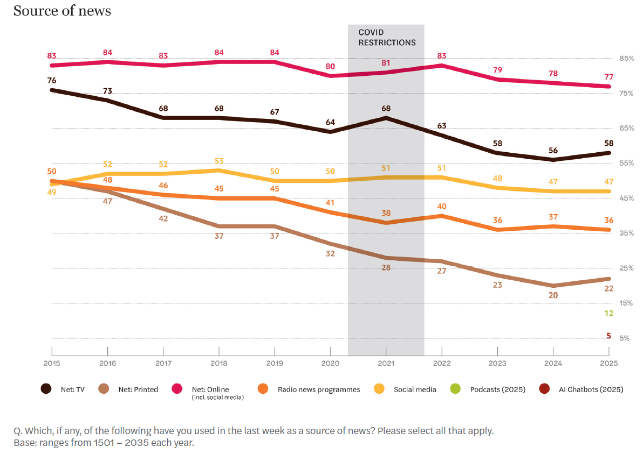
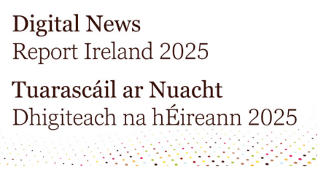


Notes:
Insights
The 2025 Digital News Report Ireland indicates general media consumption trends among all age groups in terms of the most popular sources of news. The authors tracked where people in Ireland got their news from over a 10-year period from 2015 up until last year 2025.
What’s notable is that all of these news sources have experienced a decline since 2015, indicating that people in Ireland are less interested in the news today as they were 10 years ago. While news interest did increase in 2025, longitudinal analysis shows that those ‘extremely’ or ‘very interested’ in news in Ireland have reduced to 56% in 2025 when compared to 71% in 2015.
What has plummeted across this 10-year period? Printed news, i.e. the traditional printed newspaper, down from around 50% in 2015 to 22% in 2025; so printed news is down by half across this timeline.
However, online as a news source, which includes online news “papers”, so the likes of Independent.ie and IrishTimes.com – have stayed fairly steady over the 10 years down by 6% from 83% to 77%.
Social media as a place where people in Ireland get their news – has also stayed fairly steady, down just 2% from 49% to 47%.
TV experienced the second biggest drop (after print sources) from 76% to 58%, but it’s still significant in terms of being an important channel to target audiences.
AI Chatbots were recorded as a source of news for the first time in 2025, with 5% of people saying they use them for this reason. These are generative AI chatbots – they can be paid for or free – and I’m sure many of us knows how it works by now. In the case of an AI software tool like Chat GPT, you type in a question - e.g. When did the Sydney Bondi Beach mass shooting happen? - and Chat GPT automatically returns an answer.
We can assume that AI Chatbots are going to become an increasingly popular way of sourcing news for people, thereby increasing the risk of disinformation and misinformation. This is an important consideration when it comes to Personas such as our Disengaged Pat, who is much less like to factcheck sources than the likes of Multilateralist Luke or Community Champion Aoife.
Podcasts were also recorded as a source of news for the first time in 2025, for 12% of people.

Slide 5
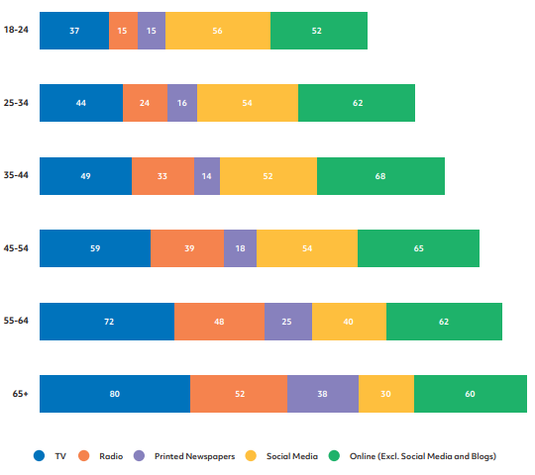
Q: Which, if any, of the following have you used in the last week as a source of news? Please select all that apply.
Digital News Report Ireland 2023
Notes:
Source: https://www.cnam.ie/app/uploads/2023/06/20230609_DNR-Final-Report_STRICT-EMBARGO-00.01-14-June-23_FINAL.pdf
The 2023 Digital News Report Ireland indicates news consumption habits by age group. This is the most up-to-date data for Ireland that specifically provides a breakdown of news sources per age group.
Insights
It asked people which media they had used in the last week as a source of news and:
For older audiences, TV and radio are more important than for younger audiences.
For younger audiences – under 54 – social media is more important than for audiences older than 54, especially for the 18-24-year-old age group.
For all audiences over 25, online sources of news, including online newspapers, are important.
In terms of our Personas:
TV, radio and online sources of news are important sources for all of our Personas, while social media is of low importance for our Pragmatist Michael but of high importance for our Disengaged Pat .

Slide 6
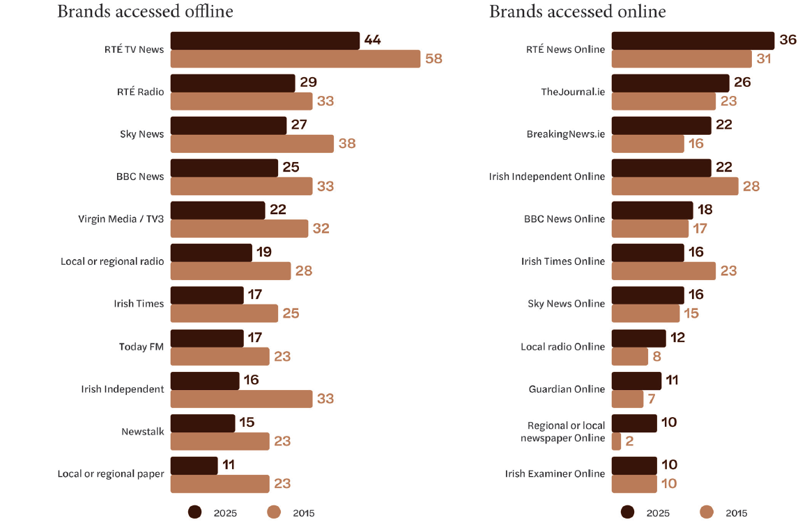
Notes:
Source: https://www.cnam.ie/app/uploads/2025/06/Digital-News-Report-Ireland-2025.pdf
Insights
The Digital News Report Ireland 2025 indicates that:
In terms of Offline Channels, RTÉ TV News (44%) and RTÉ Radio News (29%) are the most accessed brands, followed by Sky News (27%) and BBC News (25%).
In the case of Online Channels, RTÉ News Online (26%) is the most accessed, followed by The Journal (26%), BreakingNews.ie (22%) and the Irish Independent (22%).
What this data shows is:
The growing importance of online news media channels in terms of reaching audiences.
All offline news brands have experienced a drop in popularity over the past 10 years, yet some still remain strong, e.g. RTÉ TV News and RTÉ Radio News.
Offline, legacy publishers continue to dominate. RTÉ TV News (44%) and RTÉ Radio News (29%) are still the most accessed brands by consumers, followed by Sky News (27%) and BBC News (25%).
Online, RTÉ.ie News Online (36%) is the most accessed, followed by The Journal (26%), BreakingNews.ie (22%) and The Irish Independent/Independent.ie (22%).
Observations
Interestingly, we can see that there is a growth in popularity of The Guardian online for Irish audiences, up from 7% in 2015 to 11% in 2025. We know that our Multilateralist Luke is a daily Guardian reader, making it an important connection point for reaching him.
Also interestingly, the report for 2025 showed that 20% of people in Ireland now pay for news, a rise of 3% on 2024, and twice as much as those who pay in the UK. The 35-44 age group have shown the most significant gains since 2023 – our Community Champion Aoife falls within this group. However, 80% do not pay for news.

Slide 7
Social Media Trends
Notes:
Moving on now to social media trends…

Slide 8
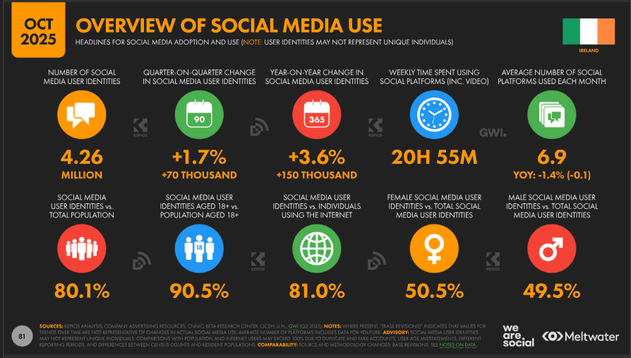
Notes:
Source: https://datareportal.com/reports/digital-2026-Ireland
According to the October 2025 Global Digital Report for Ireland by Kepios, which is an independent digital trends agency that produces some of the world's most widely read reports on digital trends and online behaviours:
Insights
Ireland has an estimated 4.26 million social media users. For perspective, this figure was equivalent to 80.1 percent of Ireland’s total population at the end of 2025.
Data indicates that there were 3.74 million user identities aged 18 and above using social media in Ireland at the end of 2025, which was equivalent to 90.5 percent of the total population aged 18 and above.
At the end of 2025, 50.5 percent of Ireland’s social media user identities were female, while 49.5 percent were male, so there’s quite an even split there in terms of gender.
What this means – which I’m sure you don’t have to tell you – is that social media is a crucial touchpoint for reaching our Personas, some more than others. Again, we know that our Disengaged Pat trusts it as a news source way more than the likes of our Multilateralist Luke, for example.

Slide 9
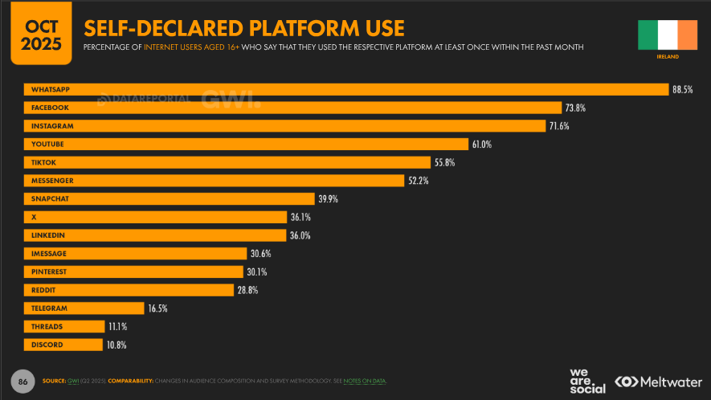
Notes:
Source: https://datareportal.com/reports/digital-2026-Ireland
Insights
WhatsApp, Facebook and Instagram are the most popular social media channels. Just as a note on WhatsApp, which is owned by Meta, WhatsApp is often grouped with social media platforms due to features like users being able to share stories via Status, connect in large groups, and follow public figures/organisations via Channels.
We all probably by now use WhatsApp as a day to day way of communicating with friends and family and other groups, but notably, at Alice, we’re witnessing clients now proactively focusing on adding WhatsApp into their communications and PR mix as a way to try and engage with their stakeholders and target audiences.
Other Insights
Platforms that saw growth: LinkedIn (+13.3%), Facebook (+8.3%), Instagram (+4.2%), YouTube (2.5%).
Platforms that saw a drop: TikTok (-8.7%) and X (-0.8%).

Slide 10
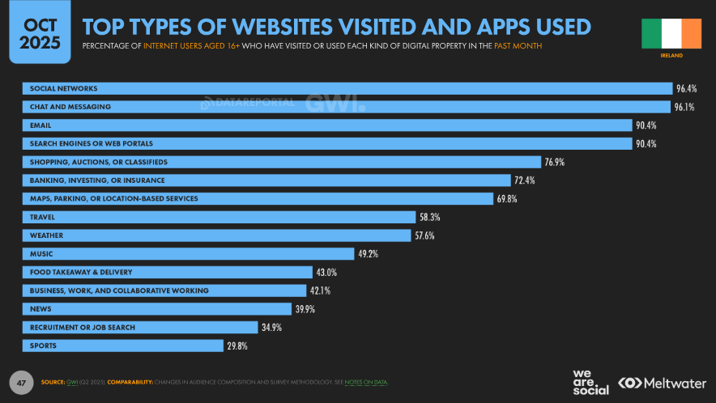
Notes:
Source: https://datareportal.com/reports/digital-2026-Ireland
What this slide tells us that’s of relevance to today’s session is that 39.9% of internet users aged over 16 in Ireland have visited News websites in the past month, which is a significant number.

Slide 11
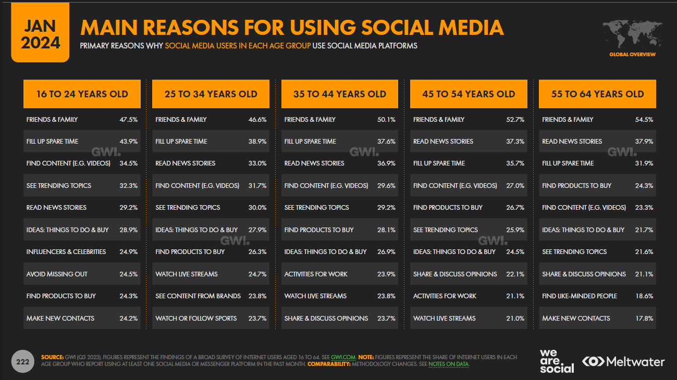
Notes:
Source: https://datareportal.com/reports/digital-2024-Ireland
The 2024 Digital Ireland Report contained valuable data per age group in relation to people’s main reasons for using social media.
It showed that slightly more 45-64-year-olds use social media to read news stories than 16-44-year-olds. But for all of these age groups, using social media to read news stories is important:
For 16-24-year-olds, it’s their fifth most popular reason for using social media.
For 25-34-year-olds and 35-44-year-olds, like our Global Citizen Fionn and Community Champion Aoife, it’s their third most popular reason.
For 45-54 and 55-64-year-olds, it’s their second most popular reason.
Aside from the data on the slide, other insights published in December 2025 by Irish Web Studios, a Limerick-based digital agency* show that:
Irish viewers are looking more toward social media sites with regard to education-based content, e.g. tutorials, how-to videos and tips.
Irish audiences value authentic, local, and funny content the most. They like local content and local businesses and organisations.
*https://www.irishwebstudios.ie/blog/irish-social-media-trends-boost-online-presence/#:~:text=When%20brands%20shift%20from%20'sellers,consumer%20prior%20to%20the%20acquisition.

Slide 12
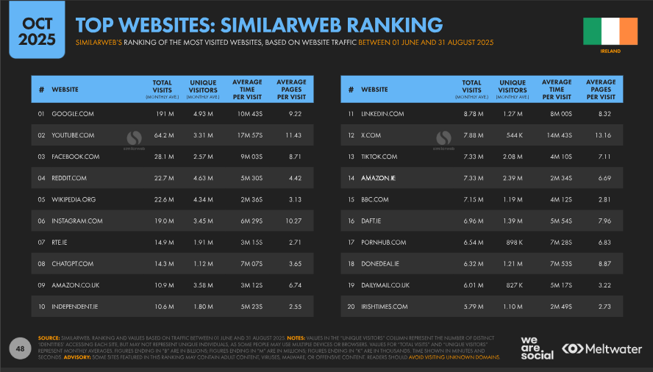
Notes:
Source: https://datareportal.com/reports/digital-2026-ireland
In terms of the top websites that Irish internet users aged over 16 visit, according to the October 2025 Kepios Digital Report for Ireland :
RTE.ie is ranked seventh and is the highest ranked news website.
Independent.ie is ranked tenth and is the next most popular news website.
BBC.com is ranked in fifteenth place.
DailyMail.co.uk in 19th place.
And IrishTimes.com in twentieth place.

Slide 13
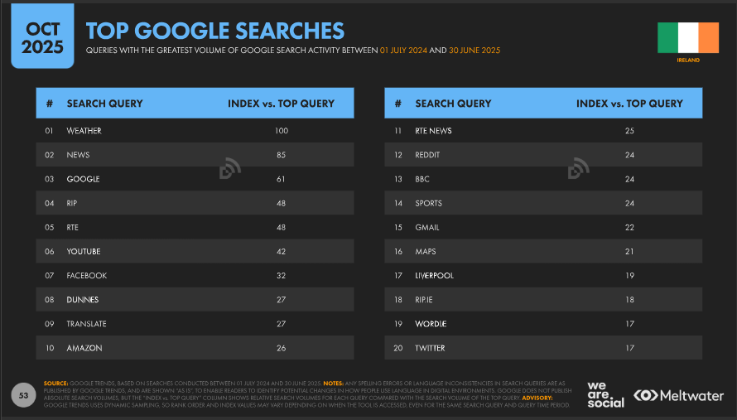
Notes:
Source: https://datareportal.com/reports/digital-2026-ireland
In terms of the top Google Searches that Irish internet users aged over 16 are making:
The weather unsurprisingly takes first position.
Followed by News at number two.
RTE is in fifth place.
RTE News in eleventh place.
And the BBC in thirteenth.
It’s heartening to see Wordle ranked among the top 20 Google searches. (Not sure about Liverpool though!)

Slide 14
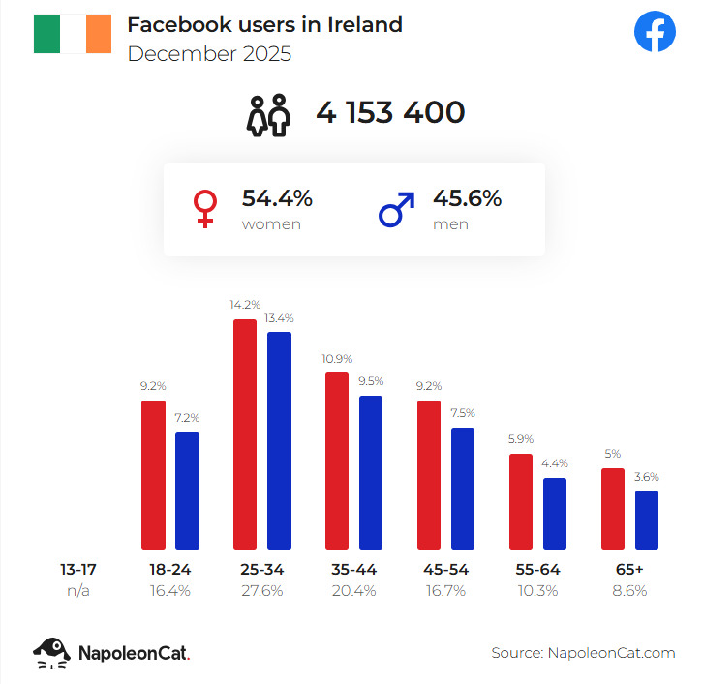
Facebook:
4,153,400 FB users in Ireland in Dec 2025 = 80% of entire population.
Majority (54.4%) are women.
Notes:
Source: https://stats.napoleoncat.com/facebook-users-in-ireland/2025/12/
In terms of data by age group that we can connect to your personas, there’s some good recent data from Napolean Cat – a reputable social media management platform - on Facebook users in Ireland that on the slide here.
Insights
Contrary to predictions of Facebook’s eventual collapse, it is actually highly relevant within Ireland, especially within specific segments and contexts.
Facebook is popular as an online space for local communities, marketplace trading, and organising events. It’s important that organisations utilise Facebook as part of their marketing / communications mix.
The strength of Facebook is that it is very useful for creating communities for an organisation, or reaching people who have aged out or have not joined newer sites.
It is useful and is ingrained in Irish culture, if not necessarily the “coolest” site.
In terms of our Personas:
Facebook is most popular with 25-34-year-olds followed by 35-44-year-old, so with our Disengaged, Global Citizen and Empathiser personas.

Slide 15
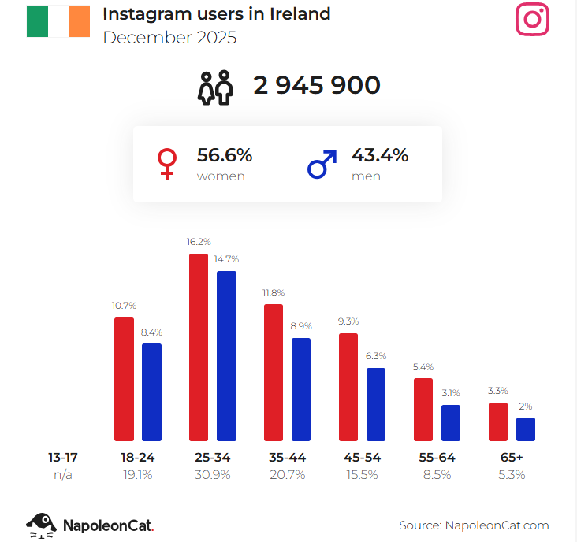
Instagram:
2,945,900 users in Ireland in Dec 2025 = 56.7% of entire population.
Majority (56.6%) are women.
Reels dominate reach compared to static posts, while carousels generate the highest engagement rates.
Shift in content – more news, more political engagement.
Notes:
Sources:
https://stats.napoleoncat.com/instagram-users-in-ireland/2025/12/
https://napolify.com/blogs/news/trending-content-formats-Instagram
The slide shows data about Instagram users in Ireland.
What content niches and topics are trending on Instagram in 2025?
POV storytelling, micro-education, and behind-the-scenes content dominate 2025 trends, emphasising authenticity and community building over polished production.
POV Narratives: "A day in my life," relatable scenarios, and first-person storytelling that builds emotional connections.
Micro-Education: Quick tips, "3 things you need to know" formats, myth-busting, and carousel breakdowns of complex topics.
Behind-the-Scenes: Authentic, unpolished content showing real processes, failures, and genuine moments that build trust.
Mini-Vlogs: Day-in-the-life content, transformation stories, and glow-up narratives focusing on personal growth.
Community-Centric Content: Posts that invite interaction, share real stories, and build genuine relationships rather than pursuing vanity metrics.
These trends reflect audience preference for authentic connection over aspirational content, creating opportunities for creators to build engaged communities through vulnerability and genuine value provision.
In terms of our Personas:
Instagram is most popular again with 25-34-year-olds followed by 35-44-year-old, so with our Disengaged, Global Citizen and Empathiser personas.

Slide 16
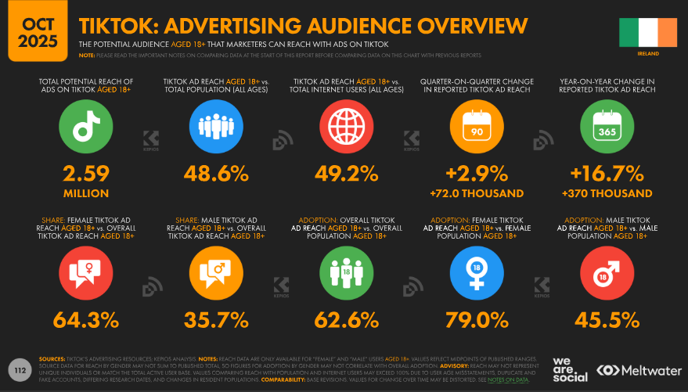
Notes:
Source: https://datareportal.com/reports/digital-2026-Ireland
In terms of TikTok users in Ireland, this is data from the October 2025 Kepios Digital Report for Ireland and it shows that there are:
Insights – TikTok
2.59 million TikTok users in Ireland (aged over 18).
Majority are women (64.3%) (aged over 18).
TikTok is continuing to grow its user base - potential ad reach in Ireland increased by 370 thousand (+16.7 percent) between the end of 2024 and late 2025.
TikTok prefers raw, creative video content over highly finished content, making it relatively affordable for organisations with limited budgets.

Slide 17
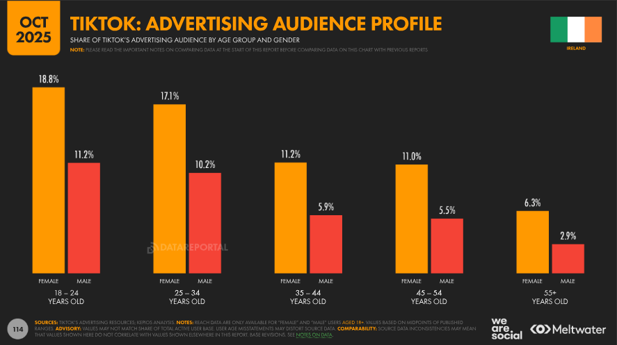
Notes:
Source: https://datareportal.com/reports/digital-2026-ireland
18-24-year-olds in Ireland are the largest TikTok users, followed by 25-34 year olds, with significantly fewer 35-44-year-old and 45-54-year-old users, and with over-55s lagging last.
Again, there are considerably more female than male TikTok users in Ireland.
In terms of our Personas:
TikTok is most popular with 18-24-year-olds and 25-34-year-olds in Ireland, so with our Global Citizen and Empathiser personas.

Slide 18
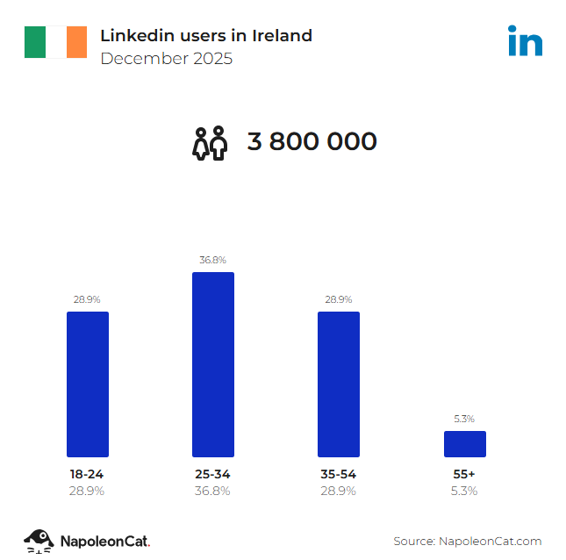
LinkedIn
3.8 million users (73.2% of total population).
Traditionally thought of as B2B.
‘Quality’ over ‘quantity’ content.
Big increases in conversations and content creation since 2020.
Content with images – 2x engagement.
Content with polls / document / image / video – up to 1.6x reach.
Notes:
Source: https://stats.napoleoncat.com/linkedin-users-in-ireland/2025/12/
The slide shows data about LinkedIn users in Ireland.
Insights
Significant growth in users – 3.8m users in Dec 2025 compared with 3.41m users in Dec 2024; representing 10.8% growth. Due to the decline in X users, with many of them jumping ship to LinkedIn instead.
The content tone continues to shift to a more professional, but increasingly more conversational, tone.
In terms of our Personas:
LinkedIn is most popular with 25-34-year-olds, so with our Global Citizen Fionn, but 34-54-year-olds are pretty active on it, too, so the likes of our Multilateralist Luke and Community Champion Aoife are more likely to regularly engage with LinkedIn.

Slide 19
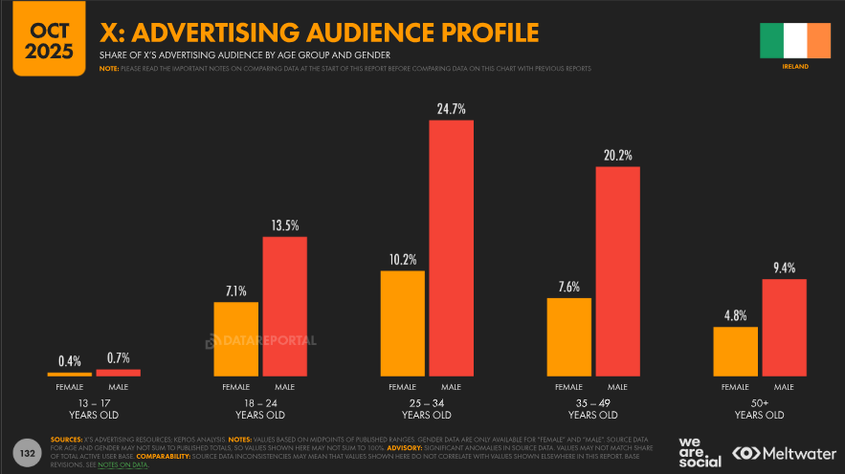
X users in Ireland in Feb 2025 =2.16 million, or approx 40% of entire population.
Majority on X are men.
Experiencing a decline in users.
Experiencing increased political polarisation.
Notes:
Source: https://datareportal.com/reports/digital-2026-Ireland
In terms of X users in Ireland, there are:
1.55 million users (29.1% of total population).
Majority of all users (69.5%) are men.
Users have decreased by 300,000 or -16.3% between the end of 2024 and late 2025.
According to the 2025 Digital News Report for Ireland, X is the channel seen as the greatest threat regarding false and misleading information (54%), followed by TikTok and Facebook.
In terms of our Personas:
X is most popular with 25-34-year-old males followed by 35-49-year-old males. While Global Citizen Fionn falls into this age bracket, we know from his key characteristics, for example his concern for social justice, that you’re not likely to find him on X these days. There’s a strong chance, however, that our Disengaged Pat, is on there, engaging with content that, for example, reinforces his concerns about immigration.

Slide 20
Any Questions?

Slide 21
© Alice Public Relations 2026

