Slide 1



WORLDVIEW
Comparative Wave 6 Statistics
Insights from the US, Great Britain, France, Germany, and Sweden

Slide 2
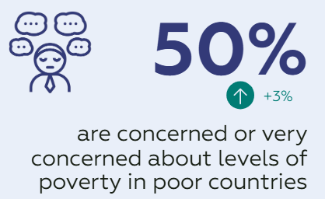
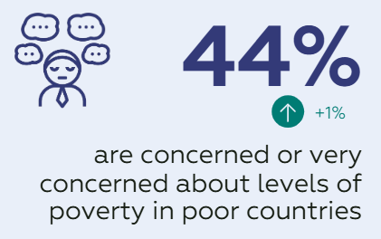

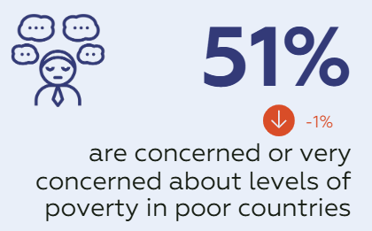
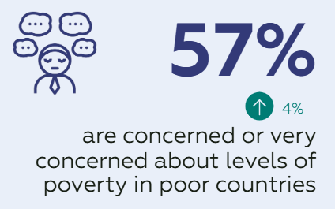
Concern about Poverty Levels
Ireland 2025
France 2025
Germany 2025
67%
50%
44%
NC
are concerned or very concerned about levels of poverty in poor countries
Great Britain 2025
USA 2025
1%
57%

Slide 3

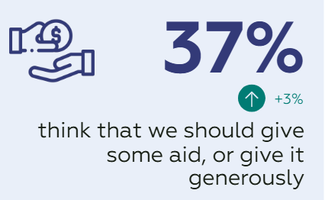
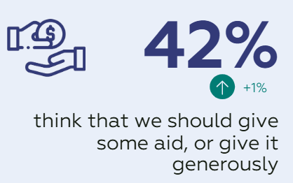
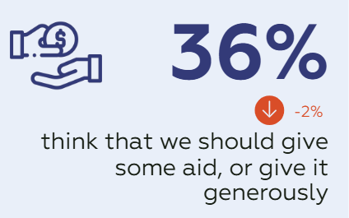
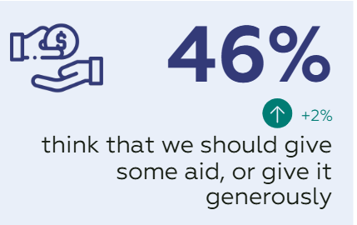
Provision of Aid
Ireland 2025
France 2025
Germany 2025
73%
37%
42%
NC
agree it’s important the Irish Government provides ODA
Great Britain 2025
USA 2025
Sweden 2024
36%
46%
75%
believe that it is important that Sweden supports development in poor countries

Slide 4

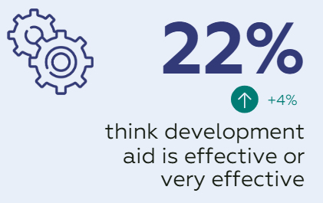
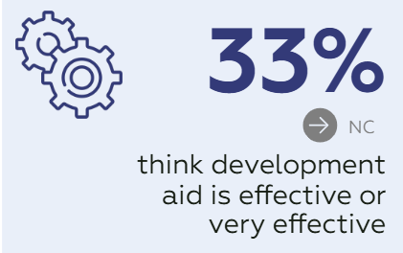
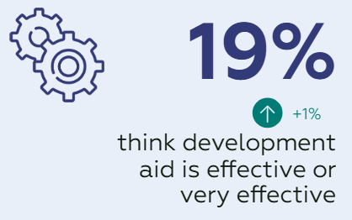
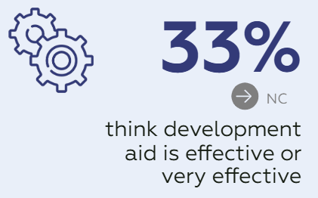
Efficacy of Aid
Ireland 2025
France 2025
Germany 2025
74%
22%
33%
-1%
agree that ODA helps to bring about positive change for those living in developing countries*
Great Britain 2025
USA 2025
Sweden 2024
19%
33%
38%
think that Sida's aid is quite or very effective

Slide 5

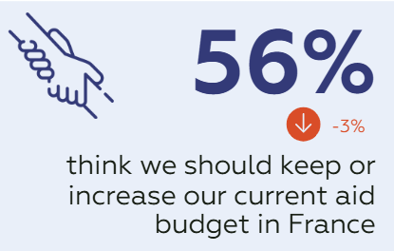
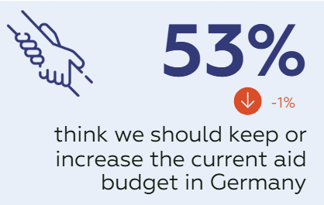
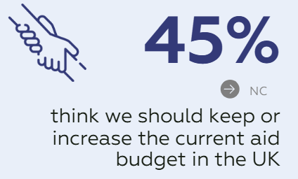
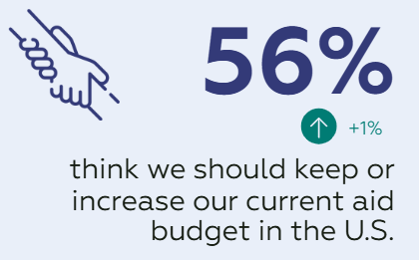
Increase/Maintain Aid Budgets
Ireland 2025
France 2025
Germany 2025
69%
56%
53%
-4%
think we should keep or increase the current aid budget in Ireland
Great Britain 2025
*
USA 2025
Sweden 2024
45%
56%
76%
think we should keep or increase the current aid budget in Sweden

Slide 6
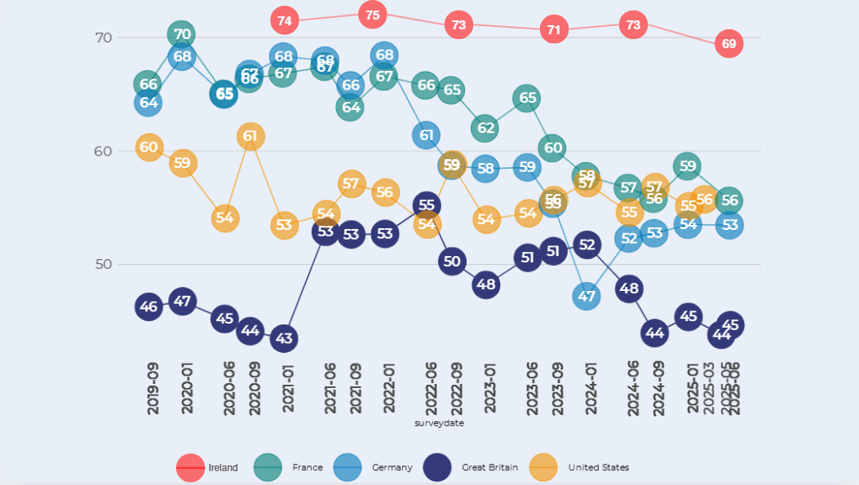

% of the public who think the amount of money spent on ODA should increase or remain the same

