Slide 1
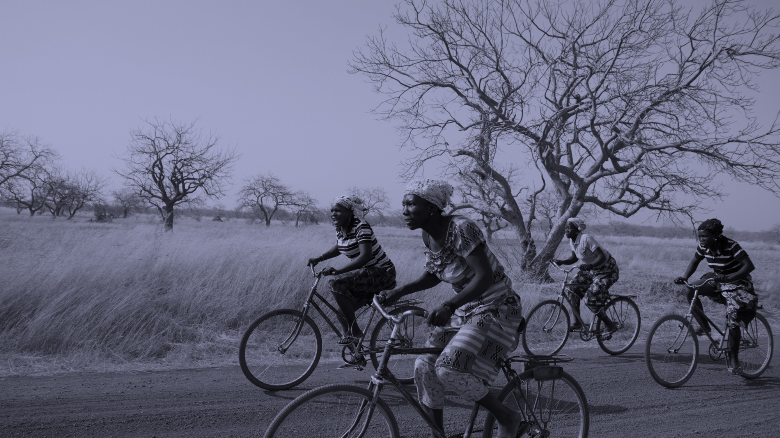


Imagery & Ethical Communications
Thursday 19 June
Notes:
Welcome to this Dóchas webinar exploring the Worldview imagery results and Ethical Communications Guidelines.
We are starting the webinar now and ask you to ensure your microphone is muted and you have your name and organisation on display.
We will have a short Q&A at the end of the webinar so please have your questions ready for then.
We are recording this webinar to share afterwards; however, only the presentations will be recorded, and will be switched off for the Q&A session.
We are delighted to have Miriam Donohue and Andrew Kartende with us today to share their perspectives of ethical comms in media, working in the field, and behind the camera lense.
Now hand over to Miriam to introduce today's presentation and talk a bit about her perspective and experience

Slide 2



WORLDVIEW WAVE 5
Exploring Irish Attitudes Towards INGO Imagery
Notes:
Thanks Miriam for intro to todays topics
Going to take you through the worldview wave 5 imagrey results from last year
Substantial piece of work encompassing quantitative survey and qualitative focus groups to dig in further to people's perspectives of imagery in our sectors campaigns.

Slide 3
ABOUT THE RESEARCH
Exploring
  Which images motivate respondents to engage in an appeal
  What emotions do images trigger and how does that matter for engagement
Notes:
Conducted a Quantitative survey and Qualitative focus groups with 5 segments
We received 141 images from 11 members. 70 selected based on a range of different attributes e.g. gender, age, emotion, eye contact etc
In the survey, each image was seen between 175-179 times. Those that performed best, worst and had interesting reactions with particular segments were then selected for the focus groups

Slide 4


ABOUT THE RESEARCH
Exploring
  Which images motivate respondents to engage in an appeal
  What emotions do images trigger and how does that matter for engagement
141 from 11 members submitted
70 selected for a range of different attributes - gender, age, emotion, eye contact etc
Each image was seen between 175-179 times
Notes:
Conducted a Quantitative survey and Qualitative focus groups with 5 segments
We received 141 images from 11 members. 70 selected based on a range of different attributes e.g. gender, age, emotion, eye contact etc
In the survey, each image was seen between 175-179 times. Those that performed best, worst and had interesting reactions with particular segments were then selected for the focus groups

Slide 5
ABOUT THE RESEARCH
OVERARCHING THEMES
Exploring
  Which images motivate respondents to engage in an appeal
  What emotions do images trigger and how does that matter for engagement
1
PROGRESS
2
AGENCY
141 from 11 members submitted
70 selected for a range of different attributes - gender, age, emotion, eye contact etc
Each image was seen between 175-179 times
3
TRANSPARENCY
Notes:
Three overarching themes
Topline result
When shown an image, respondents are more likely to say they want to find out more information about the appeal than not, indicating the power of visual imagery in attracting interest to appeals.
So which performed well, and which didn't resonate.

Slide 6


SURVEY IMAGE INSIGHTS
TOP 10 IMAGES – MOST SELECTED FOR FINDING OUT MORE INFORMATION
Notes:
Top 10 performing images
These were the most selected for finding out more information
note the colours, expressions, image clarity, the protagonists- will be sharing so will move on

Slide 7
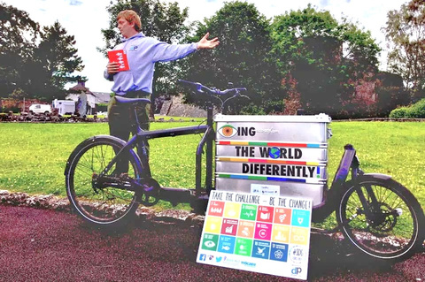

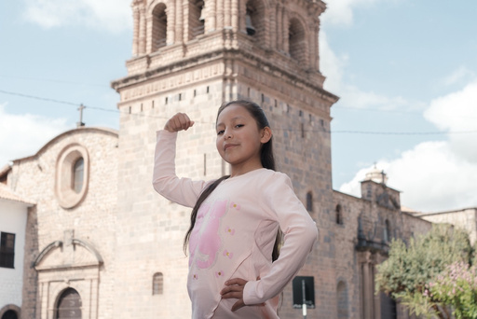


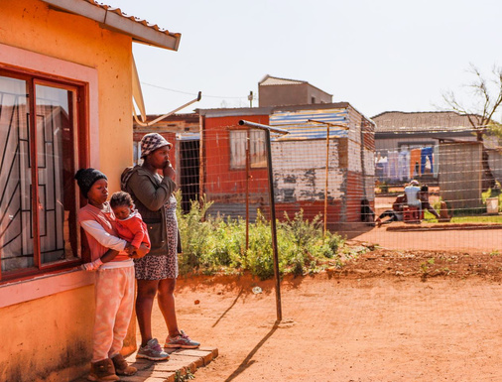
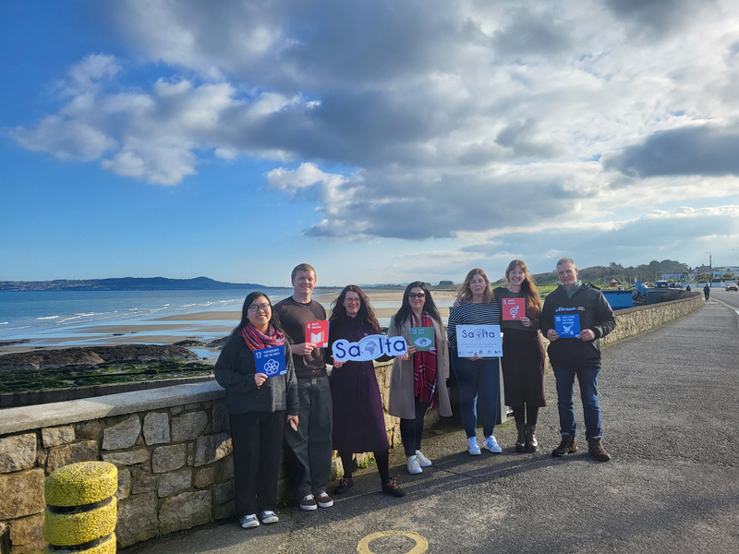

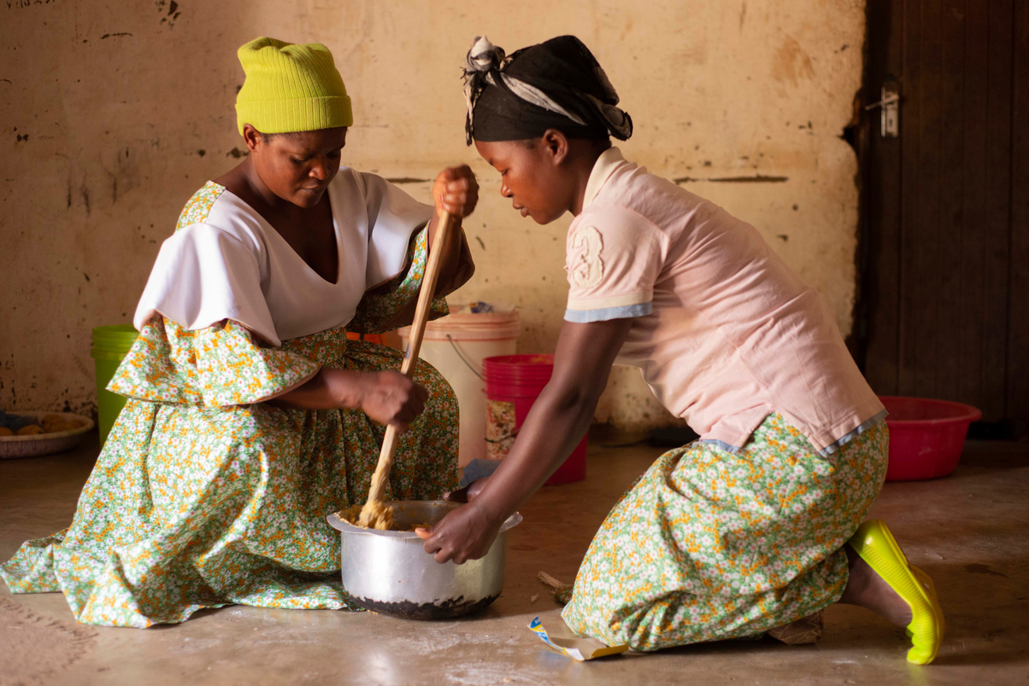
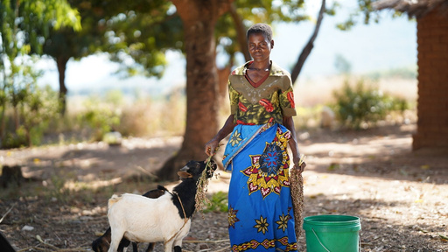

SURVEY IMAGE INSIGHTS
BOTTOM 10 IMAGES – LEAST SELECTED FOR FINDING OUT MORE INFORMATION
Notes:
These were the most selected for finding out more information
Again, note the colours, expressions, image clarity, the protagonists

Slide 8

INCREASING IMAGE ENGAGEMENT
1
Images that elicit more extreme emotional responses are more likely to generate engagement
2
Both positive (activated & deactivated) and negative (activated) images
The top images selected nearly always involved children: half feature crisis/extreme need, and half are hopeful or show progress
3
Global Citizens, Multilateralists, and Community Champions are most likely to engage
Notes:
So what can we do to increase engagement
Images that elicit more extreme emotional responses are more likely to generate engagement
Both positive (activated & deactivated) and negative (activated) images work to stimulate respondents to want to find out more about an appeal.
The top images selected images nearly always involved children, however, half of the images feature crisis/extreme need and half are hopeful or show progress.
Looking to our segments, unsurprisingly its the GC, CC, and Multi that are most likely to engage
So what did the least effective images include?

Slide 9
INCREASING IMAGE ENGAGEMENT
LEAST EFFECTIVE IMAGES INCLUDED:
1
Images that elicit more extreme emotional responses are more likely to generate engagement
1
Organisation’s members
2
Both positive (activated & deactivated) and negative (activated) images
Adults and rarely include young and/or distressed children
2
The top images selected nearly always involved children: half feature crisis/extreme need, and half are hopeful or show progress
3
3
‘Empowered’ women/girls
Global Citizens, Multilateralists, and Community Champions are most likely to engage
Notes:
The least effective images tended to include
organisations memders
adults and or rarely included young and or distressed children
and empowered women and girls
Now this is why we are pairing these reuslts with the ethical communications guidelines - because we have to contextualise these results within the ethical framework
the question is now - where can we take this? What can we do because we arent going to stop including empowered girls, adults or only focus on distressed children

Slide 10

INCREASING IMAGE ENGAGEMENT
LEAST EFFECTIVE IMAGES INCLUDED:
1
Images that elicit more extreme emotional responses are more likely to generate engagement
1
Organisation’s members
2
Both positive (activated & deactivated) and negative (activated) images
Adults and rarely include young and/or distressed children
2
The top images selected nearly always involved children: half feature crisis/extreme need, and half are hopeful or show progress
3
3
‘Empowered’ women/girls
Global Citizens, Multilateralists, and Community Champions are most likely to engage
Where can we take this?
Notes:
The least effective images tended to include
organisations memders
adults and or rarely included young and or distressed children
and empowered women and girls
Now this is why we are pairing these reuslts with the ethical communications guidelines - because we have to contextualise these results within the ethical framework
the question is now - where can we take this? What can we do because we arent going to stop including empowered girls, adults or only focus on distressed children

Slide 11










FOCUS GROUP RESULTS
FACTORS INFLUENCING REACTIONS TO IMAGES
PHOTOGRAPHIC FIDELITY
PROTAGONIST MEANING
AUTHENTICITY OF SCENARIO
VIEWER CONNECTION
IMPACT
STORYTELLING POWER
Notes:
These are the factors influencing reactions to images that we can move forward with
The more of these factors an image satisfies, the more likely you will get engagement with your image, and thus your campaign.
NAME THE 6

Slide 12
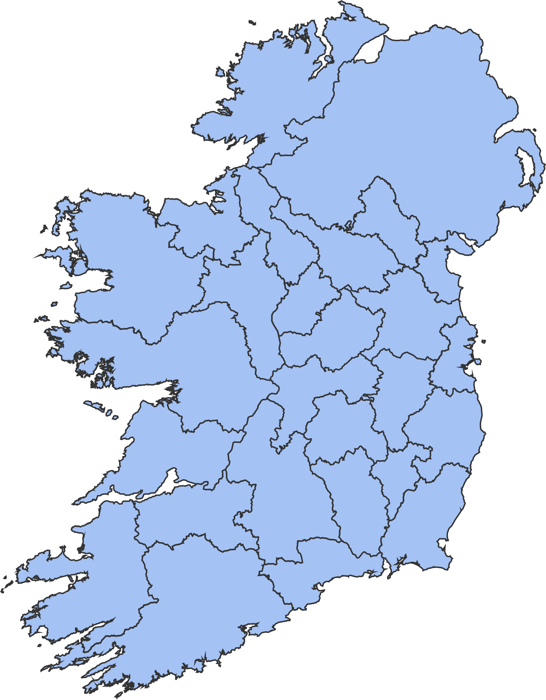
FOCUS GROUPS
WORLDVIEW SEGMENTS
Global Citizen x1
Multilateralist x1
Pragmatists x1
Empathiser x2
Disengaged x1
6 focus groups around the country
Notes:
Beofre I dive into them, a bit about the qualitative focus groups
we had 6 around the country - with each group bar the community champion because they are as engaged as our global citizen - exlucding the comm champ meant we could have two emptahiser focus groups - key because of the large age range, they are the largest segment, and the interst in them from our members.
A subset of images were selected from the survey - positive, and negative, and shown to the respondents.
With each image, respondents were encouraged to look at the screen and then note down their emotional response before discussing their feedback in the group.
Thus, we captured (as far as possible) their ‘system one’ or gut reactions at a personal level before exploring other layers of reactions and interpretations (system two).

Slide 13
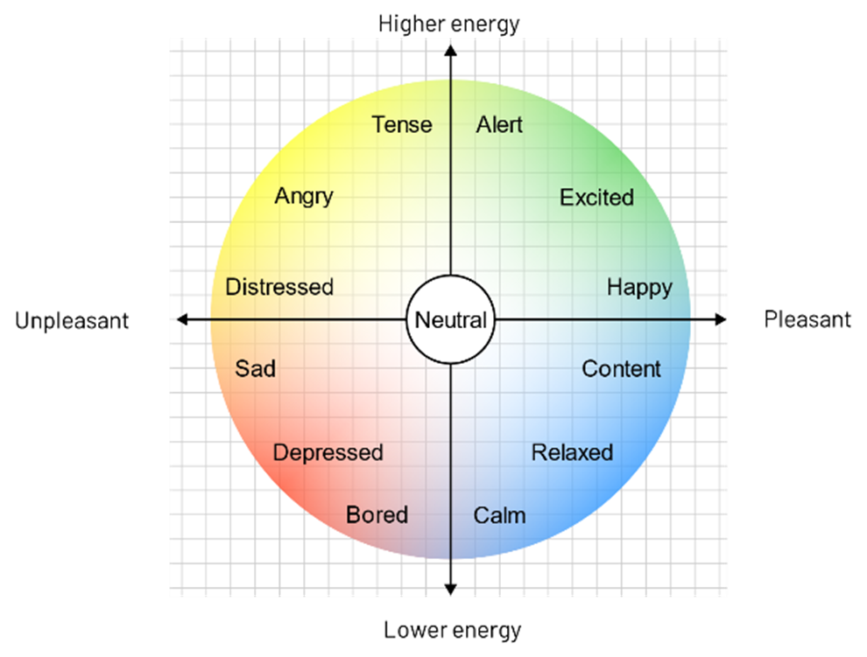
FOCUS GROUPS
EMOTIONAL CIRCUMPLEX
ACTIVATION
The Circumplex Model organises emotions based on two main axes: activation (energy), and valence (positive or negative)
Used to help guide the focus group's identification of emotions
VALENCE
1
2
4
3
Notes:
With each image, respondents were encouraged to look at the screen and then note down their emotional response before discussing their feedback in the group.
Thus, we captured (as far as possible) their ‘system one’ or gut reactions at a personal level before exploring other layers of reactions and interpretations (system two).

Slide 14
FOCUS GROUPS
EMOTIONAL CIRCUMPLEX
ACTIVATION
The Circumplex Model organises emotions based on two main axes: activation (energy), and valence (positive or negative)
Used to help guide the focus group's identification of emotions
  System 1 reaction - gut reaction at a personal level
  System 2 reaction - exploring the layers of reactions and interpretations amongst the group
VALENCE
Notes:
With each image, respondents were encouraged to look at the screen and then note down their emotional response before discussing their feedback in the group.
Thus, we captured (as far as possible) their ‘system one’ or gut reactions at a personal level before exploring other layers of reactions and interpretations (system two).

Slide 15
UNPACKING THE KEY FACTORS
IMPACT
Immediacy of the image in arresting attention can make a big difference to reactions.
Most are exposed to a lot of visual content daily and have become adept at quickly screening out images that do not reach a certain level of impact.
Essentially, impact is generated by the sense of drama portrayed in combination with the sense of image novelty.

Slide 16
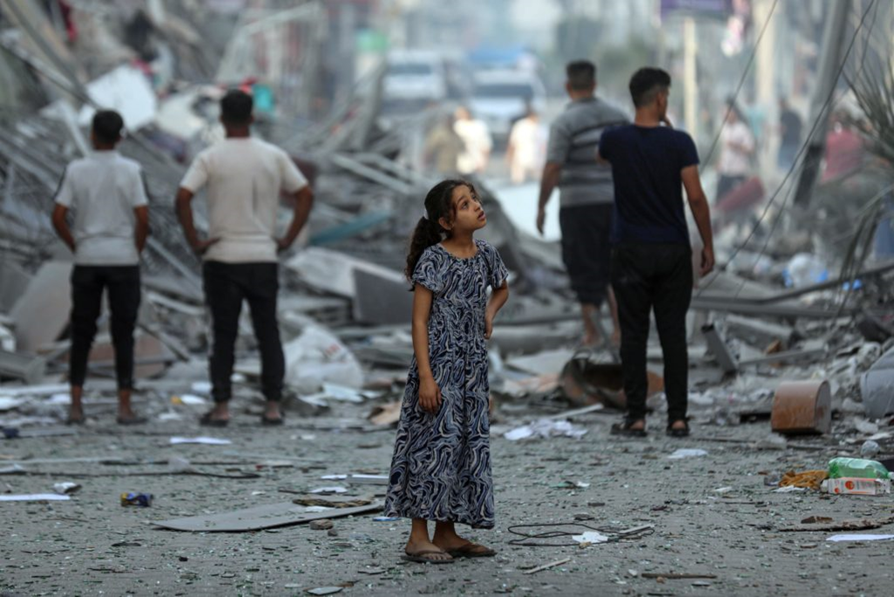

UNPACKING THE KEY FACTORS
IMPACT
Immediacy of the image in arresting attention can make a big difference to reactions.
Most are exposed to a lot of visual content daily and have become adept at quickly screening out images that do not reach a certain level of impact.
Essentially, impact is generated by the sense of drama portrayed in combination with the sense of image novelty.
Ask ourselves
  Will this image stand out from other images?
  Does this image portray something new?

Slide 17
UNPACKING THE KEY FACTORS
PROTAGONIST MEANING
A lot of successful images draw attention to an individual protagonist, sometimes juxtaposed with others or in a particular relationship with their environment.
Reactions are often largely influenced by perceptions of the protagonist’s situation or relationship with others.
In particular, respondents react strongly to a sense of a protagonist’s:
  Vulnerability
  Jeopardy
  Emotional state

Slide 18
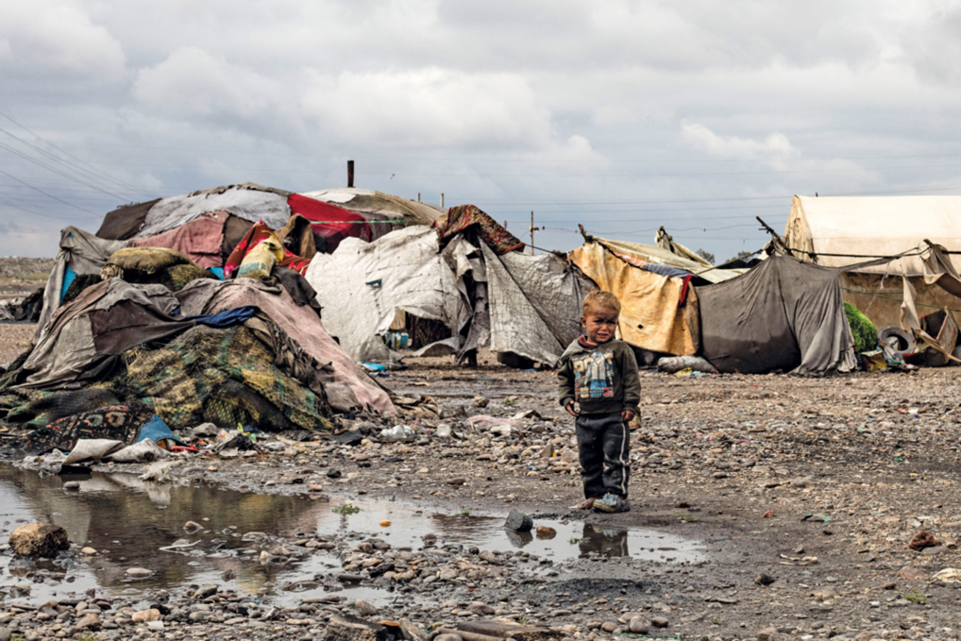

UNPACKING THE KEY FACTORS
PROTAGONIST MEANING
A lot of successful images draw attention to an individual protagonist, sometimes juxtaposed with others or in a particular relationship with their environment.
Reactions are often largely influenced by perceptions of the protagonist’s situation or relationship with others.
In particular, respondents react strongly to a sense of a protagonist’s:
  Vulnerability
  Jeopardy
  Emotional state

Slide 19
UNPACKING THE KEY FACTORS
VIEWER CONNECTION
It is clear that some images connect more strongly than others.
At times, respondents almost immediately reference their reactions in terms of similar experiences in their own lives.
This relatability can operate at an almost unconscious or gut level, or can emerge more slowly from consideration and comparison.

Slide 20


UNPACKING THE KEY FACTORS
VIEWER CONNECTION
It is clear that some images connect more strongly than others.
At times, respondents almost immediately reference their reactions in terms of similar experiences in their own lives.
This relatability can operate at an almost unconscious or gut level, or can emerge more slowly from consideration and comparison.

Slide 21
UNPACKING THE KEY FACTORS
STORYTELLING POWER
As respondents discuss their reactions, it is evident that some images ‘unfold’ with more sense of a background story than others.
Thus, a story that is expressed with clarity tends to have more effect
→ particularly if it can be interpreted as connecting to a current international issue
Similarly, stories can have symbolic meaning that can be more engaging (motherhood, sibling care, etc.)

Slide 22
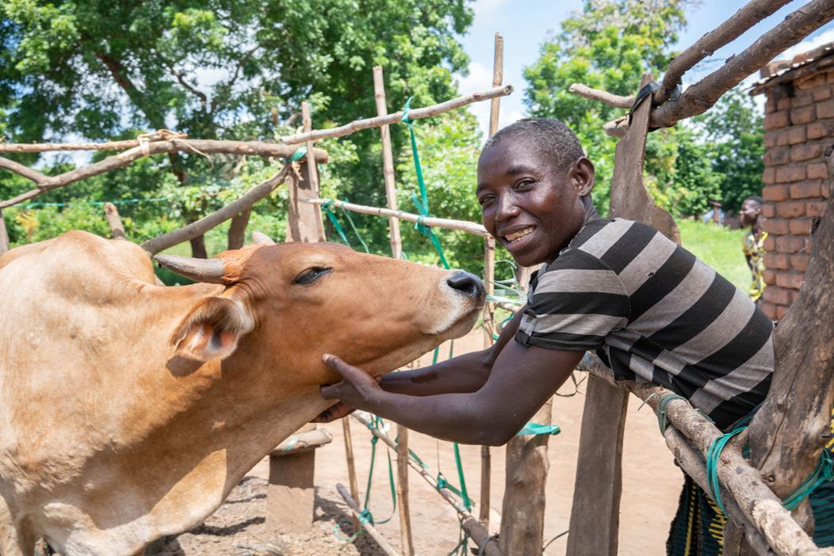

UNPACKING THE KEY FACTORS
STORYTELLING POWER
As respondents discuss their reactions, it is evident that some images ‘unfold’ with more sense of a background story than others.
Thus, a story that is expressed with clarity tends to have more effect
→ particularly if it can be interpreted as connecting to a current international issue
Similarly, stories can have symbolic meaning that can be more engaging (motherhood, sibling care, etc.)

Slide 23
UNPACKING THE KEY FACTORS
AUTHENTICITY OF SCENARIO
Images can be a ‘candid moment’ from someone’s life or a more ‘staged arrangement‘.
There can also be a rapid negative response when respondents feel there is a deliberate attempt to manipulate their reaction
→ A highly emotive scene that has been engineered for effect.
A perceived link to an active news story also supports a sense of authenticity and recency.
Keep in mind that people are ‘trained’ by daily experiences to discern the difference between photoshopped/AI generated images and reality.

Slide 24


UNPACKING THE KEY FACTORS
AUTHENTICITY OF SCENARIO
Images can be a ‘candid moment’ from someone’s life or a more ‘staged arrangement‘.
There can also be a rapid negative response when respondents feel there is a deliberate attempt to manipulate their reaction
→ A highly emotive scene that has been engineered for effect.
A perceived link to an active news story also supports a sense of authenticity and recency.
Keep in mind that people are ‘trained’ by daily experiences to discern the difference between photoshopped/AI generated images and reality.

Slide 25
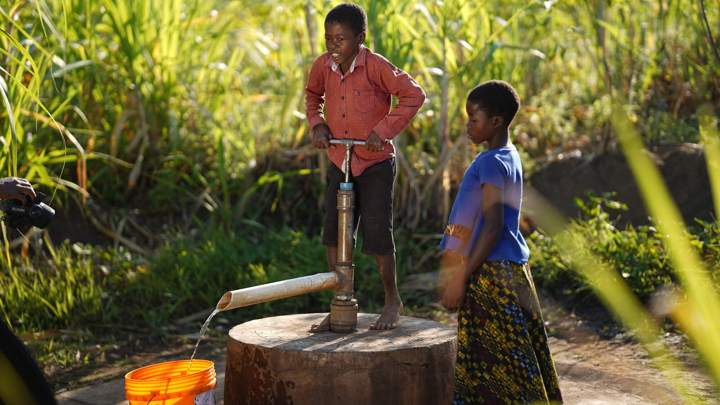
UNPACKING THE KEY FACTORS
AUTHENTICITY OF SCENARIO

Slide 26
UNPACKING THE KEY FACTORS
AUTHENTICITY OF SCENARIO

Slide 27
UNPACKING THE KEY FACTORS
PHOTOGRAPHIC FIDELITY
The simple quality of a photo has an influence on reactions:
  Is the protagonist easy or difficult to make out from the background detail?
  Is there dramatic use of colour?
  Is the viewer drawn into the scene by the protagonist’s eye contact? Or smile?
The images with more emotional impact are often simply better quality photos.

Slide 28
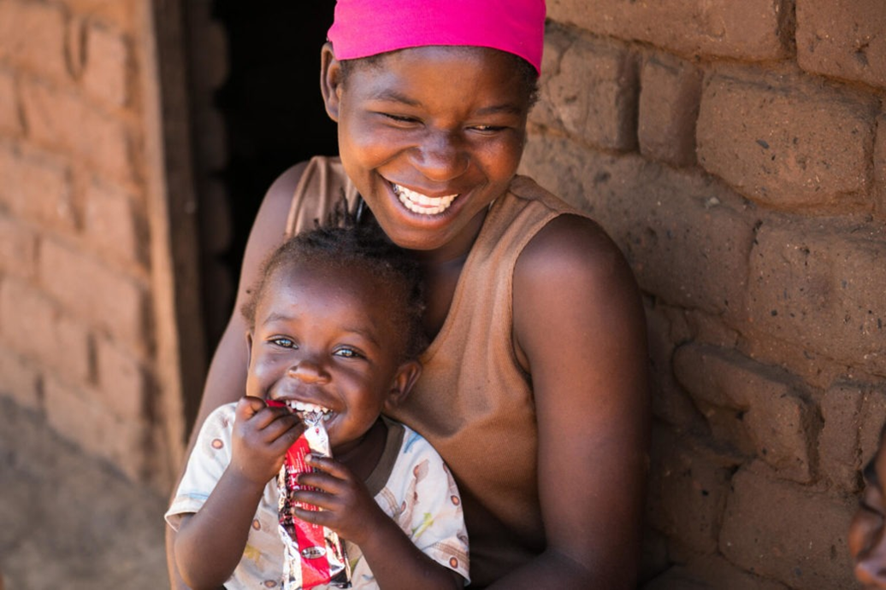

UNPACKING THE KEY FACTORS
PHOTOGRAPHIC FIDELITY
The simple quality of a photo has an influence on reactions:
  Is the protagonist easy or difficult to make out from the background detail?
  Is there dramatic use of colour?
  Is the viewer drawn into the scene by the protagonist’s eye contact? Or smile?
The images with more emotional impact are often simply better quality photos.

Slide 29
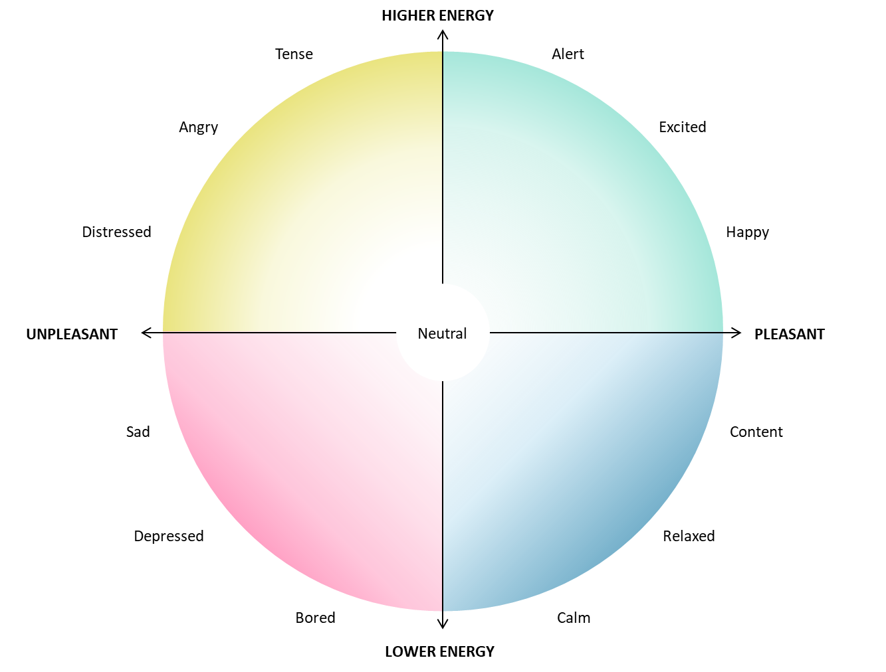
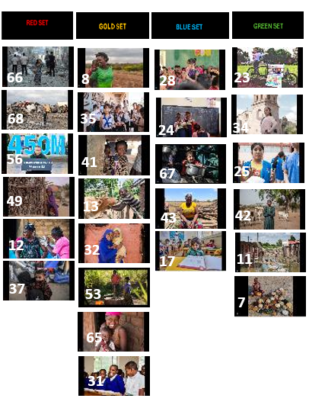
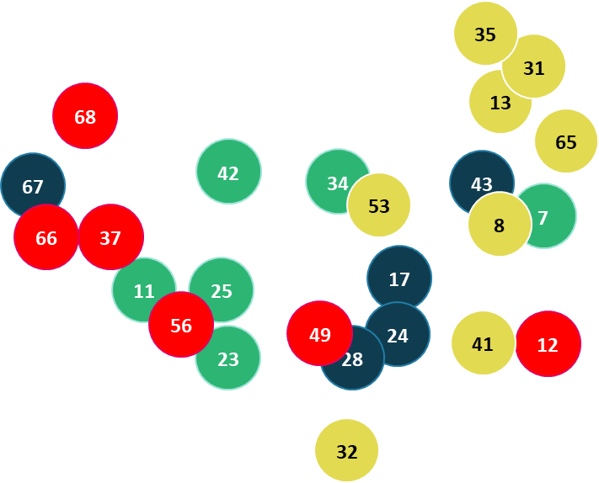
EMOTIONAL RESPONSES TO ALL IMAGES
Notes:
Here are all the focus group images plotted onto the circumploex so you can get a quick indication of the reactions to them

Slide 30
EMOTIONAL RESONANCE IS KEY
Images that drew the strongest reaction sparked feelings of:
→ CONNECTION
→ EMPATHY
→ CURIOSITY
→ CONCERN
→ HOPE
Notes:
Three overarching themes
Topline result
When shown an image, respondents are more likely to say they want to find out more information about the appeal than not, indicating the power of visual imagery in attracting interest to appeals.
So which performed well, and which didn't resonate.

Slide 31
CONCLUSION
EMOTIONAL RESONANCE IS KEY
Balance urgency with agency → Motivating images do not just evoke pity but make viewers feel they can support in a meaningful way
Target real human experience expressed with emotion
Avoid tropes and stereotypes → We need arresting fresh imagery
Simplify our messaging and images to avoid unintended and distracting elements.
Images that drew the strongest reaction sparked feelings of:
→ CONNECTION
→ EMPATHY
→ CURIOSITY
→ CONCERN
Above all our focus should be on the individual and their experience.
→ HOPE
Notes:
Three overarching themes
Topline result
When shown an image, respondents are more likely to say they want to find out more information about the appeal than not, indicating the power of visual imagery in attracting interest to appeals.
So which performed well, and which didn't resonate.

Slide 32




VIEW THE LATEST WAVE 5 RESULTS:
VIEW THE NOVEL IMAGERY RESEARCH:
LinkedIn: Claudia Lynch
Email:Claudia@dochas.ie
WORLDVIEW PROJECT MANAGER
Notes:
I'll hand over now to Niall who will contextualise these results within the Dochas Communications Guidelines but please reach out if you would like a presentation on the wider wave 5 results

