Slide 1
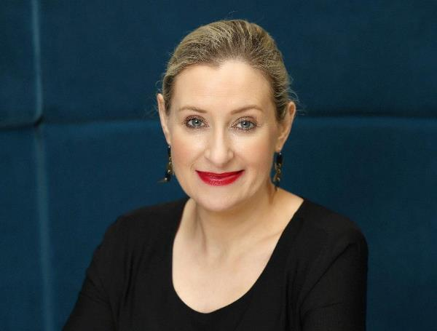
Communications Workshop for Dóchas
Thursday, 23rd May 2024
Martina Quinn, Founder and CEO, Alice Public Relations
@MartinaPQuinn / @HelloAlicePR / www.alicepr.com

Slide 2
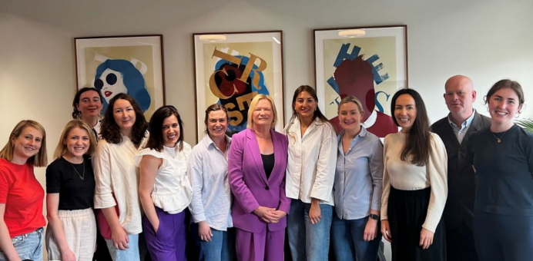
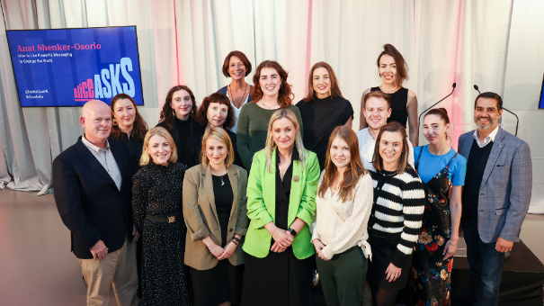
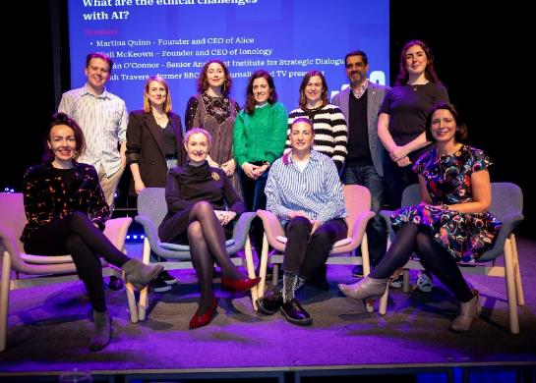
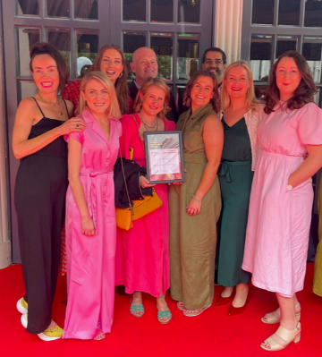
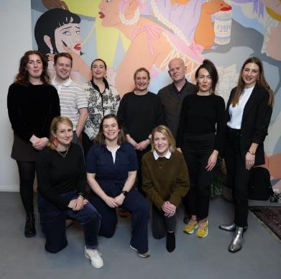
Notes:
3 min for intro

Slide 3



















Slide 4
Our ‘Empathiser’ Persona: Michelle
Notes:
10 min max. for re-introducing Michelle

Slide 5
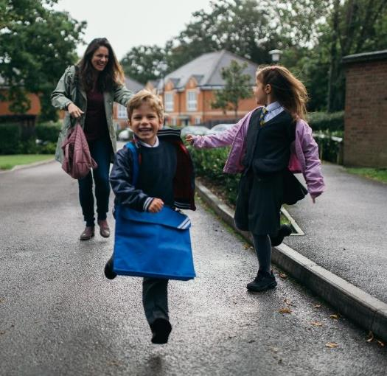
The Basics:
Lives in Clonmel.
Married to John; both from local area.
Busy mum of three (13- and 9-year-old daughters; 7-year-old son).
Formerly worked fulltime as a primary-school teacher; now does some part-time subbing.
Spends a considerable amount of time each week caring for her parents and parents-in-law.

Slide 6
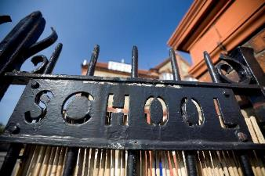
Where do we find Michelle?
At the school gates (or working in school)…

Slide 7
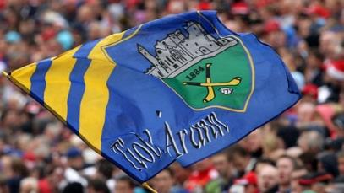
Where do we find Michelle?
At the school gates (or working in school)…
On the side of a GAA pitch...

Slide 8
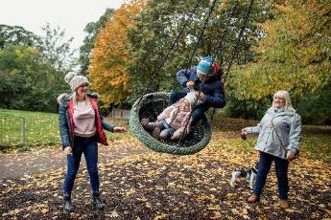
Where do we find Michelle?
At the school gates (or working in school)…
On the side of a GAA pitch...
In her local playground...

Slide 9

Where do we find Michelle?
At the school gates (or working in school)…
On the side of a GAA pitch...
In her local playground...
At her monthly Book Club…

Slide 10
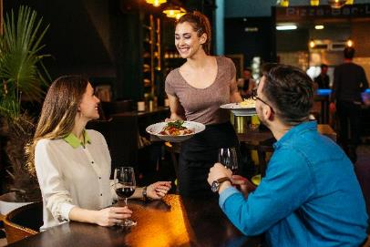
Where do we find Michelle?
At the school gates (or working in school)…
On the side of a GAA pitch...
In her local playground...
At her monthly Book Club…
Out for a night in a local
pub or restaurant...
Notes:
Can you think of anywhere else she’s likely to be?

Slide 11
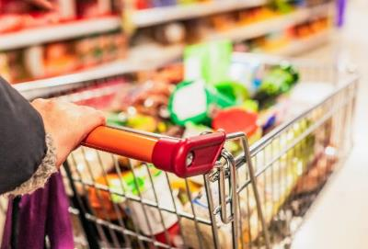
Where do we find Michelle?
At the school gates (or working in school)…
On the side of a GAA pitch...
In her local playground...
At her monthly Book Club…
Out for a night in a local
pub or restaurant...
In the supermarket
(or pharmacy or GP clinic)…

Slide 12
Who or what likely influences Michelle?
Notes:
Brainstorm this with the group.

Slide 13
Who or what likely influences Michelle?
Her husband and family.
Her two best friends – and wider circle of friends.
Other parents in her community.
Her parents and parents-in-law.
The Nationalist.
Newstalk, RTÉ Radio One, Today FM, Tipp FM.
Instagram influencers and ads.
Facebook posts and ads.
Notes:
Any other insights? Are we missing anything obvious here?
(The fact that she travels could be relevant – both for advertising targets and for tapping into her desire to be more adventurous / see more of the world AND / OR making the link with the countries she travelled to in her 20s.)

Slide 14
Your Advance Assignment
Notes:
50 min for this session
Did you all manage to identify and survey someone you know who fits a profile that’s broadly similar to Michelle?
What did you find out?
Did everyone speak to women?
Were they all in the 25-54 age-group?
Were they typically in relationships – and with children?

Slide 15
Your Research Findings:
Traditional / Legacy Media
Do they listen to their local radio station? If so, how often and in what circumstances?
Do they read / buy their local newspaper?
Do they ever read or buy a national newspaper? If so, which titles?
Online News
What news sites do they visit online, and how often?
Notes:
Give 4 different tables a spreadsheet sheet to write notes re:
Traditional / legacy media.
Online news sites.
Social media.
Wider influences.

Slide 16
Social Media
What social media channels do they use, and how?
How much time do they spend on social media each day?
What news-focused accounts do they follow on social media?
Do they click through to read full news articles from shorter social media posts?
How likely are they to share or re-post news-focused content that they come across on social media? And under what circumstances?
What celebrities / influencers do they rate on social media – and why?

Slide 17
Influences
Apart from official news sources, where do they find out about current affairs and issues affecting them and their families?
What people in their lives have a strong influence on shaping their opinions about current affairs?
Where do they socialise and what do they do for fun?
Are there local community spaces that they frequent?
How often – if ever – do they donate to an international development charity?
What influences them to donate?

Slide 18
Typical PR Tactics to Reach this Demographic
Notes:
30 min for this session

Slide 19
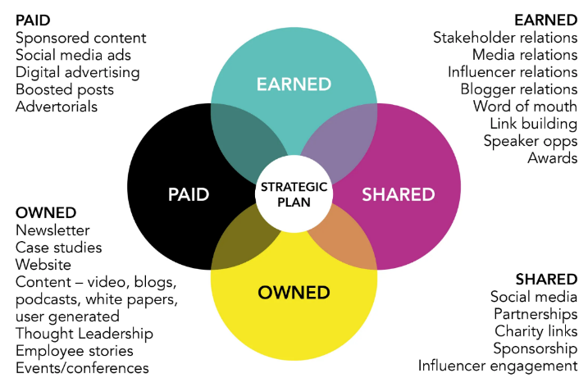
Communications Tactics - Overview
Paid = advertising you pay for.
Earned = coverage / endorsements you don’t pay for, but you have to work hard to get.
Shared = social networking, partnerships.
Owned = all content owned by you, and that you have full control over.
Notes:
Owned media doesn’t include social. While it’s true you produce the content that lives on your social channels, you don’t have ownership of it if that channel closes down.

Slide 20

News Media Consumption
70% of adults consume news media at least once per day.
Main sources of news : TV and online (excluding social media), which both sit at 32%.
Social media is at 20%; radio at 11%; and printed newspapers at 5%.
When looking at social media use for news, Facebook and WhatsApp usage peaks amongst 25-54s, with lower levels either side of those age bands.
YouTube, Twitter, TikTok, Snapchat and Reddit are used as a source of news most by those under 25.
Twitter has a relatively even spread across ages.
WhatsApp is dominant (72%) in the category of ‘social media used for any reason this year’. It saw an increase of +2pp over the previous year, continuing its steady growth since 2020.
Notes:
This is general info, not specific to our Empathiser audience.
Published in June 2023
https://www.dcu.ie/commsteam/news/2023/sep/dcu-fujo-researchers-provide-analysis-digital-news-report-ireland-2023

Slide 21
Facebook was down -2pp (to 61%), but remained most-used site for hosting a personal profile, with almost two-thirds of the population engaging with it.
Instagram saw growth from 2022 of +2pp (43%).
TikTok showed the biggest increase +5pp (24%), with a quarter of Irish respondents now using the platform, up from just 7% in 2020.
Listening to podcasts remains a very popular pastime in Ireland (44%), compared to other countries. Most popular category of podcasts is lifestyle (19%), followed by ‘specialist subjects’ (17%).
RTÉ is most popular digital brand (and offline brand): 1 in 4 people (24%) are consuming its content online.
Notes:
https://www.dcu.ie/commsteam/news/2023/sep/dcu-fujo-researchers-provide-analysis-digital-news-report-ireland-2023

Slide 22
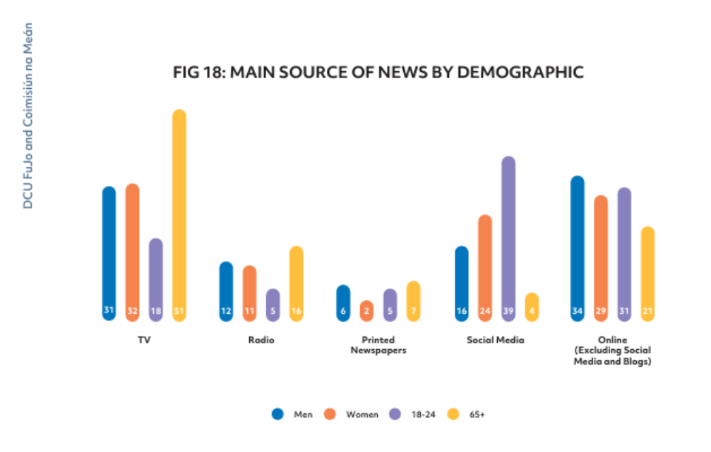


Slide 23
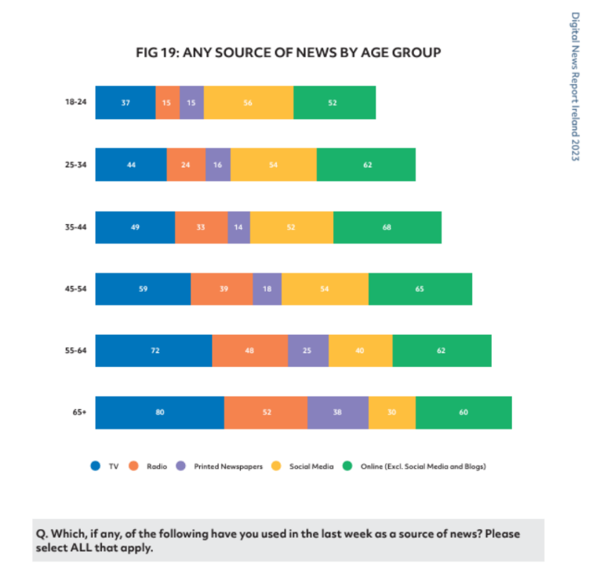
Empathisers

Slide 24
Permanent TSB Reflecting Ireland Research, July 2023
TV most popular medium for news consumption at 67% and radio at 53%, as consumers rate them as trusted, fair and balanced sources of news.
Online news websites also accounted for 53% of news consumption.
Trust in social media sources was low with only one in five adults trusting Facebook and Twitter as news sources and only one in seven trusting TikTok, Snapchat and Reddit.
More than a third of women said they are consuming less news than before, with only 27% of men reporting the same.
Notes:
Source: Permanent TSB Reflecting Ireland research from July 2023
https://www.irishtimes.com/business/2023/07/18/irish-adults-continue-to-engage-strongly-with-news-media-research-shows/

Slide 25
What social media channels to use to reach Empathisers?

Slide 26
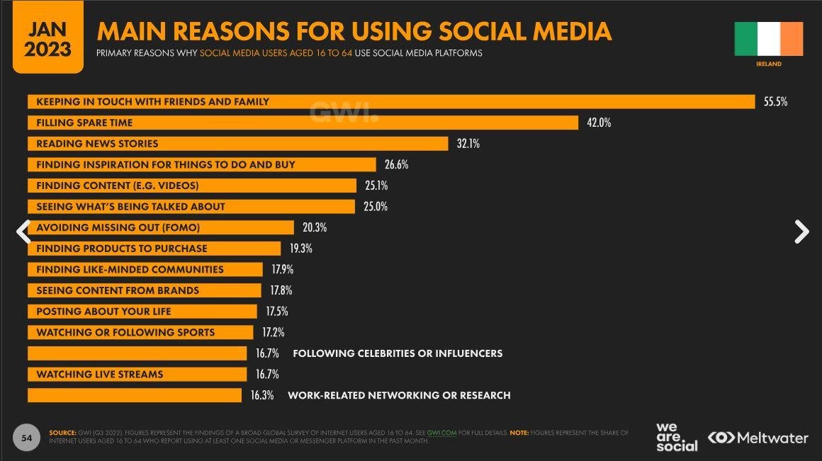
Notes:
Before we focus on individual channels, let’s look at how and why people use social media…

Slide 27
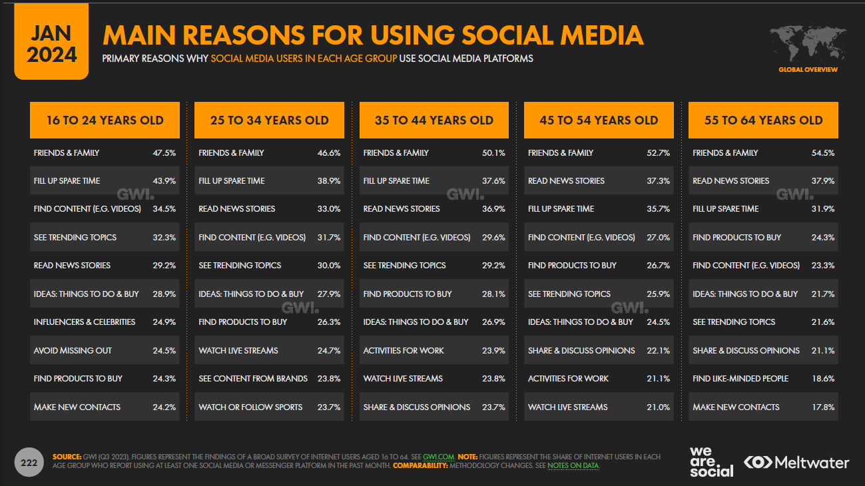
Empathisers

Slide 28
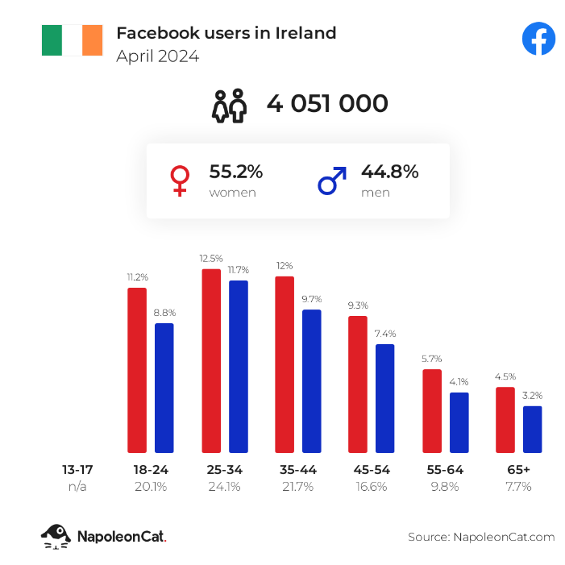
Facebook:
4,051,000 FB users in Ireland in April 2024 = 79.4% of entire population.
Majority (55.2%) are women.
People aged 25-34 make up the largest user-group.
Empathisers
Notes:
https://napoleoncat.com/stats/facebook-users-in-ireland/2024/04/

Slide 29
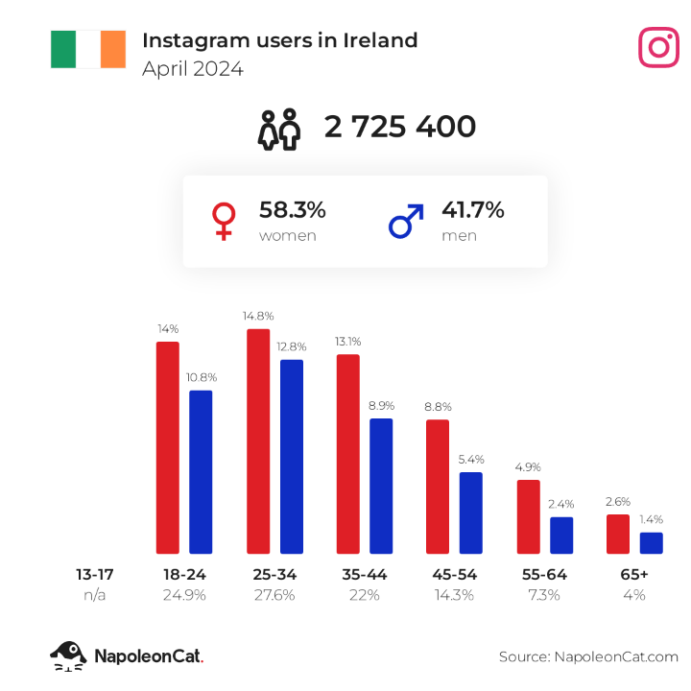
Instagram:
2,725,400 users in Ireland in April 2024 = 53.4% of entire population.
Majority (58.3%) are women.
People aged 25-34 make up the largest user-group.
Visually-led platform, shift toward video BUT still impact in static images/graphics.
Shift in content – more news, more political engagement.
Empathisers
Notes:
https://napoleoncat.com/stats/instagram-users-in-ireland/2024/04/

Slide 30
TikTok
Video-led platform.
2.1 million users in Ireland. Fastest-growing platform.
56% female / 44% male.
Assumption of younger audience, but TikTok reports that 1/3 of users are aged 35+.

Slide 31
LinkedIn
2.7 million users (53% of total population).
25-34 age-group most prominent.
46% female; 54% male.
Traditionally thought of as B2B.
‘Quality’ over ‘quantity’ content.
Big increases in conversations and content creation since 2020.
Content with images – 2x engagement.
Content with polls / document / image / video – up to 1.6x reach.

Slide 32
So, for an Alice client aiming to reach the ‘Empathiser’ demographic, what would we recommend?

Slide 33
Likely Tactics
Media relations – with pitches focused on TV news, current affairs / lifestyle / features shows (e.g. ‘Ireland AM’ or Ray D’Arcy on RTÉ Radio 1); special interest outlets (e.g. parenting sites, such as MummyPages.ie, or podcasts, e.g. ‘Catch-up with Louise McSharry’, ‘The Good Glow’ with Georgie Crawford, or Aldi’s ‘Mamia & Me’ podcast with Jen Hogan); lifestyle magazines or newspaper supplements (e.g. Saturday Irish Times Magazine).
Bespoke local media relations campaign(s), where relevant.
Good-quality photography, video content and case studies.
Facebook and Instagram for both organic and paid content.
Potential use of LinkedIn, Twitter and TikTok, depending on campaign objectives and client circumstances.
Influencer engagement, e.g. Aoibhinn Garrihy, Caroline Foran, Síle Seoige.
OOH advertising / niche events.
Notes:
TikTok use may depend on whether organisation is free to use it (public-sector organisations are not). LinkedIn could depend on whether there’s a workplace focus.
Síle Seoige’s podcast is popular also.

Slide 34
Likely Tone
Positive and upbeat.
Notes:
Avoid negative demands; people respond better to positive slogans.

Slide 35
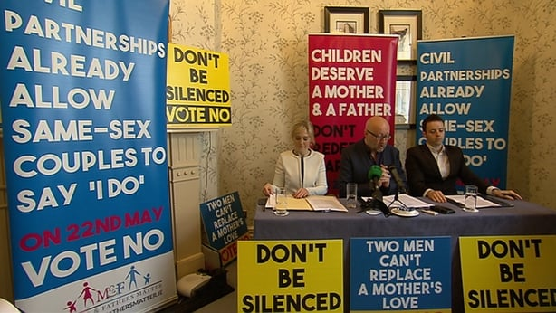
Notes:
Image credit: https://www.rte.ie/news/2015/0513/700748-kenny-marriage/

Slide 36
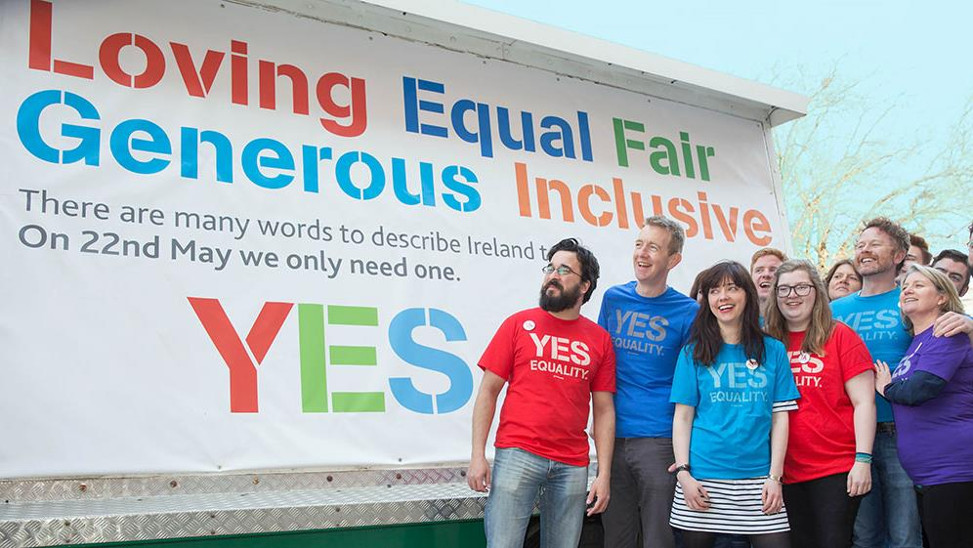

Slide 37
Likely Tone
Positive and upbeat.
Evoking empathy, rather than sympathy.
Notes:
Sympathy = othering. Throw people’s humanity in your target audience’s face. Start with what unites them, what makes them human, rather than what differentiates them. E.g. Rather than starting with “I’m a climate activist”, start with “All my life, I’ve loved the outdoors”…
Images of refugees in detention camps vs. story of a refugee who wants to come here to do good…

Slide 38
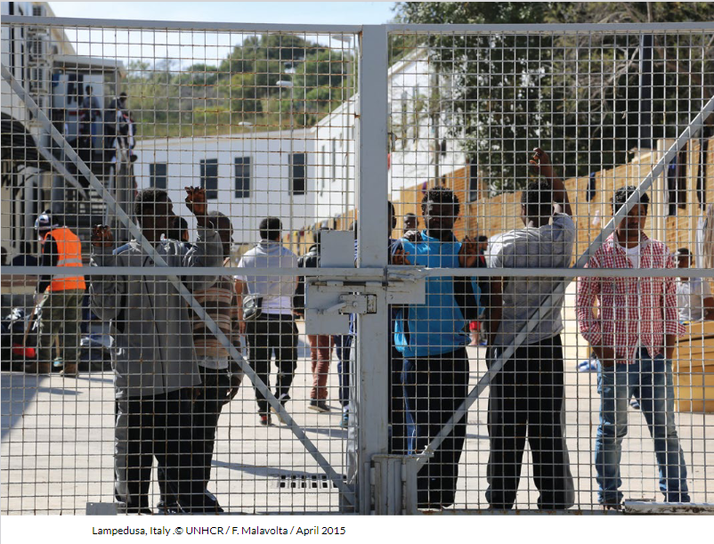
Notes:
Image taken from a ‘Beyond Detention’ report by the UNHCR.
Most people don’t live like this, so don’t empathise

Slide 39
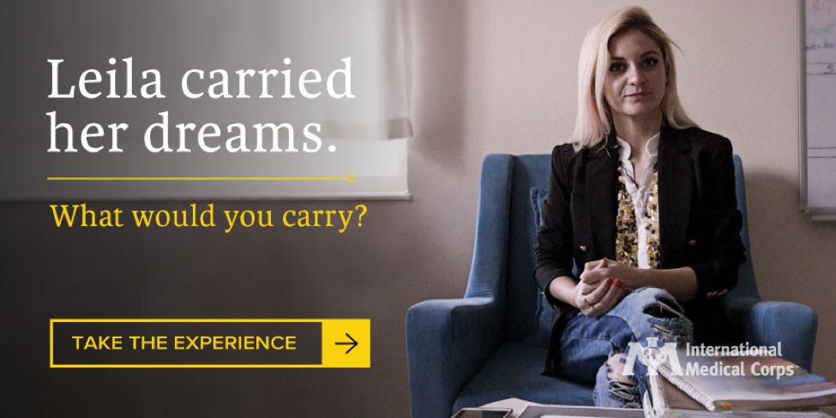
Notes:
People would find it much easier to empathise with this…
International Medical Corps, established in 1984, is a global, humanitarian, nonprofit organization dedicated to saving lives through health care training and relief. In order to spread awareness about the Syrian refugee crisis, International Medical Corps went one step further by using visual storytelling to provide a voice for refugees. “The Things We Carry” campaign, launched in March 2017 by International Medical Corps and the Conrad N. Hilton Foundation is an effort to keep public attention on the ongoing crisis in Syria.

Slide 40
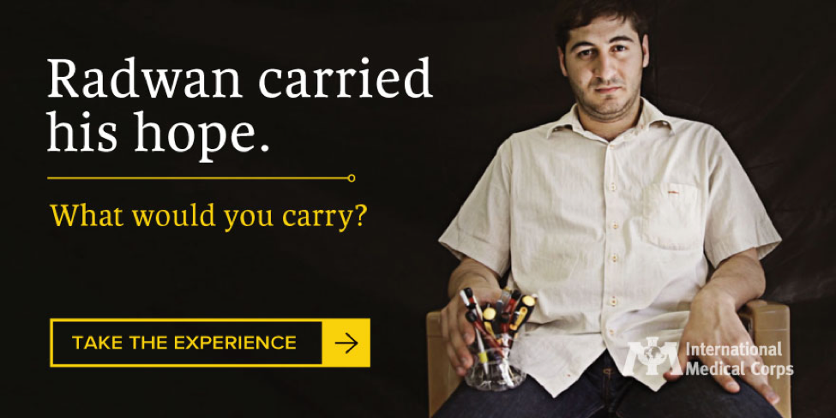

Slide 41
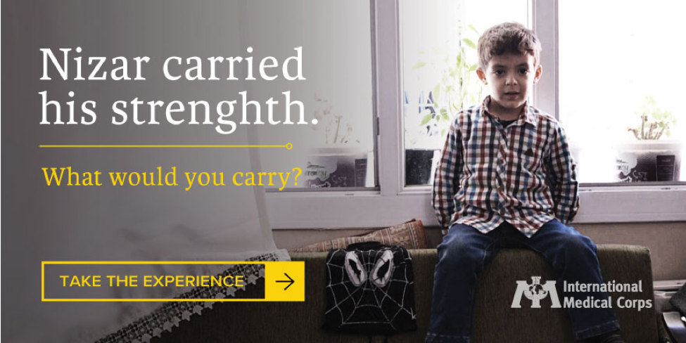

Slide 42
Likely Tone
Positive and upbeat.
Evoking empathy, rather than sympathy.
Jargon-free. Focused on outcomes, not policy (e.g. “having clean, safe air to breath and water to drink” vs. “mitigating climate change”).
Repetitive (say few things and say them often).
Notes:
People rate familiar ideas as more favourable, more convincing, and more positive.

Slide 43
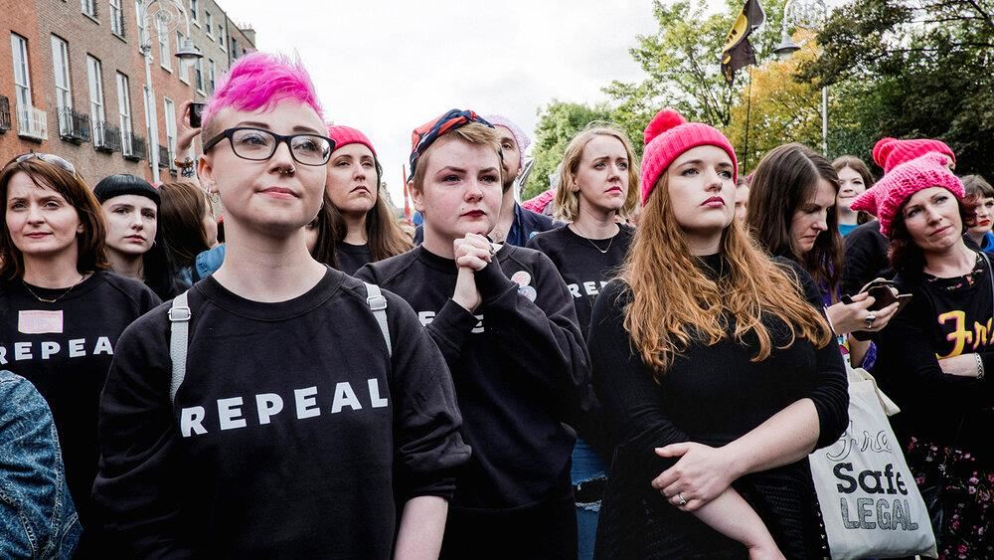
Notes:
Omnipresence of Repeal sweatshirts. Simple message being repeated everywhere.

Slide 44
Tea / Coffee Break
Notes:
15 min

Slide 45
Can we get creative in reaching the ‘Empathiser’ audience?
Notes:
45 min for this session – 10 min to describe previous campaigns; 20 min for their brainstorm; 15 min for reporting back on creative ideas.

Slide 46
The reach of a tactic should not always be the determining factor. Can you do smaller, more intensive activities – that might have lower reach but much higher impact?
Can you – very literally – meet the Empathisers where they are? In playgrounds, supermarkets, community spaces, exercise classes…?
Can you move beyond standard PR outputs to develop more creative and bespoke ways of engaging this audience?

Slide 47
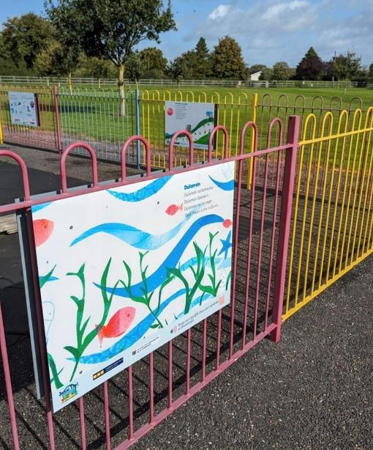
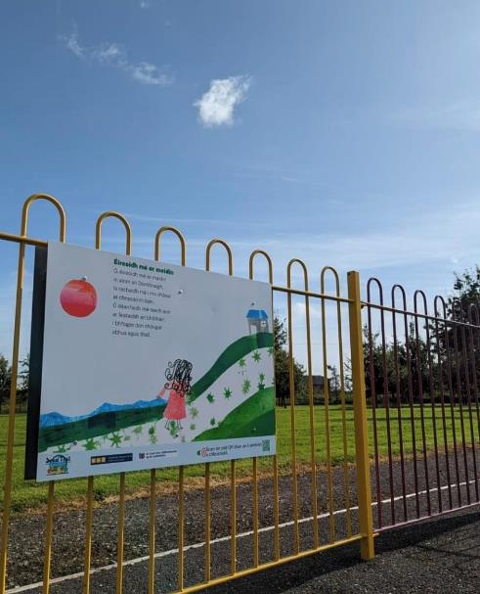
Notes:
My Irish Books have some of the pages of their books and illustrations around the railings of a playground in Meath..

Slide 48
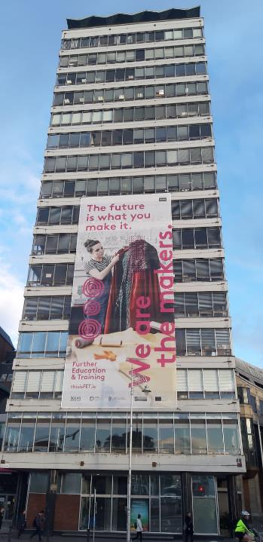
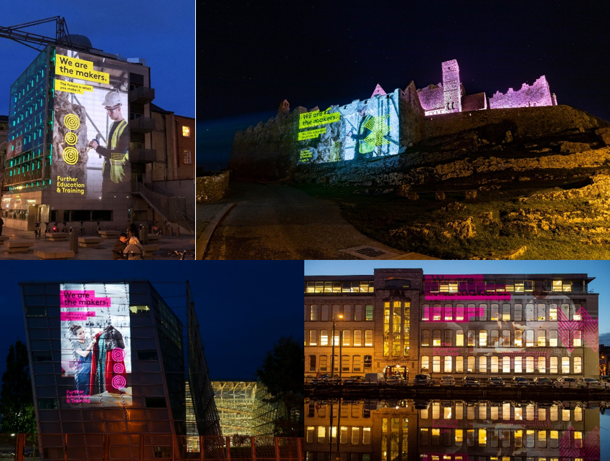
Notes:
Light projections in Dublin, Tipperary, Kildare and Cork for the launch of SOLAS’s This is FET campaign in 2019.
Barnardo’s Square, Dame Street, Dublin – adjacent to Dublin City Hall;
Cork College of Commerce;
Kildare Education and Training Board; and
The Rock of Cashel in Co. Tipperary.

Slide 49
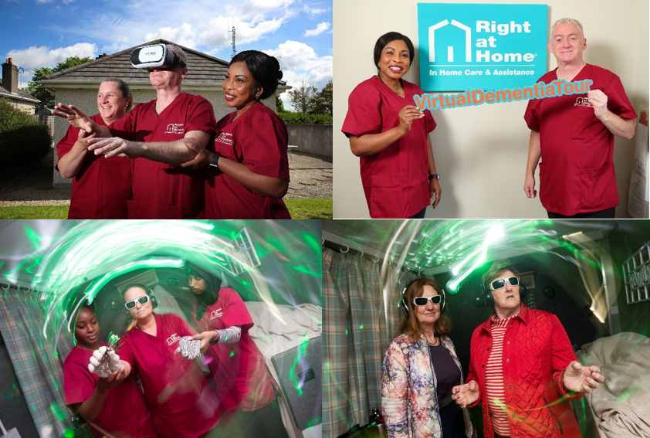
Notes:
Images from the Virtual Dementia Tour, which we brought to Ireland for Right at Home, a home-care provider.
Tour to regional locations; upskilling opportunities for RAH staff; opportunities for public engagement – as well as national and regional media campaigns.

Slide 50
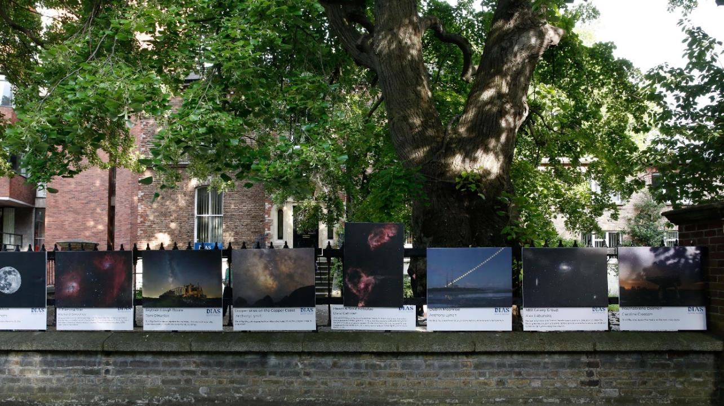
Notes:
The outdoor exhibition that was the culmination of DIAS’s astrophotography competition, ‘Reach for the Stars’, in its inaugural year (2020-2021).

Slide 51
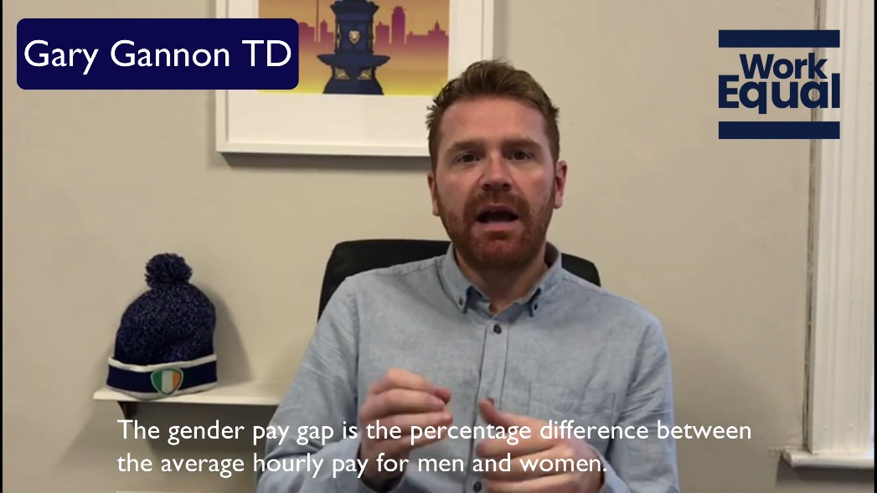
Notes:
https://www.youtube.com/watch?v=nkt2xDBQZSk&t=1s
2020 WorkEqual Campaign

Slide 52
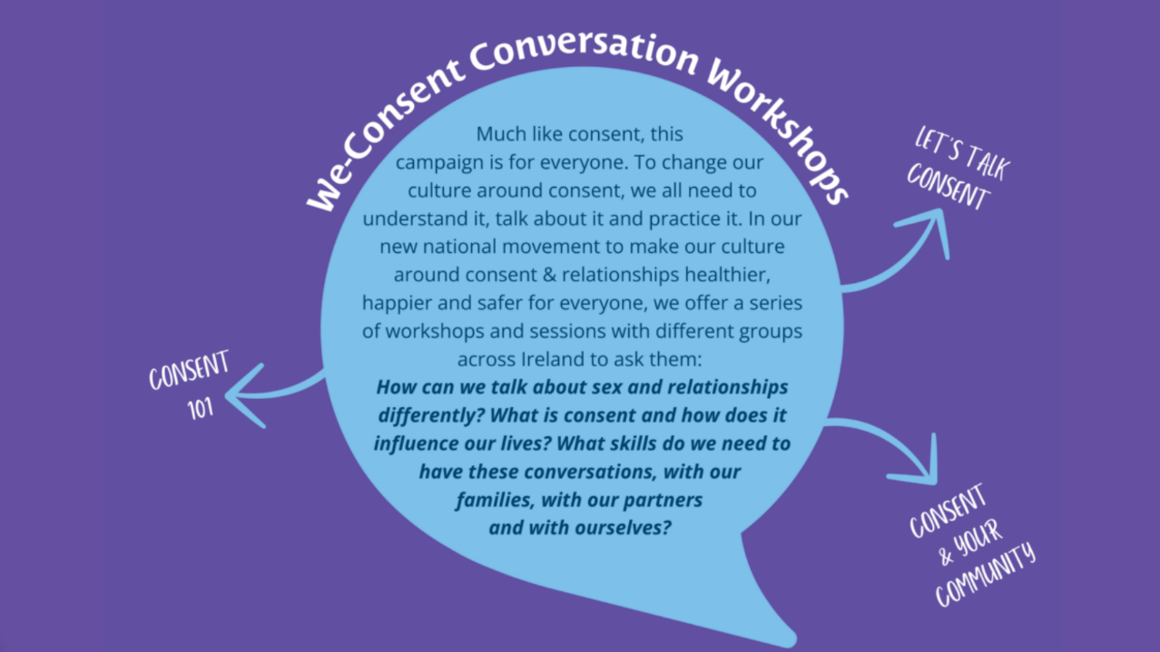
Notes:
DRCC’s We Consent campaign: https://www.we-consent.ie/get-involved/
These sorts of intimate conversations can work really well in tackling trickier topics, e.g. trans rights.

Slide 53
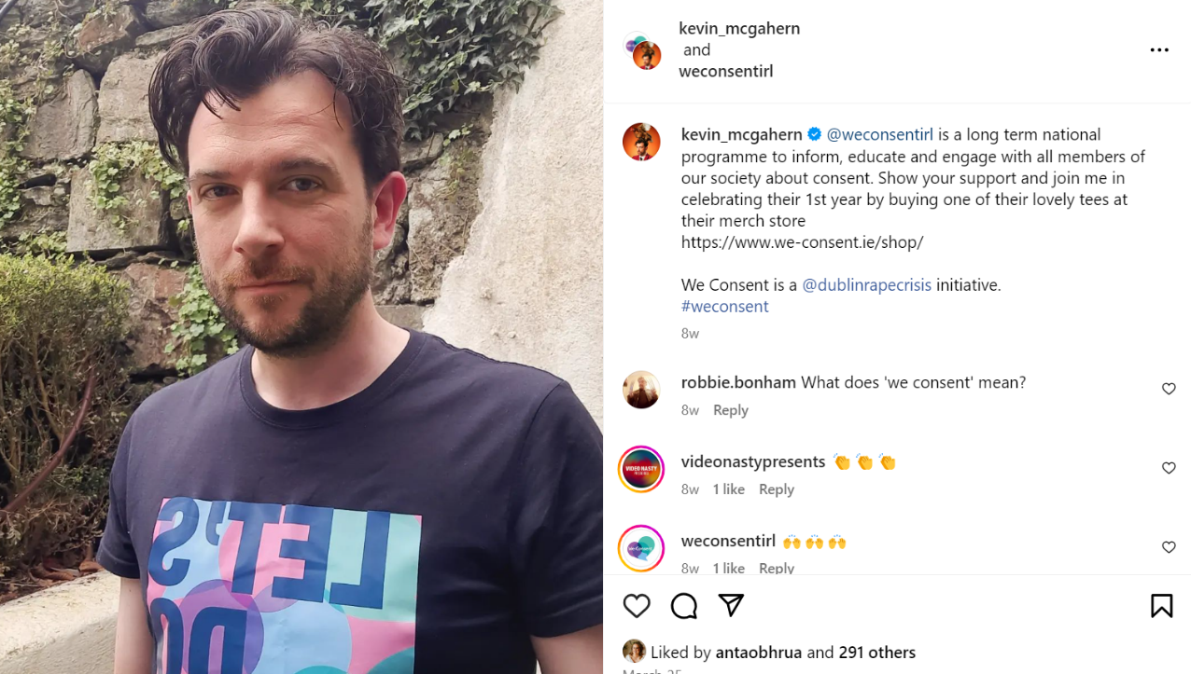
Notes:
Comedian & presenter Kevin McGahern

Slide 54
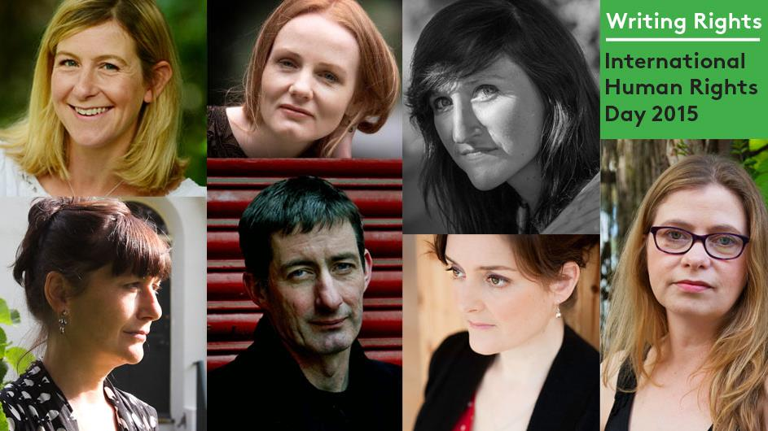
Notes:
The ‘Make Rights Real’ campaign for IHREC, 2015.
A key ‘win’ for the campaign was the establishment of a partnership with The Irish Times Book Club. Working closely with the Books Editor, Martin Doyle, we approached several well-known Irish authors to choose an article from the Universal Declaration of Human Rights, and write a creative response. These were published simultaneously on www.makerightsreal.ie and www.irishtimes.com to mark Human Rights Day 2015 and shared widely across the social media profiles of both organisations and by the participating authors themselves. Contributing authors included Martina Devlin, Nuala O’Connor, Martina Evans, Anakana Schofield and Eoin McNamee.

Slide 55
Over to you…
Working in small groups, can you develop one or more creative ideas for engaging the ‘Empathiser’ audience?
Notes:
20 min for their brainstorm; 15 min for reporting back on creative ideas.

Slide 56
Next Steps for your Individual Organisations
Notes:
10 min

Slide 57
Based on what we’ve discussed today, are there things you would change about campaigns that you’ve run in recent years?
Are there ways you can work today’s learnings into your future campaigns?

Slide 58
Wrap-Up
Notes:
Over to Claudia (5 min)

Slide 59
© Alice Public Relations 2024

