Slide 1

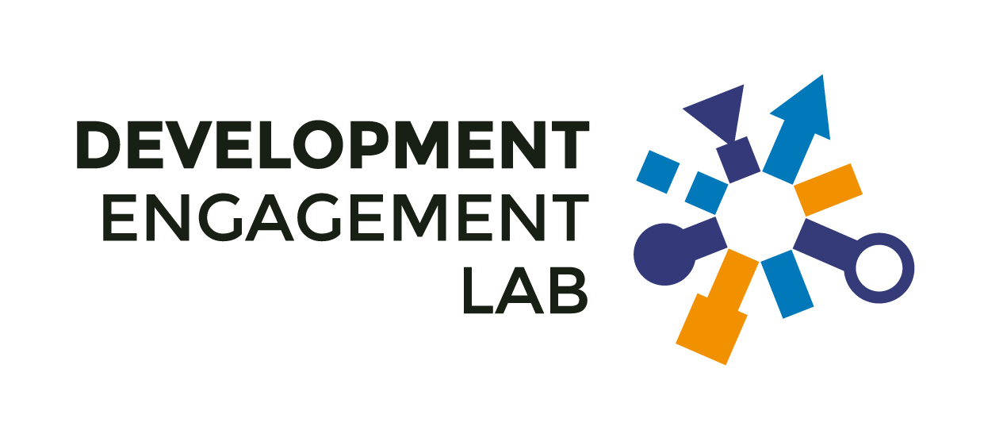
IRELAND’S ROLE IN A TIME OF AID CUTS,
GEOPOLITICAL TENSIONS, & DISINFORMATION
/ Dochas Worldview Wave 6
// October 2025
/// www.developmentengagementlab.org
David Hudson

Slide 2
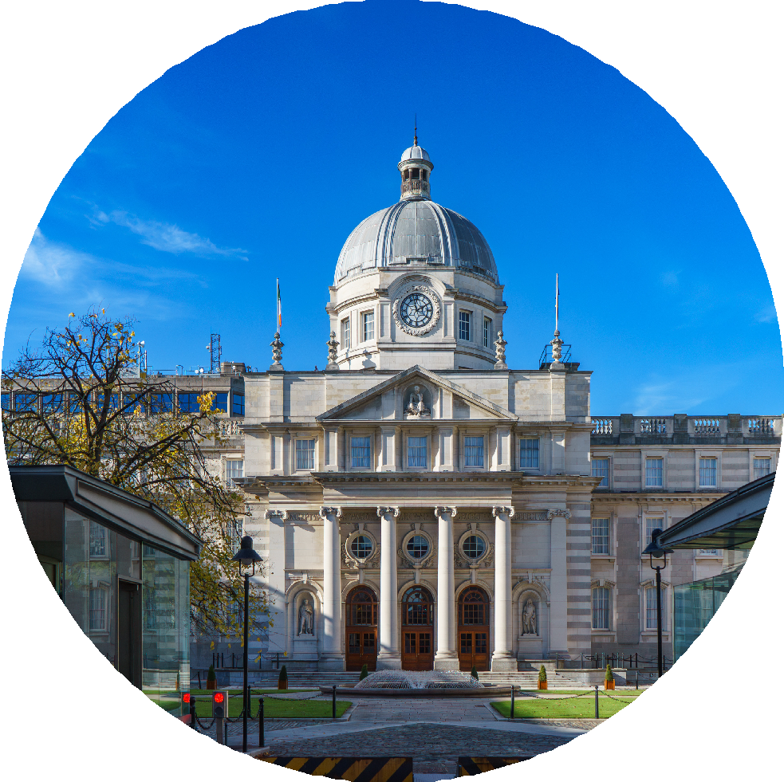
1. Irish public’s response to
aid cuts
2. Geopolitics, far right and
disinformation
13cm by 13cm
3. Ireland’s international
role

Slide 3
IRISH PUBLIC’S RESPONSE TO AID CUTS
Stay strong and multilateral

Slide 4


AID CUTS WILL IMPACT PEACE IN THE WORLD
56%
say that reducing aid will impact on peace in the
world
Impact world and Ireland
32%
Impact world only
24%
A majority of 56% of the Irish public say that if Ireland and other countries do not maintain current levels of ODA that it will
impact peace in the world.
And of this majority, three in ten say that it would affect not only the world but Ireland too (while a quarter reckon it will impact
the world but not Ireland).
Only 16% people think that a reduction in current levels of aid spending will impact neither the world nor Ireland, a minority
position.
Impact Ireland only 10%
Impact neither
16%
Don’t know
18%
0
25
50
75
100
Question: If Ireland and other countries do not maintain their current levels of aid funding, do you think it will impact peace in the world, and Ireland? | Base: IRL Adults | Sample size n= 2,002 | Data are weighted to
be nationally representative | Worldview Overseas Development Aid Survey | Fieldwork by B&A | Analysis by the Development Engagement Lab
©2025 | DEVELOPMENT ENGAGEMENT LAB

Slide 5
MULTILATERAL RESPONSE TO USAID CUTS
We told respondents that the U.S. (and others) had cut their aid spending and asked who they thought should fill the funding gap.
International organisations (e.g. UN, World Bank)
39
The top answer at 39% was international organisations such as the UN and the World Bank. While other bilateral donors was the bottom answer with only 14% of respondents selecting that option.
Businesses and corporations
32
Philanthropic trusts and foundations
23
Governments whose aid funding has been cut
20
Other top answers were the private sector (businesses and corporations) at 32% and philanthropic foundations at 23%.
No one should make up for US aid cuts
18
Development NGOs and charities
17
Religious organisations
16
Meanwhile, 18% said no one should fill the funding gap and 20% said recipient countries themselves should make up the shortfall.
Don’t know
15
Other countries that provide aid
14
Development NGOs and charities were not seen as the key way to fill the funding gap with only 17% of the Irish public selecting them.
0
10
20
30
40
Question: Recently, the United States, the largest ODA donor, reduced much of its aid funding, leaving
a $64 billion gap for overseas development aid. Many countries are also cutting their aid budgets in favour of defence spending. In your opinion, who should increase funding to help ﬁll the gap? | Base:
IRL Adults | Sample size n= 2,002 | Data are weighted to be nationally representative | Worldview
©2025 | DEVELOPMENT ENGAGEMENT LAB
Overseas Development Aid Survey | Fieldwork by B&A | Analysis by the Development Engagement Lab

Slide 6

IRELAND MUST MAINTAIN ODA AS OTHERS CUT
69%
of the Irish public believe the right response is to maintain or increase ODA
Increase our contribution
17%
Maintain current levels
52%
Around 7 in 10 of respondents want Ireland not to follow other countries in cutting Irish aid. Only 20% of the public think that the right response to aid cuts in other countries
is to also cut aid here.
Just over half of the Irish public want to at least maintain current levels of ODA
spending.
And 11% don’t know.
So how do preferences vary across the different Worldview segments?
Reduce our aid in line with others
20%
Don’t know 11%
0
25
50
75
100
©2025 | DEVELOPMENT ENGAGEMENT LAB
Question: How should Ireland respond when other countries reduce their aid budgets? | Base: IRL Adults | Sample size n= 2,002 | Data are weighted to be nationally representative | Worldview Overseas Development Aid Survey | Fieldwork by B&A | Analysis by the Development Engagement Lab

Slide 7

MAINTAIN IS MAJORITY VIEW ACROSS SEGMENTS
60%
of the Disengaged want to reduce aid in responses to cuts by other countries
Disengaged
Empathisers
Pragmatists
%
11%
13%
Increase our contribution
Maintain current levels
26%
58%
66%
Reduce our aid in line with others
60%
17%
0%
Don’t know
13%
15%
11%
The disengaged segment is the odd one out – the only segment of the public to have a majority preference to cut.
Equally, no other segment has a majority view of increasing aid.
As we’ve seen in other DEL research, this is very much in line with the sense of the public wanting us to ‘do our bit’, but not necessarily do more than others.
Multilateralists
22%
55%
11%
11%
Community champions
Global citizens
27%
53%
11%
9%
Increase our contribution
38%
Maintain current levels
55%
Reduce our aid in line with others
%
Don’t know
%
0
25
50
75
100 0
25
50
75
100 0
25
50
75
100
©2025 | DEVELOPMENT ENGAGEMENT LAB
Question: How should Ireland respond when other countries reduce their aid budgets? | Base: IRL Adults | Sample size n= 2,002
| Data are weighted to be nationally representative | Worldview Overseas Development Aid Survey | Fieldwork by B&A | Analysis by the Development Engagement Lab

Slide 8
GEOPOLITICS, FAR RIGHT AND DISINFORMATION
Fear and concern at state of the world is strikingly
high

Slide 9

MAJORITY CONCERN OF GEOPOLITICAL TENSIONS
81%
are concerned about conflicts, trade, and shifting alliances
40
30
20
43
A very large majority of the Irish public are concerned (very or fairly) about geopolitical tensions.
Only 13% say that they are unconcerned by ongoing conflicts, trade wars, and shifting alliances.
It is rare to see such a large majority on any survey question, suggesting that this is something that is true almost across the board. But who is more or less likely to be concerned?
©2025 | DEVELOPMENT ENGAGEMENT LAB
38
10
10
6
3
0
Very concerned
Fairly concerned
Fairly unconcerned
Very unconcerned
Don’t know
Question: How concerned are you about growing geopolitical tensions around the world (e.g. conﬂicts, trade wars, shifting alliances)? | Base: IRL Adults | Sample size n= 2,002 | Data are weighted to be nationally representative | Worldview Overseas Development Aid Survey | Fieldwork by B&A | Analysis by the Development Engagement Lab

Slide 10
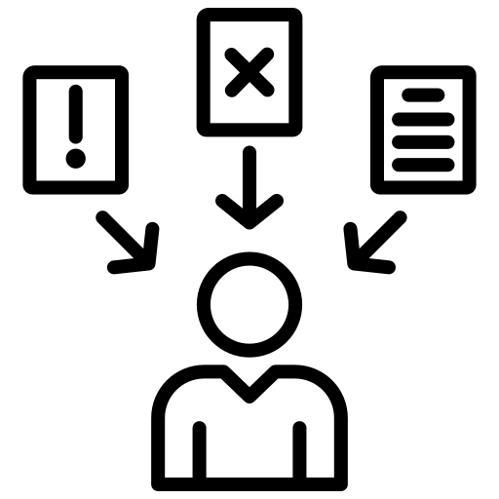
CONCERN ABOUT MIS- AND DISINFORMATION
80%
are concerned about mis- and disinformation in
Ireland
Very concerned
43%
Fairly concerned
37%
Not very concerned 11%
Similar to concern about geopolitics, concern about misinformation is almost universal. Around four in five people (80%) say they’re concerned, with nearly half (43%) “very concerned. suggesting that misinformation feels close to home
— not just an abstract or global issue.
Only a small minority (15%) say they’re unconcerned. Mis- and disinformation are seen as a major problem across Irish society.
Not at all concerned 4%
Don’t know 5%
0
25
50
75
100
Question: How concerned are you about the rise of misinformation and disinformation in Ireland today? | Base: IRL Adults
| Sample size n= 2,002 | Data are weighted to be nationally representative | Worldview Overseas Development Aid Survey | Fieldwork by B&A | Analysis by the Development Engagement Lab
©2025 | DEVELOPMENT ENGAGEMENT LAB

Slide 11

MAJORITY CONCERN ABOUT RISE OF FAR-RIGHT
73%
are concerned about the rise of the far-right around
the world
Very concerned
43%
Fairly concerned
30%
Concern about far-right politics is almost as widespread and intense. Almost eight in ten (73%) say they’re concerned, with nearly half (43%) very
concerned.
This level of concern suggests Irish people see the rise of far-right movements as a serious global risk, not just a distant political trend affecting other countries and not them personally.
Not very concerned 13%
Not at all concerned 7%
Don’t know 7%
0
25
50
75
100
©2025 | DEVELOPMENT ENGAGEMENT LAB
Question: How concerned are you about the rise of far-right political sentiment around the world? | Base: IRL Adults | Sample size n= 2,002 | Data are weighted to be nationally representative | Worldview Overseas Development Aid Survey | Fieldwork by B&A | Analysis by the Development Engagement Lab

Slide 12
FUTURE FORWARD
People believe that Ireland has a role to play
in the world

Slide 13

NEED AND MUTUAL INTERESTS ARE KEY FOR ODA
The distribution of the primary purpose of Irish aid looks similar to other countries DEL has surveyed in. It skews to need, but the most common answer – increasingly – is that most people want balance. Around a quarter (25%) believe Ireland’s aid should balance national interests with global poverty
reduction.
A further one in five (19%) think the primary purpose should be reducing poverty, placing people in developing countries at the heart of aid.
The shape of the distribution shows broad public support for Ireland’s aid having a moral and global focus, rather
than being self-serving.
The Irish public tends to see aid as both principled and pragmatic – a mix of compassion and shared benefit.
25
20
15
25
10
19
5
10
5
7
6
5
6
6
3
4
4
0
0 – The primary 1 purpose of Irish
aid spending should
be to promote Irish national interests
2
3
4 5 – The primary 6 purpose of Ireland’s
aid spending
should be both reducing poverty in developing countries and promoting Irish national interests
7
8
9 10 – The primary DK purpose of
Ireland’s aid
spending should be to reduce poverty in developing countries
©2025 | DEVELOPMENT ENGAGEMENT LAB
Question: The Irish government gives ODA to developing countries. Looking at the scale below, what do you think the primary purpose of Ireland’s aid
spending should be? | Base: IRL Adults | Sample size n= 2,002 | Data are weighted to be nationally representative | Worldview Overseas Development Aid Survey | Fieldwork by B&A | Analysis by the Development Engagement Lab

Slide 14
VIEWS ON AID PURPOSE SHAPED BY VALUES
People with a university education score about 0.5 points higher (on the 0–10 scale) in believing that Ireland’s aid should prioritise reducing poverty. Women are also more supportive (+0.35), as are older generations, especially Baby Boomers (+0.75) and the Silent Generation (+1.36).
Younger respondents, particularly Gen Z (– 0.54) and Millennials (–0.62), are significantly less supportive of poverty reduction as the main purpose. Catholics lean more toward national-interest views (–0.751), while income, region, and urban– rural differences are not significant.
The socio-demographic effects remain largely intact but are somewhat smaller, suggesting that Worldview explains part of those differences. Among segments, Community Champions (+1.87) and Pragmatists (+0.68) are most aligned with seeing aid as about reducing poverty, while Disengaged respondents (–1.43) are much
less so.
Global Citizens (+0.54) also lean toward a poverty-focused view, whereas Multilateralists show no significant difference from the reference group.
Socio-demographics
+ Segments
Gender: Female
Generation: Generation Z Generation: Millennial Generation: Baby Boomer Generation: Silent Generation Education: University
Household income: €50-€100k Household income: More than €100k
Religion: Catholic Region: Dublin Living: Urban
Segment: Disengaged Segment: Pragmatists Segment: Multilateralists
Segment: Community champions Segment: Global citizens
-2
-1
0
1
2 -2
Average Marginal Effect
-1
0
1
2
Not Significant Significant
Question: The Irish government gives ODA to developing countries. Looking at the scale below, what do you think the primary purpose of Ireland’s aid
spending should be? | Base: IRL Adults | Sample size n= 2,002 | Data are weighted to be nationally representative | Worldview Overseas Development Aid Survey | Fieldwork by B&A | Analysis by the Development Engagement Lab | Modelled the average marginal effect of each predictor on the 0–10 scale of perceived purpose of Irish aid using weighted linear regression. Reference category for the categorical variables. Generation: Generation X, Household income: Less than C50k, Segment: Empathisers
©2025 | DEVELOPMENT ENGAGEMENT LAB

Slide 15
MUTUAL INTEREST ACROSS ALL SEGMENTS
Across (almost) all segments, the midpoint (score 5) — where people see aid as serving both Ireland’s interests and global poverty reduction — attracts the largest share of
responses.
Community champions are the most globally oriented: 38% choose 10 (poverty reduction only), with very few selecting
national-interest options.
Disengaged respondents stand out as the most divided group — with noticeable peaks at both 0 (Irish interests) and 5 (balanced), showing the least coherent
view.
Empathisers cluster most strongly around the middle (5), suggesting a moderate but consistent belief in mutual benefit.
Pragmatists, Multilateralists, and Global citizens also lean toward the global end (8–10), but with slightly more spread across the middle values than the champions or
multilateralists.
Overall, the segments differ mainly in how strongly they emphasise the global vs. national purpose of aid — not in whether they see a balance between the two. There are large constituencies in all segments for
mutual interest.
Disengaged
Empathisers
Pragmatists
40
30
20
22
28
26
24
10
21
9 9
7
₈ 10 ₆
9
14
13
9
9
4
1
3
4
4
7
4
6 ₅
4
3
1
5 4
3
7
5
4
2
0
0
40
Multilateralists
Community champions
Global citizens
30
20
38
28
22
22
10
18
21
9
7 7
7
9
₈ 11 ₈
7 ₇
6 6 7 6 6
5
4
4 4 4 4
3
2 2 3 2
2 1
0 1 2 3 4 5 6 7 8 9 10 DK
0
1
0 1 2 3 4 5 6 7 8 9 10 DK 0 1 2 3 4 5 6 7 8 9 10 DK
Question: The Irish government gives ODA to developing countries. What do you think the primary purpose of Ireland’s aid spending should be? 0 – The primary purpose of Irish aid spending should be to promote Irish national interests - 10 – The primary purpose of Ireland’s aid spending should be
to reduce poverty in developing countries | Base: IRL Adults | Sample size n= 2,002 | Data are weighted to be nationally representative | Worldview Overseas Development Aid Survey | Fieldwork by B&A | Analysis by the Development Engagement Lab
©2025 | DEVELOPMENT ENGAGEMENT LAB

Slide 16

IRELAND HAS A ROLE TO PROMOTE PEACE
71%
believe Ireland has a role to play in promoting peace and stability globally
Yes
71%
No
17%
An overwhelming majority (71%) of people in Ireland believe their country has a role to play in promoting global peace and stability.
Only around one in five (17%) disagree, showing broad national consensus that Ireland should be an active, positive actor internationally.
This finding aligns with Ireland’s strong self- image as a neutral but principled country— valuing peacekeeping, diplomacy, and humanitarian work.
The result provides a clear public mandate for maintaining Ireland’s global engagement through aid, peacebuilding, and international cooperation.
Don’t know
13%
0
25
50
75
100
Question: Do you believe Ireland has a role to play in promoting peace and stability globally? | Base: IRL Adults | Sample size
n= 2,002 | Data are weighted to be nationally representative | Worldview Overseas Development Aid Survey | Fieldwork by B&A | Analysis by the Development Engagement Lab
©2025 | DEVELOPMENT ENGAGEMENT LAB

Slide 17
OVERWHELMING CONSENSUS ACROSS SEGMENTS
Overwhelming consensus among engaged segments: Support is near universal among Community Champions (93%), Pragmatists (83%), Multilateralists (78%), Global Citizens (78%), and Empathisers (78%) — showing that across most Worldview segments, there’s strong belief that Ireland should play a role in promoting peace and stability globally.
Only among the Disengaged does it come close to a majority (49%) saying No.
The scale of agreement is striking: Even the least enthusiastic of the engaged segments still show more than four in five in favour — suggesting that the principle of Ireland as a peaceful actor has deep, cross-cutting resonance across values and politics.
It is one of the most unifying findings in the data — bridging ideological divides and reaffirming Ireland’s self-image as a positive, outward-looking force.
Disengaged
Empathisers
Pragmatists
Yes
32%
72%
83%
No
49%
12%
8%
Don’t know
19%
16%
9%
Multilateralists
Community champions
Global citizens
Yes
78%
93%
78%
No
0%
%
12%
Don’t know 12%
%
9%
0
25
50
75
100 0
25
50
75
100 0
25
50
75
100
Question: Do you believe Ireland has a role to play in promoting peace and stability globally? | Base: IRL Adults | Sample size
n= 2,002 | Data are weighted to be nationally representative | Worldview Overseas Development Aid Survey | Fieldwork by B&A | Analysis by the Development Engagement Lab
©2025
| DEVELOPMENT ENGAGEMENT LAB

Slide 18
HUMAN RIGHTS, DEMOCRACY, RULE OF LAW
Ireland’s history promoting human rights and a soft-power identity is clear. People overwhelmingly want Ireland’s contribution to peace to come through values-driven and humanitarian means.
Promoting human rights, democracy,
and the rule of law (67%)
  Supporting humanitarian relief
efforts (64%)
Promoting human rights, democracy, and rule of law
67%
Supporting humanitarian relief efforts
64%
Contributing to international peacekeeping (e.g., UN)
57%
Contributing to UN peacekeeping (57%) and supporting diplomacy and
mediation (56%)
Supporting diplomacy, mediation, and conflict resolution
56%
Leading by example through neutrality & peaceful policy
56%
About half (49%) favour long-term development aid and just over two in five (42%) back advocating nuclear disarmament — both consistent with Ireland’s tradition of neutrality.
Much less emphasis on asylum or direct protection. Only one-third (33%) mention offering asylum, suggesting most see Ireland’s role as principled influence abroad rather than domestic
action.
Providing long-term development ODA
49%
Advocating for nuclear disarmament and non-violence
42%
Offering asylum and safe haven for people fleeing war
33%
Other (specified) 1%
0 25 50 75 100
Weighted percent (among those who said 'Yes')
Question: In your opinion, in what way should Ireland contribute to global peace and stability? | Base: IRL Adults | Sample size n= 2,002 | Data are weighted to be nationally representative | Worldview Overseas Development Aid Survey | Fieldwork by B&A | Analysis by the Development Engagement Lab
©2025 | DEVELOPMENT ENGAGEMENT LAB

Slide 19
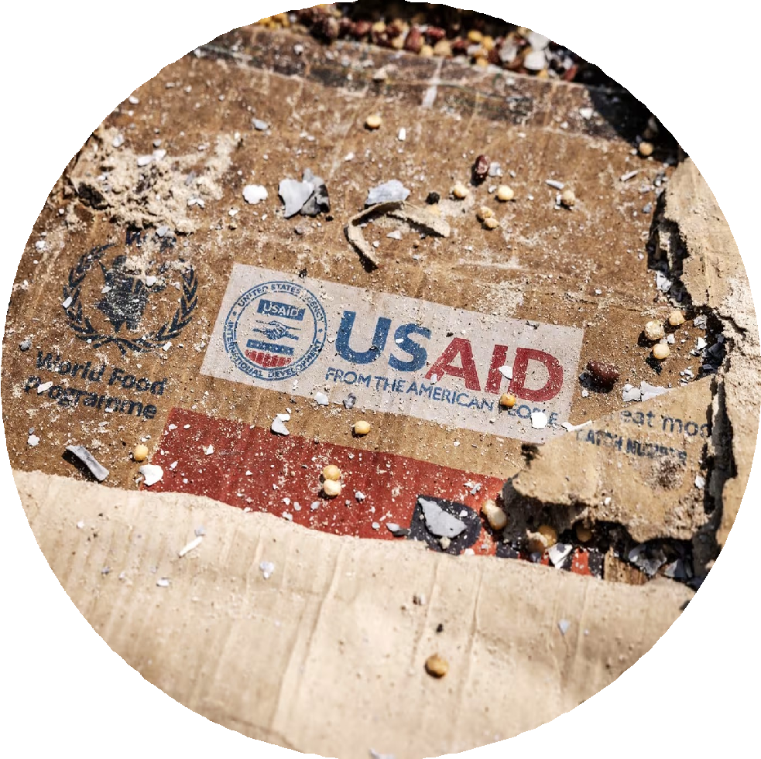
IMPLICATIONS
AID CUTS
The public believes aid matters for
peace: around 56% say cutting aid
threatens peace — reinforcing that
ODA is seen not just as charity but as a
serious international public &
diplomatic policy
Ireland should lead, not follow: 69%
want Ireland to maintain or increase
aid even as others cut
But multilateralism matters: The
instinctive public response is collective
action — UN, World Bank, business,
and philanthropy — showing that collaboration legitimises leadership
Frame Ireland’s aid stance as
protecting peace through partnership
— a quiet but firm defence of multilateralism and global stability
13cm by 13cm

Slide 20
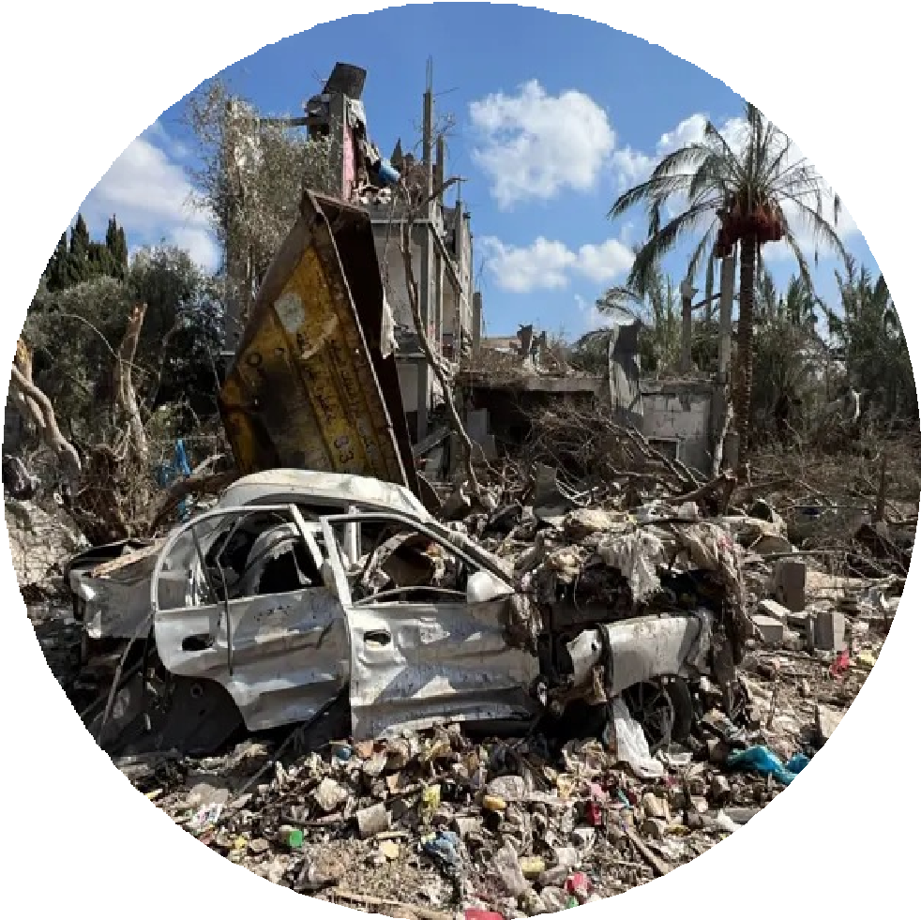
IMPLICATIONS “THE WORLD!”
Anxieties are near-universal: Over 70- 80% are concerned about geopolitical tensions, misinformation, and the far
right
Trust divides the country: The Disengaged are markedly less concerned — highlighting a polarisation between the globally attentive and those tuning out
Ireland’s strength is calm conviction: The data suggest a population that’s uneasy about global instability but prefers steady, cooperative responses
Ireland’s diplomatic and communications posture should acknowledge global fear but channel it into reassurance and bridge-building
13cm by 13cm

Slide 21

IMPLICATIONS IRELAND’S ROLE
People believe that Ireland very much has a role to play in the world
Strong consensus on global engagement: 71% believe Ireland has a role to play in promoting peace and stability; cuts across ideology and identity.
A values-led vision: People want Ireland to contribute via human rights, democracy, peacekeeping, diplomacy, and long-term aid.
Ireland’s foreign policy sweet spot is principled pragmatism — standing firm on values, working multilaterally, and communicating moral leadership without moralising.
¹0cm x 10cm and tilt 23*

Slide 22
The Development Engagement Lab (DEL) is a five-year study of public attitudes and engagement with global development in France, Germany, Great Britain, and the United States (2018-2023).
The Development Engagement Lab
(Aid Attitudes Tracker Phase 2) has three goals:
Co-production of an evidence base for development campaigning
Enabling collaboration across the sector
Increasing advocacy capacity through the sharing of research and strategic insights
DEL is a partner focussed research programme, convening and co-producing research and insights with over 30 international development NGOs and government agencies to understand the
drivers of engagement and inform development communications.
You can find out more information about DEL research at www.developmentcompass.org, follow us on Twitter @DevEngageLab or by contacting del@ucl.ac.uk.
Fieldwork is carried out by YouGov and surveys are weighted to be a nationally representative of the adult population. DEL is funded by the Bill & Melinda Gates Foundation and led by Professor Jennifer Hudson (University College London) and Professor David Hudson (University of Birmingham).
Cover photo: manzur alam on Unsplash

