Slide 1
DÓchas worldview wave 5
Qualitative report
Image Deep Dive
November 2024
24-028629-01
Prepared by: Neil Douglas

Slide 2
Objectives
Approach
Segments
Pre-task
Issues that catch public imagination and provoke a desire to respond.
Reactions to images identified as likely to provoke an emotional response (from Development Engagement Labs).
Variations by segment to understand what motivates a desire to respond.
6 face to face groups across Ireland
Spontaneous review of global issues that matter
Detailed exploration of selected images
2 x Empathisers
1 x Global Citizens
1 x Multilateralists
1 x Pragmatists
1 x Disengaged
(Community champions considered similar to global citizens)
All asked to identify recent international events that moved them deeply
Something that left you feeling hopeless
Something that left you wanting to take action

Slide 3
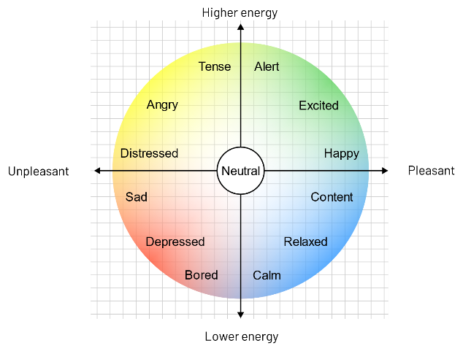
Circumplex model used in groups
With each image, respondents were encouraged to look at the screen and then note down their emotional response before discussing their feedback in the group.
Thus, we captured (as far as possible) their ‘system one’ or gut reactions at a personal level before exploring other layers of reactions and interpretations (system two).

Slide 4
Factors influencing reactions to images
IMPACT
Each variable had an influence on responses and a strong or weak performance on any of these could alter overall assessments.
PHOTOGRAPHIC FIDELITY
PROTAGONIST MEANING
AUTHENTICITY OF SCENARIO
VIEWER CONNECTION
STORYTELLING POWER

Slide 5
Unpacking the key factors
IMPACT
Immediacy of the image in arresting attention can make a big difference to reactions
Most are exposed to a lot of visual content daily and have become adept at quickly screening out images that do not reach a certain level of impact.
Essentially, impact tends to be generated by the sense of drama portrayed in combination with the sense of novelty of the image
Will this image standout from other images?
Does this image portray something new?

Slide 6
Unpacking the key factors
PROTAGONIST MEANING
A lot of these images draw attention to an individual protagonist
Sometimes juxtaposed with others or in a particular relationship with their environment.
Thus, reactions are often largely influenced by perceptions of the protagonist’s situation, or their relationship with others.
In particular, respondents react strongly to a sense of a protagonist’s:
Vulnerability
Jeopardy
Emotional state

Slide 7
Unpacking the key factors
VIEWER CONNECTION
It is clear that some images connect more strongly than others.
At times, respondents almost immediately reference their reactions in terms of similar experiences in their own life.
This relatability can operate at an almost unconscious / gut level or can emerge more slowly from consideration and comparison.
The more immediate response tends to be more intense emotionally but the ‘considered’ form of relatability can be strongly moving too (as more of a ‘depth charge’ that is revealed over time).
Another aspect of ‘viewer connection’ comes from the sense that the viewer has a role to play. Does the protagonist need something? Can the viewer do anything to help?
Note, this last aspect of connection can be critical in leveraging a ‘call to action’ effect.

Slide 8
Unpacking the key factors
STORY TELLING POWER
As respondents discuss their reactions it is evident that some images ‘unfold’ with more sense of a background story than others.
Thus, a story that is expressed with clarity tends to have more effect (particularly if it can be interpreted as connecting to a current international issue).
In a similar way the ‘story’ may have a symbolic meaning that is more or less engaging (motherhood, sibling care, etc.).
Also, in some cases there can be a sense of layers to the story where there is more depth to the photo as it is considered for longer.

Slide 9
Unpacking the key factors
AUTHENTICITY OF SCENARIO
Initially, something which respondents ‘intuit’ is their sense that an image is more or less authentic.
Over time they can pick out elements that undermine or support the credibility of an image.
At the most obvious level is the sense that an image is a ‘candid moment’ from someone’s life or a more ‘staged arrangement’.
Note, there can also be a rapid negative response when respondents feel there is a deliberate intention to manipulate their reaction
A highly emotive scene that has been engineering for effect.
Keep in mind that people are ‘trained’ by daily experience to discern the difference between photoshopped/AI generated images and reality.
A perceived link to an active news story also supports a sense of authenticity and recency.

Slide 10
Unpacking the key factors
PHOTOGRAPHIC FIDELITY
The simple quality of a photo has an influence on reactions
Is the protagonist easy or difficult to make out from the background detail?
Is there dramatic use of colour or a more neutral tone?
Is the viewer drawn into the scene by the protagonist’s eye contact?
The images with more emotional impact are often also simply better quality photos.

Slide 11
Provocation to support international aid
Linking emotions to a bigger issue can help.
However ‘Big issues’ can actually act as a source of inaction/ hopelessness if they are expressed without connection to possible ways to help.
NEGATIVE EMOTION TRIGGERS
POSITIVE EMOTION TRIGGERS
Emotional connection to protagonist (especially a child) and their experience.
Clear sense there is a way to help their predicament.
Linking the problem shown to bigger issue/injustice (and anger about this).
Evidence of positive impact of aid (before and after).
Concrete and proportionate so it is also relatable and authentic (helps diffuse concerns that money will not reach recipient).
Linked to bigger story (long term resilience etc and sense of hope about this).
Notes:
This slide could be used stand-alone for investor days, proposals & pitches

Slide 12
Elements that inhibit desire to act
Inauthentic or staged scenario.
No apparent problem or need expressed in the image
Protagonists seem happy, healthy and/or affluent.
(this came up across the groups, most prominent with Disengaged)
No clear way to make a difference, and/or concern that potential donations will not reach recipient.
Something about the image does not ring true or viewer can see no way that they are needed/or can help.

Slide 13
Emotional responses to all images
HIGHER ENERGY
Tense
Alert
Angry
Excited
35
66
8
28
23
31
68
35
68
13
24
34
Distressed
65
Happy
56
41
67
42
34
43
67
25
Neutral
53
7
66
37
8
49
13
UNPLEASANT
PLEASANT
43
42
17
11
25
12
32
56
17
11
49
24
41
12
23
28
37
53
Sad
Content
7
65
32
31
Depressed
Relaxed
Bored
Calm
LOWER ENERGY

Slide 14
Effective images include
1
Direct eye contact
2
Immediate sense of need or vulnerability of protagonist
3
Clarity to story, but also some depth to unpack
4
Connection to contemporary narrative
5
Clear role for viewer – a need for a response

Slide 15
THANK YOU
NAME:
Neil Douglas
DETAILS:
Neil.Douglas@Ipsos B&A.com
Ipsos B&A
@IpsosBandA
© Ipsos B&A | Dochas Worldview | Nov 2024 | Client Use Only | Strictly Confidential

Slide 16
Group specification
Group | Gender | Age/Stage | Social Class | Segment/Other criteria | Location | Date/Exec
1 | Mix | 20-34 No kids | BC1 | Multilateralists | Dublin | 24.10.24
2 | Mix | 20-34 (Stage as falls) | BC1 | Global citizens | Dublin | 24.10.24
3 | Female | 31-40 Young family | C2D | Empathisers | Rural | 30.10.24
4 | Male | 35-49 (Stage as falls) | BC1 | Disengaged | Cork | 29.10.24
5 | Mix | 41-55 Older family | C1C2 | Empathisers | Cork | 29.10.24
6 | Mix | 50+ Empty Nester | F/C1 | Pragmatists | Athlone | 30.10.24
All to have above average emotional articulacy (Q8a, Q8b)
Groups 2, 3 & 5 donate to international charities intermittently (Q6)
Check segment criteria on all groups (Q 2,3,4 & 5)
All groups moderated by Neil Douglas, Ipsos B&A
One_ipsos_template_proposal_angle_v1

Slide 17
The media landscape is more multi-faceted
Local radio, national TV news, Podcasts, YouTube
But a lot of talk centres on social media:
TikTok clips shared and reshared
Links to news sites
Opinions and discussion from their network
Posts direct from people in the conflict
Victims suffering
Soldiers glorifying their actions
Observers celebrating bombing
People witnessing atrocities.
The landscape is also more ‘curated’ as comments on one platform influence what you see on another via cookies.

Slide 18
Long term change in how ‘news’ is evaluated
There is a longer-term shift in how we select and process information about challenges internationally. News sources are no longer categorised in just one way.
Most use multiple sources with some appearing to be more engaging and used more than others.
‘Official’ journalistic news.
Balanced and verified reporting
RTÉ News
Immediate and filtered information direct from the event
YouTube
Visceral and relatable information from someone like me
Tik Tok
Truth is
verified
Truth is
Right now
Truth is
Connecting
‘Old school/hidden bias and slow’
‘Rapid access but hard to trust?’
‘Immediate, relatable, feels more real’

Slide 19
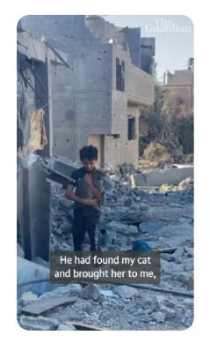
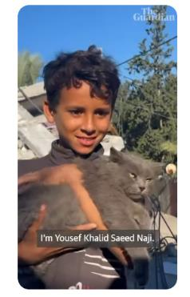
Things that move us most (Spontaneous capture)
Content experienced visually now includes highly upsetting posts on social media (hospitals burning in Gaza) that cause huge impact as well triggering a deep emotional response.
The desire for ‘unfiltered content’ heightens sensitivity to anything that appears selected or staged. ‘Is it real?’ is part of how images are interpreted.
Strongly relatable moments (for example a man reunited with his lost cat in Gaza) have the power to transcend numbed reactions when someone suddenly recognises themselves in the authentic human moment.

Slide 20
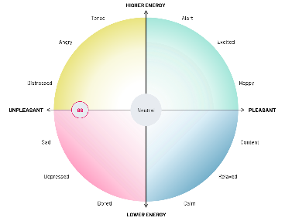
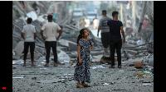
Image review (Red set) Image 66
66
A provocative and emotionally engaging image with both powerful impact and immediacy as well as a sense of layers and depth.
The spotlight focus on the innocent girl draws attention to the contrasts in the image
Destruction in the background yet the girl is perfectly presented
A calm and slightly quizzical expression on her face yet she is detached from nearby adults.
The image accentuates her vulnerability, prompting a desire to respond and creating a strong sense of relatability.
In many groups respondents quickly began discussing her story, feeling drawn in by the scenario and her expression. In essence, while the initial story is clear (a recent disaster has occurred) her specific story remains elusive.
This specific image is relatable and emotionally impactful, it has depth and can even work as a symbol of ‘humanity’ and ‘spirit’.
Impact
Protagonist
Viewer
Story
Authentic
Photo
Excellent
Good
Queried
Poor

Slide 21
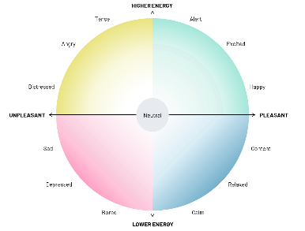
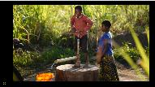
Image review (Gold set) Image 53
53
This image generated effective impact and communicated a clear story
Largely about the benefit of aid.
Some details suggest vulnerability
Children have to collect the water
They have no shoes.
But other elements undermine the desire to respond:
Lush green backdrop suggests there is enough water locally
The image of another camera (on the left) signals a staged image not a real one.
While most feel that positive images are effective as a trigger to respond, in fact they rarely prompt as strong an urge to do something in the way achieved by vulnerable child images.
Impact
Protagonist
Viewer
Story
Authentic
Photo
Excellent
Good
Queried
Poor

Slide 22
Management summary
Effective emotional triggers
Vulnerability (especially children).
Direct eye contact.
Deeper layers of meaningful and unresolved elements.
A single-minded focus on an individual.
Backstory coherence and topicality.
Role for viewer.
A sense of an authentic and relatable moment, mood or relationship.
Tangible results of aid (but care is needed to avoid signalling no longer any need for support).
Open expressions, whether expressing calm or a puzzled mind can be effective.
Inhibitors to engagement
Complexity of image and text elements interferes with direct strong response.
Staged images fail to connect.
Closed expressions can put off viewers as they do not feel drawn in.
No clear route to helping
Scale of problem seems hopeless.
Protagonist seems self reliant.
Target real human experience expressed with emotion
Avoid tropes and stereotypes we need arresting fresh imagery.

